Slide 1





Introduction of Dashboards developed for Primary Care in Wales
Webinar
1st July, 2025

Slide 2
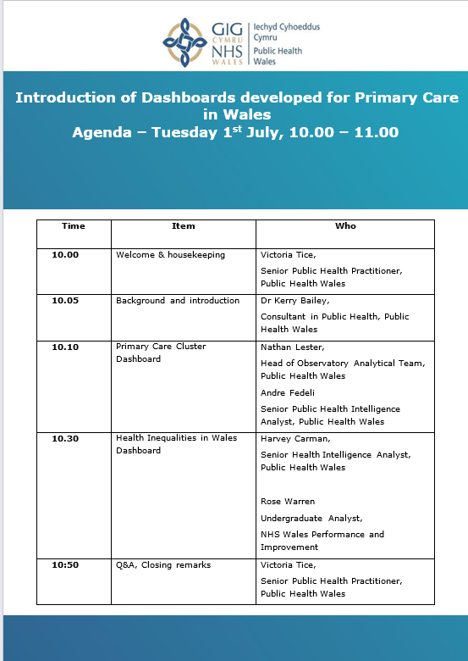
Agenda

Slide 3
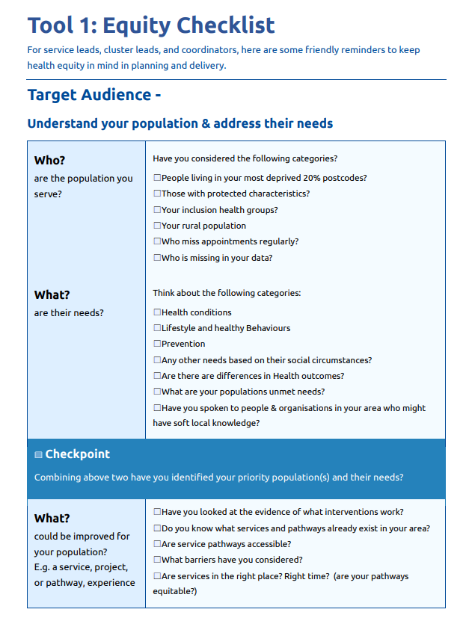
Primary Care One
How to turn data
into equitable action
Notes:
Best available data
Made it to be useful - very under reported and vulnerabe group
Lack of data and evidence, bought together data / evidence aviaable to highlight the need but is not likely to represent the actual situation,

Slide 4
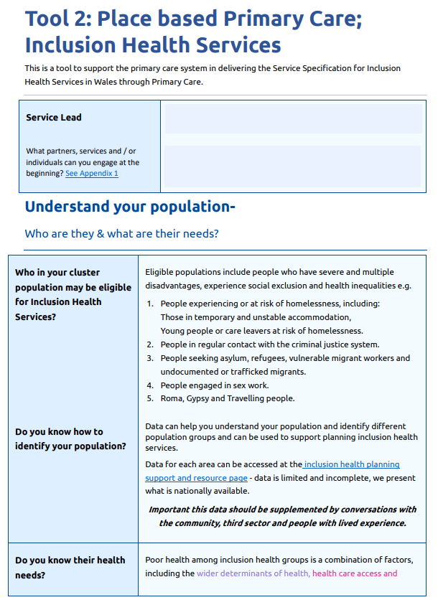
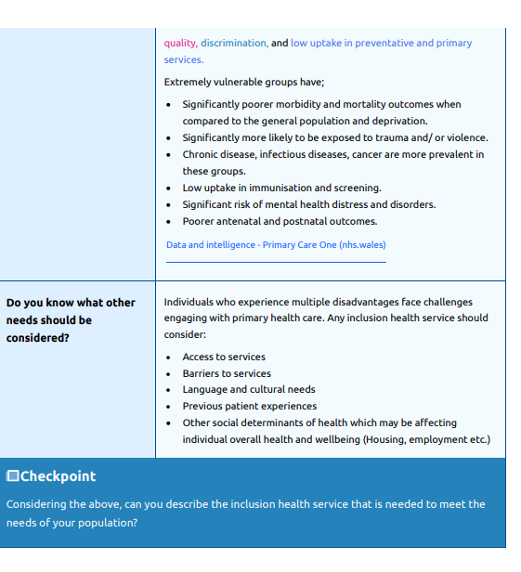
Primary Care One
Notes:
Best available data
Made it to be useful - very under reported and vulnerabe group
Lack of data and evidence, bought together data / evidence aviaable to highlight the need but is not likely to represent the actual situation,

Slide 5
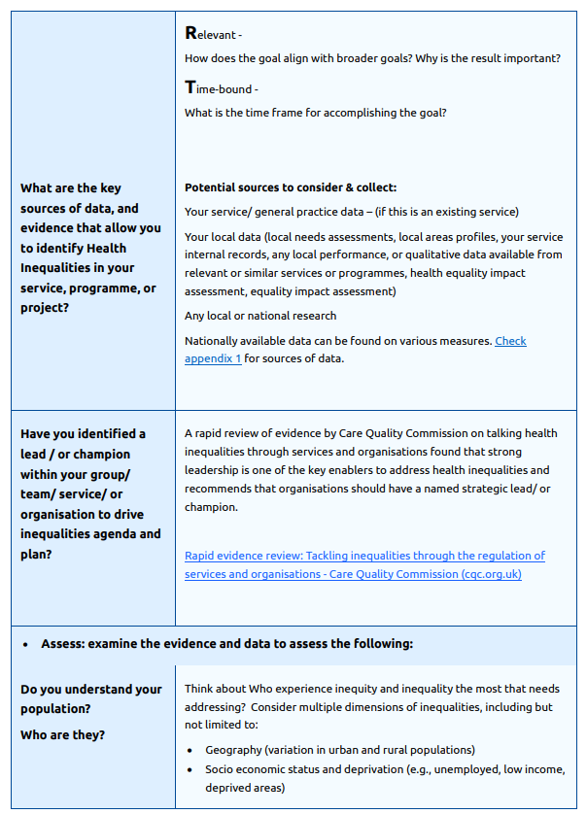
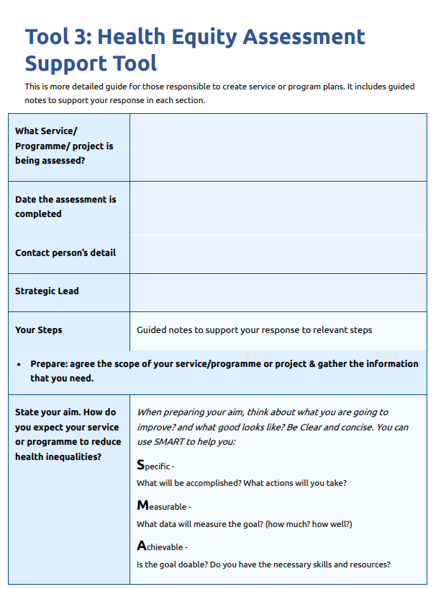
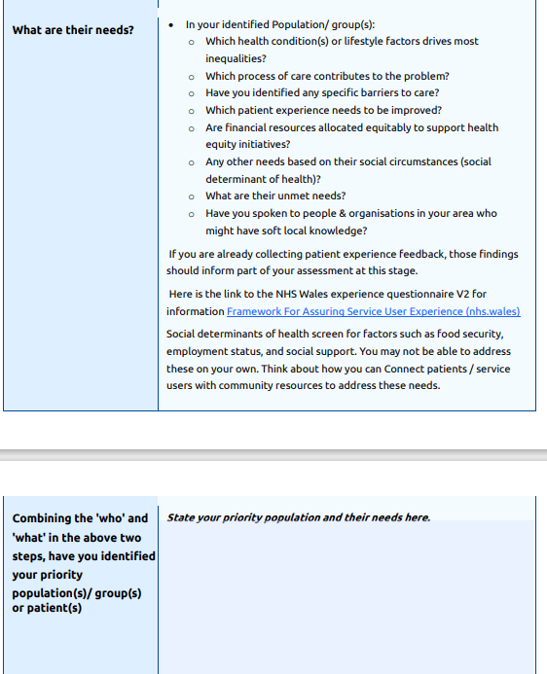
Primary Care One
Notes:
Best available data
Made it to be useful - very under reported and vulnerabe group
Lack of data and evidence, bought together data / evidence aviaable to highlight the need but is not likely to represent the actual situation,

Slide 6
Q&A Session

Slide 7
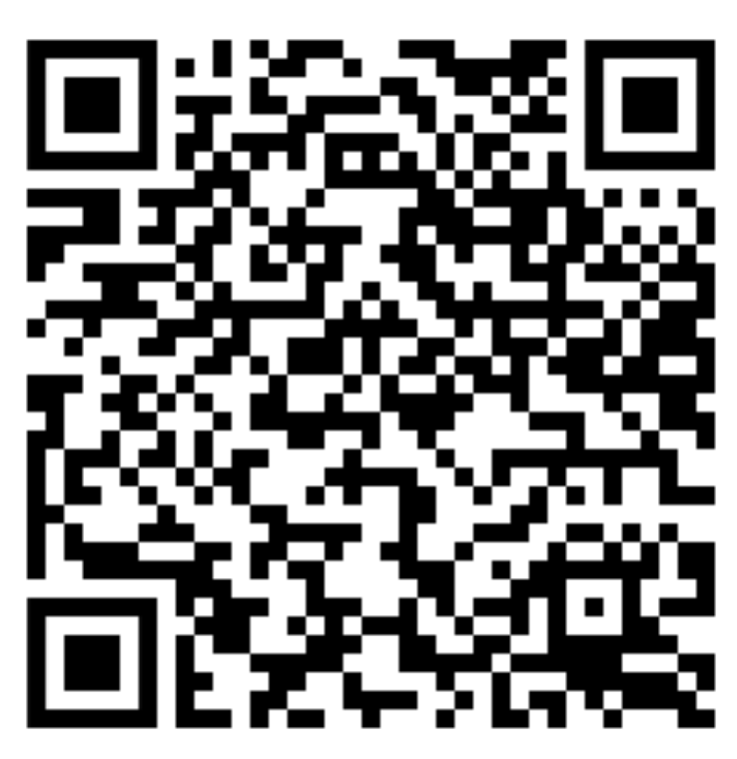
Diolch / Thank you
Reducing Health Inequalities through Primary Care - Primary Care One (nhs.wales)

