Slide 1



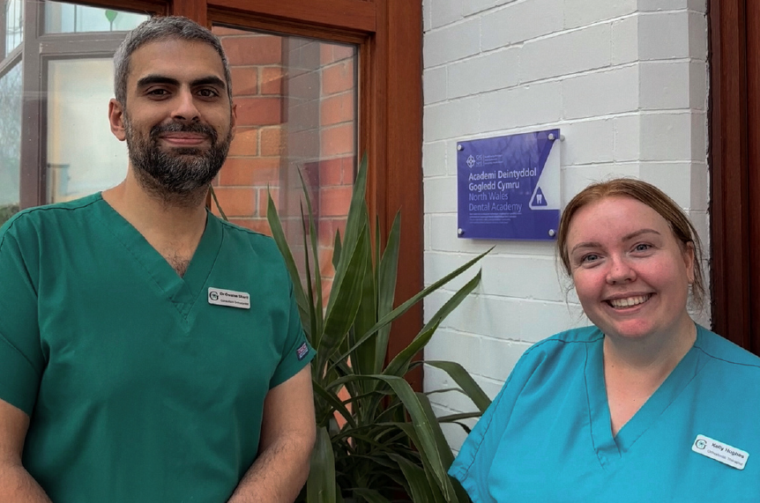
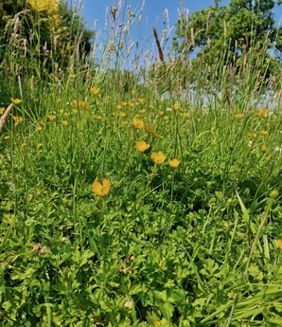
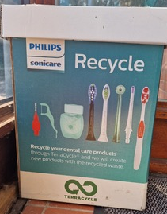


Greener Primary Care Wales Case Study: DENTAL PRACTICE
Greenacre Orthodontics, Betsi Cadwaladr University Health Board
WHAT WE DID
We were thrilled to be awarded the prestigious Greener Primary Care Wales Gold Award for a second consecutive year in 2024. The awards recognise our unwavering commitment to sustainability in healthcare. This reflects our belief that healthcare and sustainability can go hand-in-hand, ensuring not only the highest standard of care but also making a meaningful contribution to a greener planet.
In addition to our Gold Award, we were honoured to receive the SOS UK Green Impact Environmental Hero Special Award for 2024. This serves as a powerful reminder of the dedication and hard work our team has put into creating a more sustainable future.
HOW WE DID THIS
We have embedded sustainability into our everyday clinical and administrative processes. This included reducing single-use items where safe and appropriate, improving recycling streams, optimising energy use within the practice, and engaging the whole team through regular sustainability discussions and training. We also reviewed our procurement choices, favouring suppliers with strong environmental credentials and choosing products with lower carbon impact.
“Sustainability is not an optional consideration; it is a professional and ethical imperative. Our role extends beyond the chairside, and the environmental consequences of our practice must be acknowledged and addressed”
WHAT DIFFERENCE DID IT MAKE
Environmental
We have introduced a structured waste-segregation system that has significantly increased recycling rates.
Financial
Our energy usage has reduced by switching to LED lighting, installing automatic shut-off systems, and monitoring equipment efficiency.
Clinical
We have implemented more efficient digital workflows (digital forms, electronic correspondence, digital treatment planning) to reduce paper and postage.
Social
Staff and patients are encouraged to utilise active travel through bicycle storage, promoting public transport, and flexible scheduling.
TOP TIPS
We’re always available to offer advice and guidance—let’s join forces for a healthier, greener future.
Sustainability in orthodontics is not about a single breakthrough, but a series of incremental steps.
TO FIND OUT MORE VISIT:
https://www.greenacreortho.co.uk/
CONTACT
Owaise Sharif and Kelly Hughes
info@greenacreortho.co.uk
(Sustainability Lead and Sustainability Champion)
“The journey demands creativity and collaboration, but it is one worth undertaking”

