Slide 1

Behavioural Insights
Enablers and barriers to patients returning inhalers to the community pharmacy for safe disposal
Commissioned by Primary Care Division, Public Health Wales Delivered by Cardiff Metropolitan University
Professor Delyth James, Dr Heidi Seage, Alys Harrop & Aleysha Caffoor

Slide 2
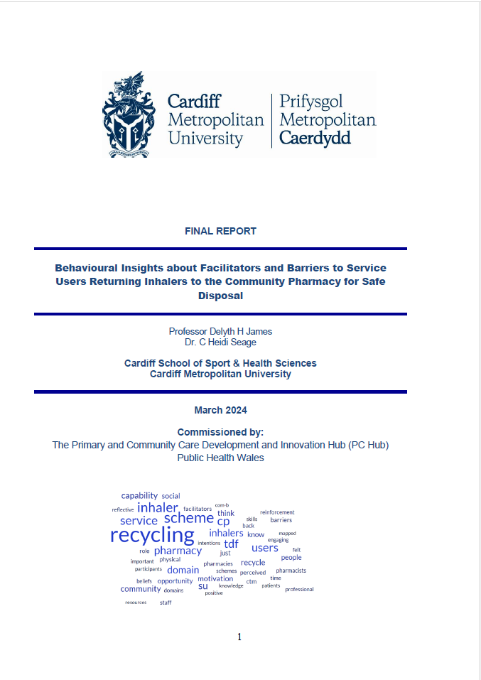
Aim
To explore the enablers, barriers and opportunities that influence the behaviours of patients in relation to returning inhalers to the community pharmacy for safer disposal in order to inform the design of interventions to encourage responsible inhaler disposal across Wales.

Slide 3

Research questions
What are the barriers and facilitators to responsible disposal of metered dose inhalers?
What interventions are likely to be effective in encouraging patients to return used and waste inhalers to community pharmacies in Wales?

Slide 4
Four workstreams
Workstream |  | Activity | Timeline
1 | Setting up | Target behaviours agreed Ethical approval gained Jan 2023 literature review updated | Spring 2024 July 2023 Jan 2024
2 | Service Users | Interviews (n=11) (3 areas BCUHB, CTMUHB, SBUHB) 2 service users from SBUHB and neither located in UV area | Sept & Oct 2023
3 | Community pharmacists | Focus groups / interviews (n=5/8) (SBUHB Upper Valleys Cluster inhaler pilot) Conducted before new contractual arrangements in Sept 2024 | Aug & Sept 2023
4 | Synthesising findings | Report Designing interventions | Nov-Jan 2024 March 2024 onwards

Slide 5
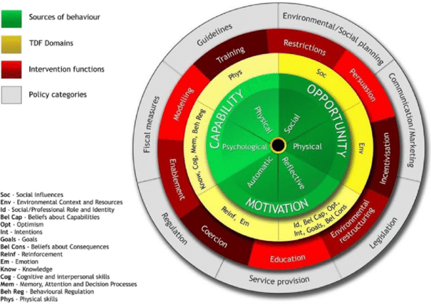
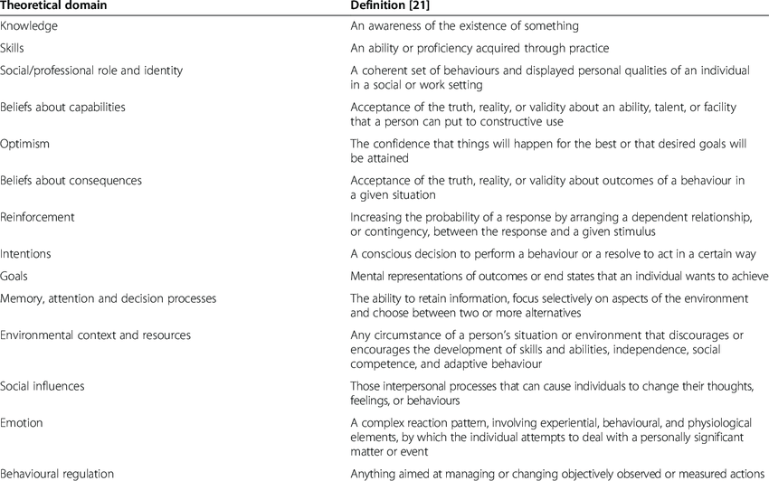
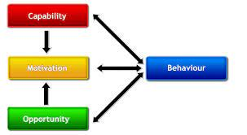
Use of psychological frameworks
The COM-B Model: A framework for understanding behaviour (Michie, 2011)
Behaviour Change Wheel (Michie et al., 2011)
Domains of the Theoretical Domains Framework (Atkins et al., 2017)

Slide 6


Recruitment
£20 voucher offered as token of appreciation for time to participate in study
Service User Inclusion Criteria
aged 18 years or older & prescribed one or more inhalers (at least one an MDI)
parent or guardian of an individual aged <18 years who is prescribed inhaled medication (at least one an MDI)
resident in BCUHB, CTMUHB or SBUHB
Community Pharmacist Inclusion Criteria
18 years or older and
employed in one of the eight Community Pharmacies located in the Upper Valleys Cluster in Swansea Bay UHB that operated the safe inhaler disposal scheme.

Slide 7
Key findings
Service user perspective
Community pharmacist perspective
Pharmacists are understaffed & underpaid
Enablers
Barriers
Enablers
Barriers
Theme 1:
Now that we know about it, we’ll do it!
Theme 1:
I’m not going out of my way
Theme 1:
It’s the right thing to do!
Service users want to recycle inhalers
Theme 1:
The pressure is too much
Pharmacy too busy – add to workload
Pharmacists have a responsibility to recycle inhalers
Not pharmacists' job to remind SU to recycle inhalers
Theme 2:
I already recycle, so it shouldn't be a problem
Theme 2:
No-one told us
Theme 2:
Sustainability is a hot topic (on social media)
Theme 2:
Are we doing this right?
Only knowledge about inhaler recycling from pilot
Unsure if progress
Theme 3:
How hard can it be?
Theme 3:
Will it even really make a difference?
Theme 3:
Guidance & support from other H/C professionals and organisations
Visual cues
Theme 3:
A difficult adjustment
Not a priority
Pharmacists are yet to form inhaler recycling as a habit
Drum is too big

Slide 8

Key findings
Enablers
Service user perspective
1. Reflective Motivation
2. Psychological Capability
3. Automatic Motivation
4. Social Opportunity, Physical Capability
5. Physical Opportunity
SUs have the intention to bring back their inhalers and see it as a goal of theirs.
If SUs were informed, they would bring their inhalers back.
SUs see it as a moral responsibility and would be happy to play their part in improving sustainability.
If inhaler-recycling is not convenient, then SUs deem it to be problematic and not worth the extra task.
SUs need to perceive their pharmacies as having the time, space or resources to facilitate inhaler recycling. Currently that is not the case, so they don’t know that it is an option.

Slide 9
Key findings
Barriers
Service user perspective
1. Psychological Capability
2. Reflective Motivation
3. Social Opportunity
4. Physical Opportunity
5. Automatic Motivation
6. Physical Capability
SUs didn’t know they could return inhalers back to pharmacies, which makes it hard for them to make it a priority to remember.
SUs are happy to take part, but only if they believe it will make a difference to the environment.
SUs believe that it is the community pharmacy staff’s role to tell that how to dispose of their inhalers.
SUs believe that community pharmacy staff have enough opportunities to inform them about inhaler-recycling, but they are not utilising them.
Incentives would not persuade SUs to recycle, but they are looking for appreciation.
If the scheme is straightforward, SUs would be more than happy to take part.

Slide 10
Key findings
Community pharmacist perspective
Physical Opportunity
Physical Capability
Psychological Capability
Social Opportunity
Reflective Motivation
Automatic Motivation
Enablers & Barriers
Labels on medication
The bins are too big!
Contact time with service users
Passion about the environment keeps up motivation
It will benefit sustainability in the future
Patients want to create a legacy for future generations
Unsure what happens to the inhalers once they leave the pharmacy
More effort should be put in ONLY if it the scheme takes off
Are people able to return them?
How are we going to get the bins out once they’re full?
Both pharmacists and service users making it a habit to recycle inhalers
Hard to remember
It’s not a priority
Helps to have a close-knit community
Sustainability is trending in the media

Slide 11
Key findings
13 studies identified (12 originally by PCD, one additional one by CM)
Murphy et al. 2023 Understanding the feasibility and environmental effectiveness of a pilot postal inhaler recovery and recycling scheme [Chiesi postal scheme]
Baithun et al. 2022 ‘I know where you bin’: inhaler use and disposal practices within paediatrics at Milton Keynes University Hospital
Nurse et al. 2022 Improving environmental sustainability of inhaler use in paediatric asthma patients
Liatsikos et al. 2021 A regional study of the availability, uptake and barriers to inhaler recycling: Promoting environmental sustainability
Roome et al. 2021 Reducing the environmental impact of inhaler use and disposal within paediatrics and the local community
Sivarajasingam, 2021 Understanding patients’ knowledge of inhaler recycling
Sivarajasingam, 2021 How general practice can support safe asthma inhaler disposal
Walpol et al. 2021 An investigation into hospital prescribers’ knowledge and confidence to provide high-quality, sustainable respiratory care
Walpol et al. 2020 Ease of use, effectiveness and environmental impacts: Evaluating inhaler prescriptions, patient preferences and opportunities for improvement
Vos et al. 2020 Inhaler recycling prevalence in a secondary care clinic in England
Sim et al. 2018 Development and Validation of the Return and Disposal of Unused Medications Questionnaire (ReDiUM) in Malaysia
Ong et al. 2020 Knowledge, attitude and disposing practice of unused and expired medicines among the general public in Malaysia
Wajid et al. 2020 Prevalence and Practice of Unused and Expired Medicine - A Community-Based Study among Saudi Adults in Riyadh, Saudi Arabia
Literature review

Slide 12
Key findings
Synthesis of findings
Once services users know about the existence of, need and rationale for an inhaler recycling scheme they were confident that they will use it - as it builds on existing recycling behaviours and links to their moral obligations.
Service users think that community pharmacies are well placed (especially if part of a well-knit community) to offer a recycling scheme as they are not prepared to go out of their way to recycle (One-Stop-Shop).
If the recycling scheme is straightforward – service users will want to take part.
Service users perceive community pharmacy as having the many opportunities to inform them of the need to recycle (but not making the most of them) however perceived to be too busy to deliver it.
Whereas community pharmacy felt they did not have the contact time with services users (hence using labels on the medication packaging).
Service users think community pharmacies play a key role in raising awareness but not doing so at the moment about how to recycle whilst the community pharmacies were hesitant about this due to working in an extremely busy environment with competing tasks.
2

Slide 13
Key findings
Synthesis of findings
Feedback is needed for both
  Service users (showing appreciation for engagement – not looking for incentives)
  Community pharmacy (number of inhalers recycled, are we doing it right, what happens to the inhalers, progress etc.) to optimise engagement with the recycling scheme
Inhaler recycling scheme is not fully integrated into the community pharmacy service or day to day activities
  Due to competed priorities, size of recycling drums)
  Agreement that it is ‘the right thing to do’
More investment needed from community pharmacies but will only do this if they see the scheme ‘taking off’
Community pharmacies welcomed a shared responsibility to inhaler recycling where all members of the healthcare team and professional organisations are on board to help promote it
  GP surgery – visual cues
  Social media
2

Slide 14
Limitations
Service Users
Low awareness of the issue for engagement in research
Use of monetary incentives to take part in interviews drew ‘imposter participants!!
Screening tool introduced
No Swansea Bay scheme users recruited
Community Pharmacy
Slow recruitment of CPs to focus groups and interviews from Swansea Bay scheme
Workload pressures may be a barrier to participating in research
NOTE – Low number of participants overall, however, rigorous approach underpinned by behavioural theory minimises the potential sampling bias due to this.

Slide 15
Recommendations and what next
To inhaler Task & Finish sub group
A national approach is needed for this which should also include publicity in the community pharmacy.
Raise public awareness of the existence of, need and rationale for inhaler recycling.
Need to show that the recycling scheme is making a difference to the environment.
A recycling scheme needs to be as easy as possible for service users to use and the community pharmacy setting provides a convenient location for this.
The community pharmacy should take a lead role in driving engagement with the recycling scheme, showing appreciation for those service users who recycle.
Provide education to whole pharmacy team before implementation and regular feedback to community pharmacy on progress within the scheme etc.
Address logistical issues such as size of recycling drums and develop systems of work that creates the perception for service users that inhaler recycling is part of the daily routine in community pharmacy.

