Slide 1



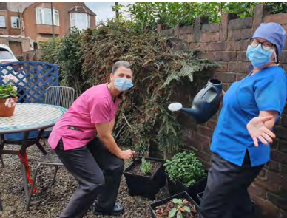


Greener Primary Care Wales Case Study: PRIMARY CARE DENTISTS
Talbot Road Dental Practice, Port Talbot
Source: Greener Primary Care Wales 2022 Yearbook
WHAT WE DID
We wanted to create a green space where our team can go to relax at lunchtime, or just step out for a quick ‘mask-free’ break. Our practice is on an urban street, however despite this we felt we had some space to better utilise. We wanted to use the gravel rear garden that the owners used for parking to create a garden to help insects and birds thrive and to be enjoyed by staff. The design had to allow space to park two cars.
HOW WE DID THIS
Our first step was to construct a gate at the rear of the property for privacy, to reduce litter from the lane blowing into the garden and to stop dogs using the area as a toilet. We collected a top up of gravel from a staff member’s garden who was also renovating their garden to increase wildlife and biodiversity at home. This would have otherwise gone in a skip.
One staff member introduced a bird feeder. Straight away, more birds were visiting. Unfortunately, we had to remove our bird feeder as squirrels were taking all the food and then they chewed through an electric cable! Unperturbed we installed a bird nesting box donated to us. We now have plans for a hedgehog house and a bug hotel.
Two old planters picked up from our local civic amenity site were painted with recycled paint providing some privacy. We have also reused planters that have been donated by the team. We have asked friends and family for plants and have grown cuttings ourselves. We have tried to use plants that encourage pollinators.
A member of staff started planting a border with some trees which were free from The Woodland Trust and other shrubs that will provide berries for the birds and with a bit of luck some plums for us! We have started a herb garden in recycled containers that the team are welcome to pick. Our tea brewed with our chocolate mint leaves is very popular!
Needing somewhere to sit, we were lucky enough to have picked up a free table and chair set, that otherwise would have gone to landfill. After a little TLC it provided a lovely area for the team to socialise. We have installed a solar water fountain which doubles up as a bird bath, however, we recognise that this is very much dependent on the local weather in Port Talbot! We are really proud of what we have achieved so far and look forward to watching it grow. We are still using the garden every day.
WHAT DIFFERENCE DID IT MAKE
We have been pleasantly surprised by
the effect the garden has had not just on our
team, but also on our local community.
We have had neighbours we have never
spoken to stopping to chat.
The team were most appreciative of
the space during the summer, especially
in the heatwaves and some are asking for garden advice and cuttings so that they can ‘green up’ their own space at home.
Watching the wildlife from the practice windows helps us all de-stress during our busy working days. We are amazed by the amount of wildlife such as birds, bees and butterflies that visit our garden.
TALBOT ROAD DENTAL PRACTICE RECEIVED A GREENER PRIMARY CARE WALES BRONZE AWARD IN 2022, SILVER IN 2023 AND GOLD IN 2024
TOP TIPS
Make sure your team is on board as you can’t do it alone and no-one wants to see a wilting, neglected garden every day. Utilise friends and family for donations. Be creative. You don’t have to spend a lot of money to create a lovely green space.
CONTACT
talbotroaddp@live.co.uk

