Slide 1


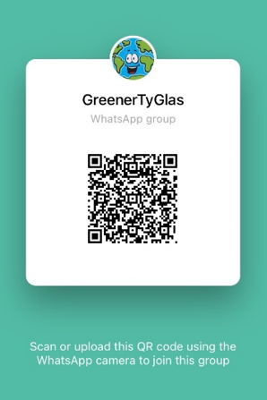


Greener Primary Care Wales Case Study: COMMUNITY PHARMACY
Boots Tŷ Glas, Cardiff
WHAT WE DID
In January 2022 we found out that Boots Tŷ Glas had been successful in applying to participate in the Greener Primary Care Wales pilot. We were excited to get started and initially chose actions that would get our staff on board, support a team approach to this agenda and ultimately allow us to influence our primary care colleagues and our patients.
As we are a community pharmacy with a large staff headcount, it was soon apparent that to promote our participation in the Scheme would be a huge undertaking for one person - communication would be key. We started to think about communication with the team, with our employers and with our customers. All three would need to play their part.
“As healthcare professionals we are all familiar with the three pillars of ‘Safety’, ‘Efficacy’ and ‘Quality’. Now is the time to add a fourth equal partner - ‘the Environment’. It must become part of every decision we make if we are to reach net zero by 2030.”
WHAT DIFFERENCE DID IT MAKE
All dispensary team members are now aware of our participation in the Greener Primary Care Wales Scheme and are being asked to complete Module 1 of SEE Sustainability Online Carbon Literacy for Healthcare training which is a free online learning resource. The wider team are also being encouraged to look at their personal carbon footprint by using the online WWF carbon calculator.
Before participating in the Scheme conversations about climate change and its effects were rare. Team members were not encouraged to talk about climate change, and any available channels for recycling and minimising waste were underutilised. However, by encouraging a ‘greener’ team focus, communicating and sharing ideas, and celebrating successes we have started to change this.
The ‘Greener Tŷ Glas’ WhatsApp® group has proven helpful in getting the wider team involved in this initiative. This is especially useful when staff work different hours or on different days. It provides us with a safe space to stay connected, share ideas and work as a team.
OVERCOMING CHALLENGES
Working for a large company has many benefits but not without its challenges. Uploading evidence to the framework needed Support Office assistance and one of the biggest barriers in working for a large organisation was knowing ‘who’ to speak with. However, as soon as we were put in touch with the Environmental Social Governance team at Support Office we were able to progress this work. Having Public Health Wales engage with Boots Head Office has also been very helpful.
BOOTS TŶ GLAS RECEIVED A SILVER GREENER PRIMARY CARE WALES AWARD IN 2022
TOP TIP
This process has shown me that most people will consider change if it is put to them in a way that they have a choice and with benefits that they can see.
One of the activities we implemented was to develop a staff WhatsApp® group.
We agreed that this method of communication would be green, interactive, scalable and fun. A QR code was created to help work colleagues join the group.
We also utilised team briefings, emails and our noticeboard to promote the green work and encourage staff to join the WhatsApp® group.
CONTACT
claire.willis@boots.com

