Slide 1



The Public Health contribution to Better Healthcare:
A Healthcare Public Health Framework for Wales
March 2025
Notes:
This work is co-sponsored by PHW and Executive Directors of Public Health.

Slide 2

Why we have done this work & what it includes
This slide set is an accompaniment to the report on The Public Health Contribution to Better Healthcare: a Healthcare Public Health Framework for Wales, requested by Welsh Government
It highlights:
  the aims & objectives of this work
  the three-part Framework – 1/ a whole system approach; 2/ application of a healthcare public health approach, and 3/ tools, roles & responsibilities and worked examples
  how specialists in public health can support
  the system gaps that need filled if we want an effective Healthcare public health approach for better healthcare
  a set of strategic recommendations from this work
Alongside the Framework report, the slide set forms part of a suite of products including the toolkit and details of 3 worked examples to illustrate a healthcare public health approach in action

Slide 3
Definitions: Healthcare Public Health – applying public health to healthcare
Population Health
Improves the health of an entire population. It is about improving the physical and mental health outcomes and wellbeing of people, whilst reducing health inequalities within and across the population. It includes action to reduce the occurrence of ill-health, including addressing wider determinants of health, delivering social justice and working with communities.
Healthcare Public Health
Concerned with maximising the population benefits of healthcare while meeting the needs of individuals and groups, by:
- Prioritising available resources for best health and social outcome gain
- Preventing diseases and deterioration and
- Improving health outcomes through design, access, utilisation and evaluation of effective
and efficient health interventions and pathways of care
- Applying public health skills, techniques and expertise appropriately across the system to achieve this

Slide 4
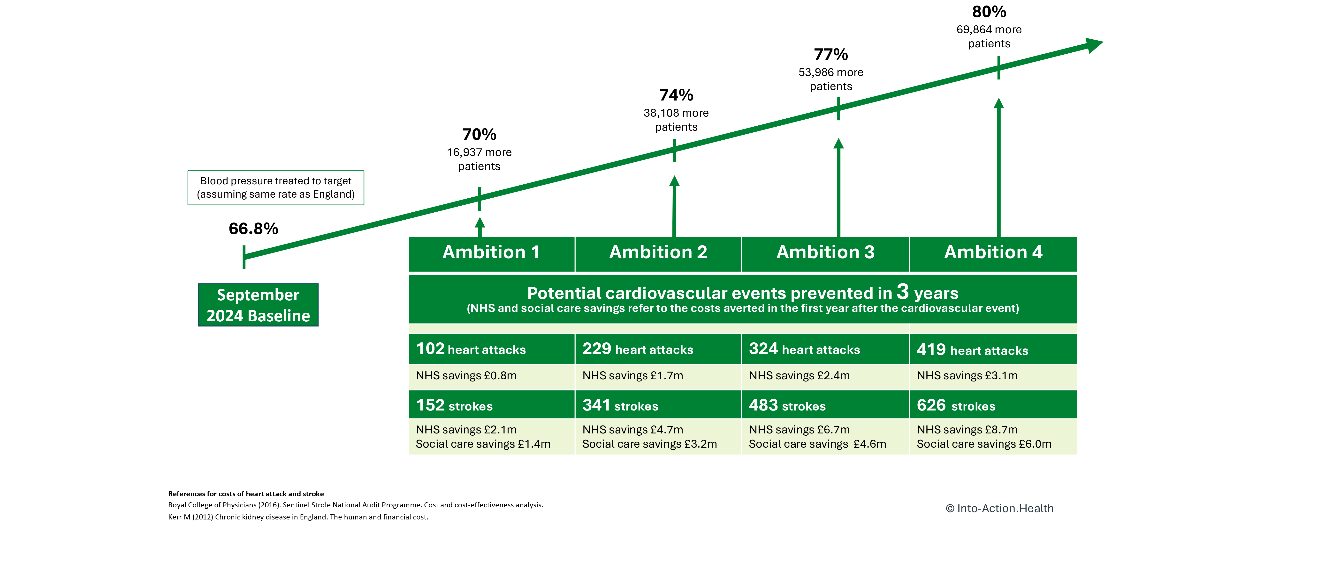

The impact of a healthcare public health approach on blood pressure
Based on estimated % pf people with diagnosed hypertension treated to target

Slide 5
Aims of this work
To develop an approach to strengthen Healthcare public health for better healthcare in Wales
To provide a clear articulation of the roles of public health in achieving this

Slide 6
Short to longer term objectives of this work are:
To support better understanding in the NHS of what taking a healthcare public health approach means, how it could be applied and the tangible benefits through articulation of a framework
To co-design application of a healthcare public health approach in practice, using impactful examples
To connect together, and highlight the relative role played of, current key frameworks and programmes that contribute
To work towards a strengthened skillset in applying a healthcare public health approach – for those in the NHS generally and those in specialist public health
To work towards strengthening support in the system (supportive architecture) to apply a healthcare public health approach, where there are recognised gaps

Slide 7
A Healthcare Public Health Framework for Wales
Notes:
This work is co-sponsored by PHW and Executive Directors of Public Health.

Slide 8
The Framework includes
PART 1 – THE WHAT – WHOLE SYSTEM APPROACH:
A set of underlying principles
Arenas of application
Intended impacts
PART 2 – THE HOW – 4 MAIN AREAS OF APPLICATION
PART 3 – TOOLS, ROLES AND RESPONSIBILITIES AND WORKED EXAMPLES TO HELP ORGANISATIONS TO DISCERN KEY ACTIVITIES THEY NEED
Notes:
This work is co-sponsored by PHW and Executive Directors of Public Health.

Slide 9
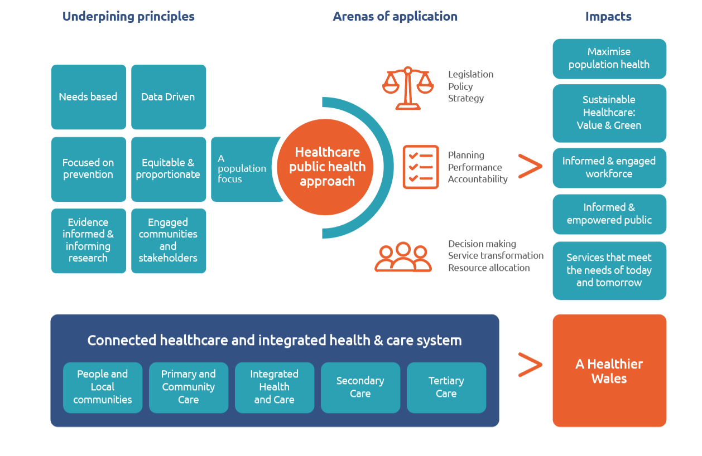
PART 1 - The What - Whole system approach

Slide 10
PART 2
The How – application of a healthcare public health approach
Notes:
This work is co-sponsored by PHW and Executive Directors of Public Health.

Slide 11
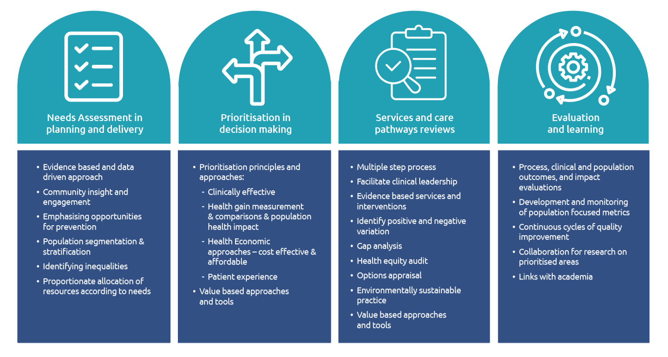
PART 2 - The How
Application of a healthcare public health approach

Slide 12
PART 3
Tools; roles & responsibilities and worked examples to help organisations discern key activities they need
Notes:
This work is co-sponsored by PHW and Executive Directors of Public Health.

Slide 13
Questions for NHS organisations & teams to ask I
Healthcare public health themes
Needs assessment in planning and delivery | what ways could your In approach to needs-based planning be strengthened?
Prioritisation in decision making | Which prioritisation principles do you use when making key decisions?*** How could their use be strengthened? Which key decisions have you made in the past year that will have the biggest population health gain? How could you strengthen the balance of your organisational, programme or departmental investment between hospital, community and preventative services or interventions? What opportunities do you have in the medium term for resource shift upstream, for greater population health impact? ***confidence in clinical evidence; the nature and size of health gain/the number of individuals benefitting; priority status - national/local; addressing health inequalities including in access & outcome; comparative cost effectiveness & affordability; accessibility

Slide 14
Questions for NHS organisations & teams to ask II
Healthcare public health themes
Services and care pathways’ reviews | How is a population health lens and expertise being incorporated into major service reviews and developments? Which service reviews/developments are you planning that could have the biggest population health gain?
Evaluation and learning | How could you track the extent of impact on clinical and health outcomes over time? Are there academic institutions or academic-applied partnerships elsewhere in the UK developing models that could help assess and target the right population with the right intervention?

Slide 15
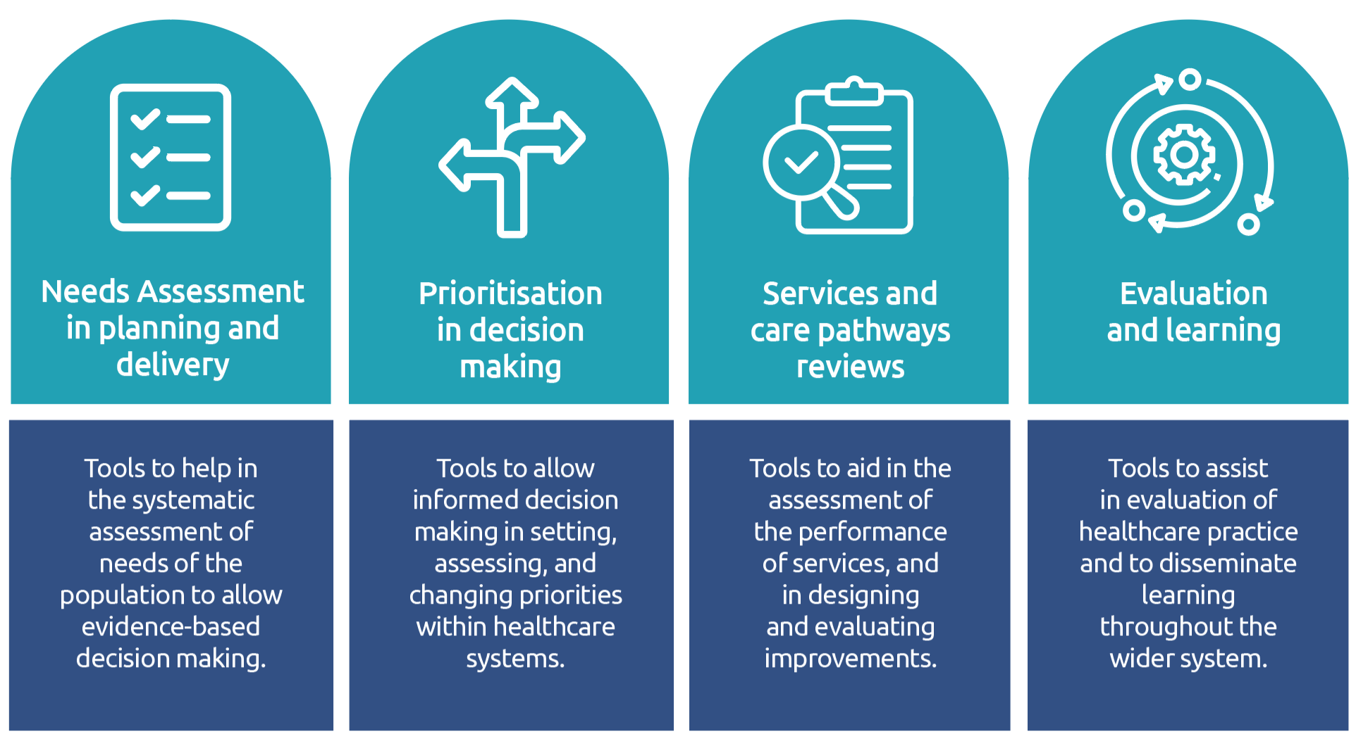
Web-based Healthcare public health framework toolkit
This toolkit brings together a number of tools and frameworks which could be used alone or in combination to support healthcare settings, systems, and partnerships to assess and optimise their services with a population lens.
The toolkit is a resource to aid in the identification of trends, needs, and disparities within communities, and to support effective planning and delivery, making the most efficient use of resources. The tools it contains are not intended to be prescriptive but to act as a guide to allow decisions to be taken in a systematic way.

Slide 16
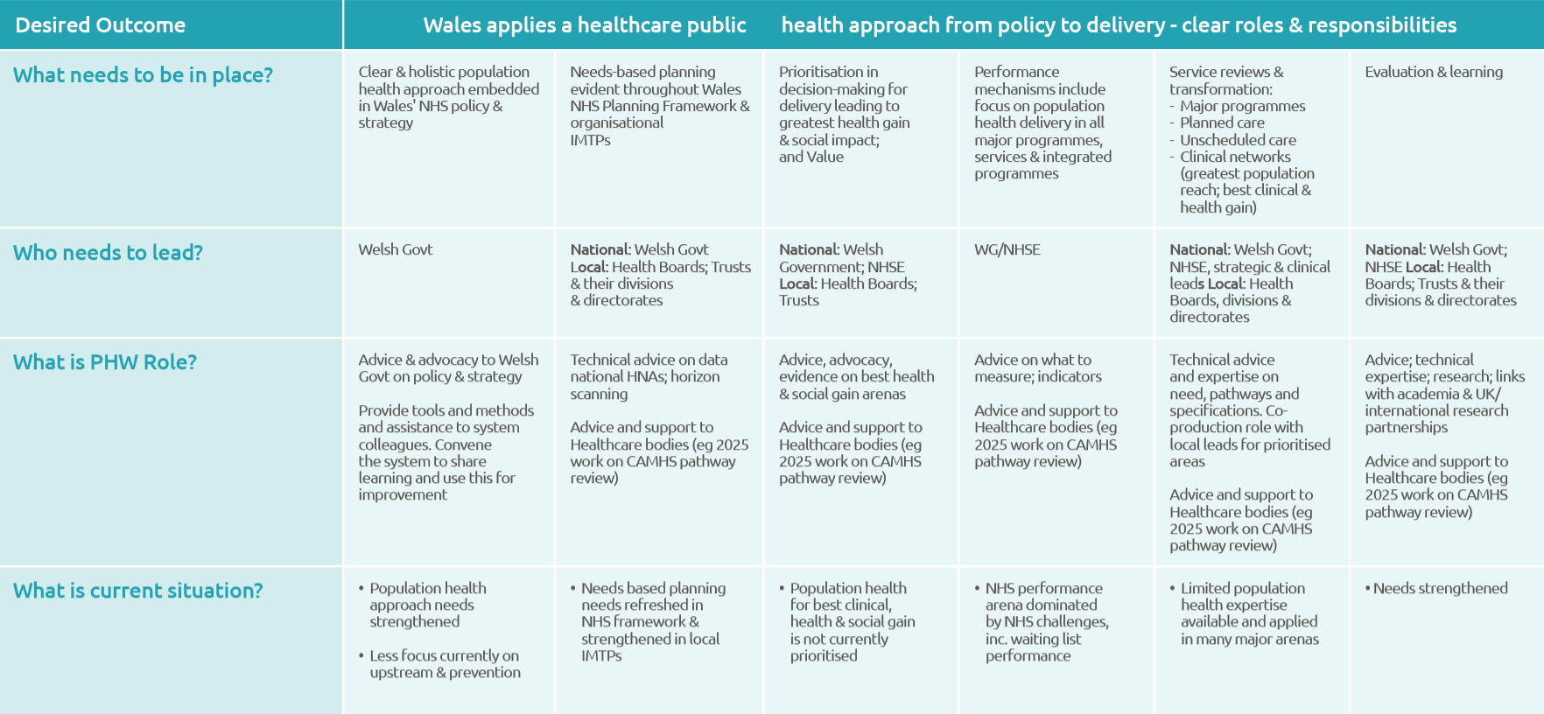
Roles and responsibilities in a Healthcare public health approach

Slide 17
How Specialists in Public Health can support
Providing the evidence and data intelligence (where it is available) to support decisions and developments through needs assessments; service reviews; identification of health inequalities; health impact assessments and health equity audits
Providing the tools for effective service transformation - to help decide priorities; in planning capacity and managing demand; in developing clinically led models of care; for service design and redesign; in engaging public and communities; for option appraisal; in systems’ approaches; in supporting the development of business cases and the case for change; in procuring services
Developing effective assessment of impact and outcomes through advice on design of monitoring and evaluation, development of population, clinical and patient outcomes, and supporting evaluation and research with the academic sector

Slide 18
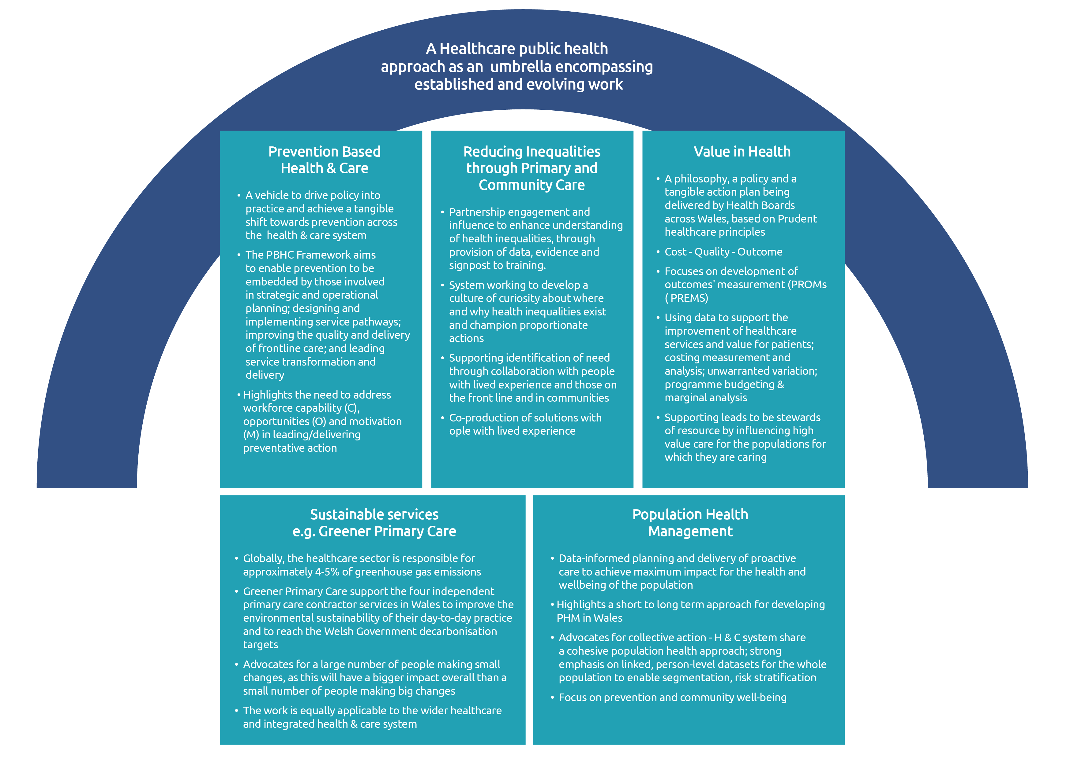
A HCPH approach as an umbrella encompassing established and evolving work

Slide 19
Worked examples - future impact of a HCPH approach & role of specialist public health
Example | Specialist public health involvement
Secondary prevention in a high burden of disease area – tackling hypertension. Could save £17.8m for Wales over 3 years, prevent 419 heart attacks and 626 strokes | Leading & advocacy for preventative approach Scanned best practice elsewhere - commissioned modelling work Partnership with primary care & key Health Board, WG & clinical colleagues – cardiovascular clinical network
Frailty – falls prevention: risk stratification & population targeting for higher impact: ~28k ED attendances with falls and ~17k admissions with fall/fracture in people aged 65+ per year. We project ~28% increase in fall/fracture admissions in people aged 65+ 2025-2035 A strategy targeting people at medium risk and above (>10% 1y-risk of ED attendance or hospital admission) would target ~9% of people aged 65+ but more than 1 in 3 of all fallers | Worked with University sector - University of Leeds Engaged clinical expertise Modelling team work to apply eFalls risk prediction model to Wales
Planned care & the duty of quality: a methodology to examine inequalities in waiting lists | Scanned research and practice from elsewhere in UK to identify a useful method that could be replicated in Wales (dependent on data availability) Summarised the method for Wales
Notes:
An example from the literature and professional bodies highlights the need to, and impact of, secondary prevention of osteoporosis in primary care.

Slide 20
Addressing the gaps – an effective Healthcare public health system in Wales needs…
A strengthened Healthcare public health approach to NHS policy, planning, resource allocation & performance
A stronger joined up approach between national and local specialist public health, working on high impact examples, with best use of respective skillsets
A joined up approach to Healthcare public health across directorates of Public Health Wales
Strengthened public health expertise into major NHS Executive arenas where there are gaps – Planned care; Urgent Emergency Care; Quality, Improvement & Patient Safety; Clinical Networks
Core support infrastructure in the right places – supporting the NHS Executive and supporting Local Health Boards: health economics; strengthened datasets; population health data intelligence
Strengthening capacity and capability gaps in the system – specialist and generic, especially data analysis, modelling, health economics’ input, evidence reviews for service reviews/transformation, upskilling of relevant healthcare teams to support them to take a population health approach

Slide 21
Strategic Recommendations
March 2025
Notes:
This work is co-sponsored by PHW and Executive Directors of Public Health.

Slide 22
Strategic Recommendations
1. To strengthen understanding, capability and practical application in strategic roles and functions across the healthcare system in taking a healthcare public health approach
2. To strengthen capacity and capability in the specialist public health system to advise on, and support, delivery of a healthcare public health approach in Wales at a national, regional and local level
3. To co-produce a roadmap & steps for practical application
of a healthcare public health approach, to deliver tangible improvements towards a sustainable healthcare system by 2035

Slide 23
Strategic Recommendations – suggested action areas
To strengthen understanding and capability in strategic roles and functions:
  Joined up leadership & advocacy by PHW & Exec. Directors of Public Health in this arena
  Identifying & working on practical opportunities in Health Boards & in national planning, networks & programmes
  ‘Once for Wales’ tools, resources and support, available online, to support partners to take a healthcare public health approach in key decisions and service development/transformation

Slide 24
Strategic Recommendations – suggested action areas
2. To strengthen capacity and capability in the specialist public health workforce:
  Establish a modus operandi between PHW & Exec. Directors of Public Health including specified roles and responsibilities
  Identify resource opportunities at a local & national level to provide practical support & action (e.g. for needs assessment; resource allocation-prioritisation; service reviews & transformation; equity work)
  Work with partners (academia and HEIW) to develop training and skills development opportunities for Public Health specialists and key wider NHS arenas
  Establish and lead a community of practice in a healthcare public health approach, including opportunities for practical experience across the NHS system in Wales

Slide 25
Strategic Recommendations – suggested action areas
3. To co-produce a roadmap & steps for practical application:
  Identify high value interventions that support a focus of resources (financial, workforce) on prevention and early intervention and reducing health inequalities
  Strengthen governance and accountability for a healthcare public health approach, including within the NHS planning framework, performance measures and application of relevant legislation e.g. the Duty of Quality; Socioeconomic Duty

