Slide 1
Multi-Criteria Decision Analysis (MCDA)
Multi-Criteria Decision Analysis (MCDA) is a decision-making analysis that evaluates multiple (sometimes conflicting) criteria as part of a decision-making process.
There are five steps of MCDA;
Define the context
Identify the options available
Decide the objectives and select the right criteria that represents the value
Measure out each of the criteria in order to discern their relative importance
Calculate the different values by averaging out and weighting scores

Slide 2
Weigh up Investment options
Disinvest
Shift list
Wish list
Invest
Resource neutral

Slide 3
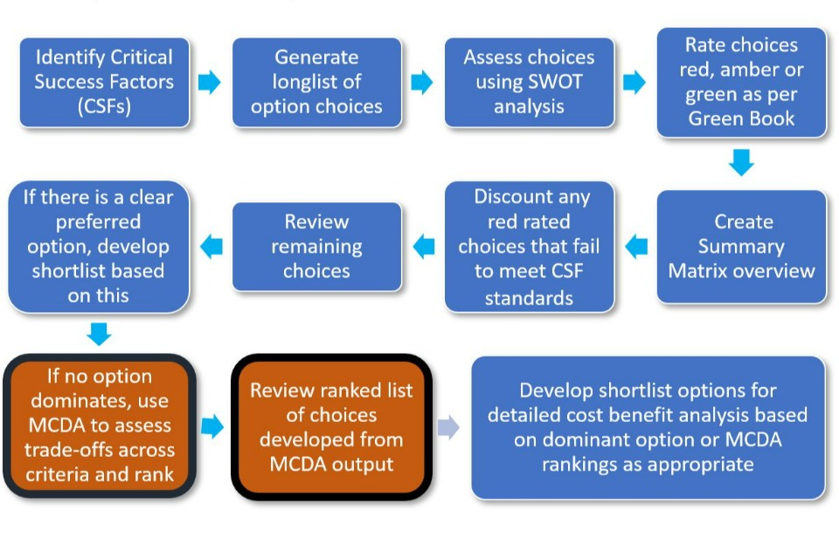
UK Treasury process for MCDA

Slide 4
MCDA (Multi Criteria Decision Analysis)
MCDA can be used to provide intelligence to prioritise investments.
It can be used several ways;
To choose one from a set of alternatives
To understand which criteria are most important in making a decision
To rank a set of programmes against each other.
As with other economic methods, it is only one tool in the toolbox, and is never perfect, still needs a sense check.

Slide 5
Multicriteria Decision Analysis
MCDA increasingly used by academics and in Government
MCDA has been criticised as not being robust – for instance because of overlap between criteria.
I think MCDA has promise because it adds some rationality to the way decision makers weigh up decisions in the real world.
UK Treasury considered de-recommending MCDA but have produced guidance that MCDA cannot replace CBA and ‘swing weighting’ and rigorous sentivity analysis needs to be included.

Slide 6
Using MCDA to prioritise public health interventions
Commissioners completed a submission for each service with answers to questions corresponding to ten criteria;
These were
Corporate Priorities
Policy Implications
Evidence Base: Facts, Figures & Trends
Best Practice
Impact on Inequalities
Outcomes
Targets & Performance
Local views
Cost effectiveness and derived benefits
Reach

Slide 7
MCDA Process
Agree decision context and identify options to be appraised
- Identify strategic objectives/outcomes (e.g. inequalities, efficiency etc.) and criteria (e.g. cost benefit analysis, value for money).
- Agree scoring methodology (e.g. panels using a preference scale) and score each area (against each criterion).
- Agree weighting (assign weights for each of the criterion to reflect their relative importance to the decision).
- Combine the weights and scores for each option and derive an overall value
- Analyse and examine the results
- Undertake a sensitivity analysis of results

Slide 8
Using MCDA to prioritise public health interventions
Each submission was discussed by a panel who were convened to score each service from zero to 100 against the criteria; e.g.

Slide 9
Using MCDA to prioritise public health interventions
Each criteria had a weighting and a weighted sum method was used.
Weighted sum score =
Sum {[score against each criteria] *[criteria weight factor]} / 100

Slide 10
Example of results (not real results)

Slide 11
MCDA – What could happen next
Services that score low can be looked at in more detail as to why they score low, it may be that;
the providers are not doing well,
that the commissioners have not been clear about what they want
submission was badly written or there is a lack of data on the effectiveness of a service
the service was a bad idea in the first place
It may be that poorly performing services could ultimately get decommissioned or paired up with better performing services

Slide 12
Programme Budgeting and Marginal Analysis (PBMA)
Programme budgeting:
Need to know where resources are currently used
Marginal analysis:
To have more of some services, it is necessary to shift resources from others

Slide 13
Programme Budgeting and Marginal Analysis (PBMA)
Brambleby & Fordham state there are eight stages to conducting a PBMA
1. Choose a set of meaningful programmes
2. Identify current activity and expenditure in those programmes
3. Think of improvements
4. Weigh up incremental costs and incremental benefits and prioritize a list
5. Consult widely
6. Decide on changes
7. Effect the changes
8. Evaluate progress
Brambleby, P & Fordham, RJ 2003, 'What is PBMA? Evidence Based Medicine: 'What is ' series', EPRINTS-JOURNAL, vol. 4, no. 2. http://www.evidence-based-medicine.co.uk

Slide 14
PBMA - Features
Starts with reality - pragmatic
Should be resource neutral – not increasing or reducing spend
Data hungry – need lots of information on costs, services, outcomes
Participative – need decision makers and stakeholders round the table
Notes:
We have HRGs (healthcare resource groups) that translate to PBMA groups
This means that for procedures and hospital inpatients we can easily see what are spend is, for outpatients and primary care it is more difficult, although these do not reflect actual cost to hospitals
PBMA generally starts with the picture as it is now not redesigning a system from scratch
What do we mean by resource neutral? Means that any new investments should be evened out with disinvestments elsewhere, do you think this happens?
Needs to take a practical approach, needs to be carried out relatively quickly because you could describe your system, look at everything that is going on and then find that everything had changed.
Participative – should reflect peoples views of what treatments are useful, have you done about contingent valuation? Could use this as a method or discrete choice.
Need to engage with different types of people, clinicians, patients etc
What kind of participation was there in the Tayside paper in your reading can anyone remember?
They set up an advisory group, asked each person to think of 10 services to expand and 10 services to reorganise
Then they did a postal survey
Excluded providers with a vested interest

Slide 15
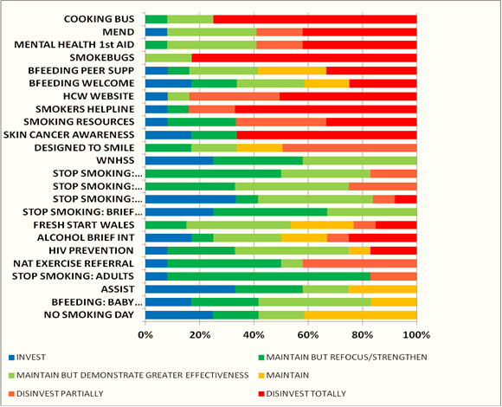
6. Decide on changes
https://bmcpublichealth.biomedcentral.com/articles/10.1186/1471-2458-14-837

Slide 16
Programme Budgeting and Marginal Analysis (PBMA)
A PBMA exercise can be conducted at a macro level looking – an example of this approach would be England’s Spend and Outcome Tools for CCGs and Local Authorities
These SPOTs show spend on categories against outcomes to benchmark and identify priority areas Spend and outcomes tool (SPOT) - GOV.UK (www.gov.uk)
Or at a micro-level looking at a particular care pathway or service within a health board or hospital
Use of programme budgeting and marginal analysis as a framework for resource reallocation in respiratory care in North Wales, UK | Journal of Public Health | Oxford Academic (oup.com)
The costs of caring for stroke patients in a GP‐led community hospital: an application of programme budgeting and marginal analysis - Henderson - 2001 - Health &amp; Social Care in the Community - Wiley Online Library

Slide 17
Other examples of MCDA/ PBMA
Has been used in Canada & Australia
Norfolk Mental Health PBMA Pilot Project

