Slide 1






Supporting Practices with CVD and CKD GMS Quality Improvement Projects 2025/2026
Webinar
30th September 2025

Slide 2
Webinar: Supporting practices with the CVD and CKD GMS Quality Improvement Projects 2025/26
Jonathan Goodfellow
National Clinical Lead
Wales Cardiovascular Network

Slide 3
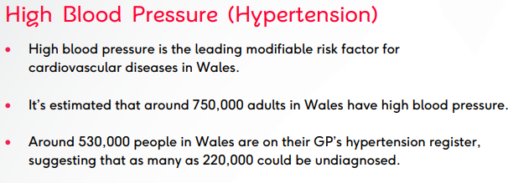
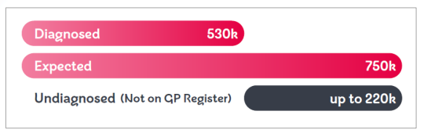

Slide 4
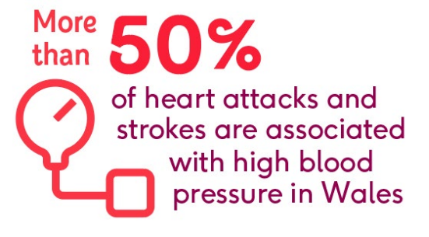
High Blood pressure is a major risk factor for Chronic Kidney disease
CKD is associated with 1:8 cardiovascular deaths in Wales
Cardiovascular disease and CKD share many of the same risk factors

Slide 5
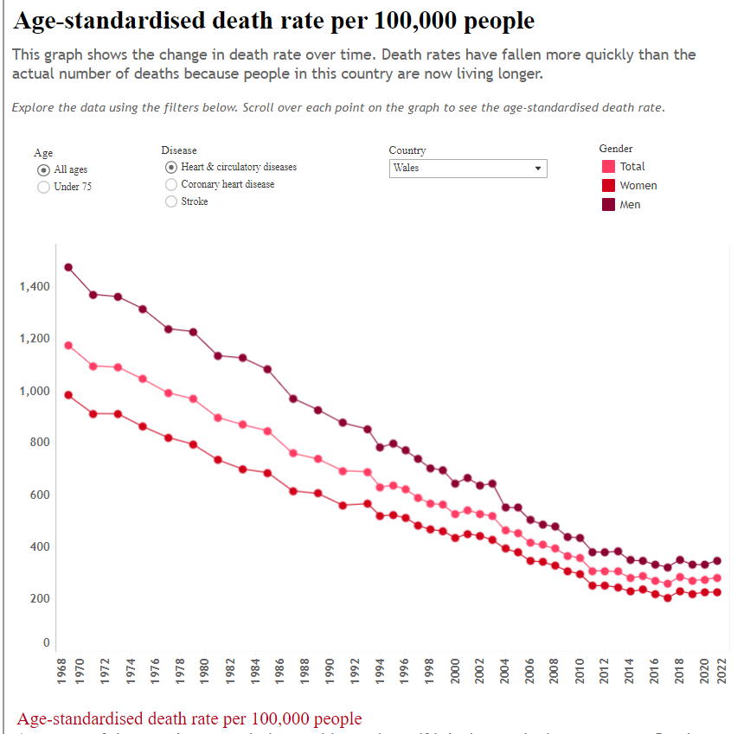
Pre-pandemic
Dramatic fall in ASMR has plateaued since 2011¹
Due to slowing of CVD incidence decline^{1,2}
Unclear cause but:
Rise in obesity and type 2 DM, may be cancelling out benefit in decline of smoking and BP prevalence
Cost next 10 years £54 Billion³
COVID pandemic⁴
Worse outcomes from Covid-19 for those with pre-existing CVD
Excess death rates have persisted since pandemic and appear to be largely driven by excess CVD deaths
ASMR, age-standardised mortality rate; BP, blood pressure; CVD, cardiovascular disease; DM, diabetes mellitus.
1. British Heart Foundation. Death rates – over time. Available at: https://www.bhf.org.uk/what-we-do/our-research/heart-and-circulatory-diseases-in-numbers/death-rates-over-time. Accessed April 2024;
2. British Heart Foundation. UK Factsheet – April 2023. Available at: https://www.bhf.org.uk/what-we-do/our-research/heart-statistics. Accessed April 2024;
3. Collins et al., PLoS One 2022; https://doi.org/10.1371/journal.pone.0268766;
4. British Heart Foundation. Tipping Point. Available at: https://www.bhf.org.uk/what-we-do/policy-and-public-affairs/tipping-point. Accessed April 2024.

Slide 6
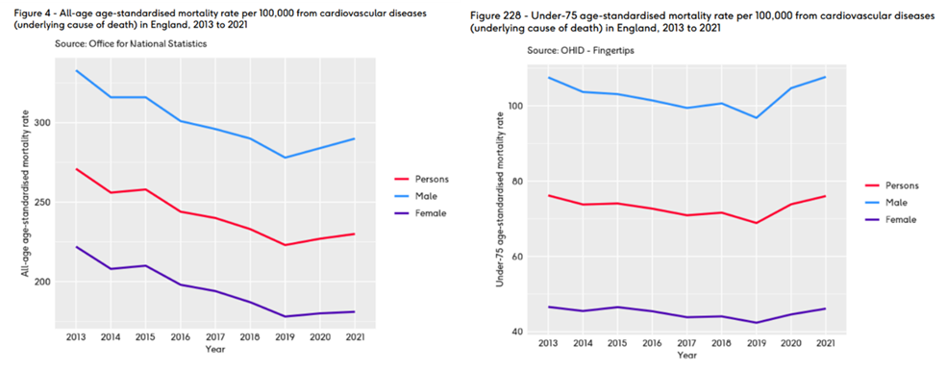

Slide 7
There is currently no reliable data on the numbers of people in Wales with hypertension who are optimally treated, but it is estimated that only around 50% are treated to target.
Treatment for high blood pressure significantly reduces the risk of heart attack, stroke, heart failure, progression of CKD, and all-cause mortality.
Every 10-mmHg reduction in systolic blood pressure reduces the risk of major cardiovascular events by 20%.
Optimal treatment is very effective at lowering blood pressure and at improving cardiovascular outcomes.
Notes:
7

Slide 8
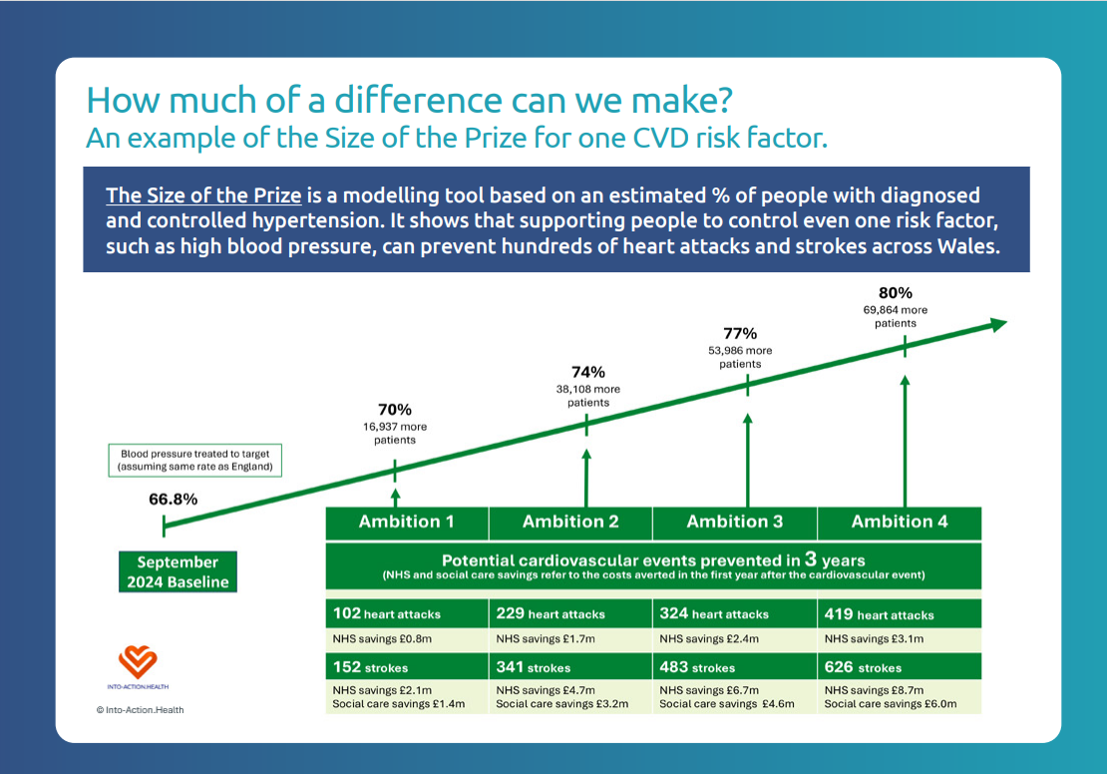

Slide 9
QI Project: CVD Prevention in People with High Blood Pressure.
Dr Dyfrig Ap Dafydd, GP Partner
September 2025
Notes:
9

Slide 10
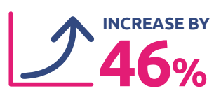


Why CVD prevention?
Responsible for 27% all deaths
Record waiting lists with costs to the Welsh NHS £770 million each year
First sustained increase in CVD mortality for a generation
One of the key drivers of health inequalities
Since 2009, heart failure in Wales has increased by 49% and is projected to increase by a further 46%, over the next decade
Talking to people in Wales about CVD highlighted:
Up to 80% of premature deaths from CVD are preventable
Clear guidance and some of the strongest evidence for preventative medicine
Patients keen to act
Public Health Wales
10
Notes:
10

Slide 11
Size of the Prize for Blood Pressure in Wales
CVD Prevention: Optimising blood pressure
80%
69,864 more patients
77%
53,986 more patients
74%
38,108 more patients
70%
16,937 more patients
Estimated blood pressure treated to target (assuming same rate as England)
66.8%
Ambition 1 | Ambition 2 | Ambition 3 | Ambition 4
Potential cardiovascular events prevented in 3 years (NHS and social care savings refer to the costs averted in the first year after the cardiovascular event)
102 heart attacks | 229 heart attacks | 324 heart attacks | 419 heart attacks
NHS savings £0.8m | NHS savings £1.7m | NHS savings £2.4m | NHS savings £3.1m
152 strokes | 341 strokes | 483 strokes | 626 strokes
NHS savings £2.1m Social care savings £1.4m | NHS savings £4.7m Social care savings £3.2m | NHS savings £6.7m Social care savings £4.6m | NHS savings £8.7m Social care savings £6.0m
September 2024 Baseline
References for costs of heart attack and stroke
Royal College of Physicians (2016). Sentinel Strole National Audit Programme. Cost and cost-effectiveness analysis.
Kerr M (2012) Chronic kidney disease in England. The human and financial cost.
© Into-Action.Health
Notes:
11

Slide 12
QI Project: CVD Prevention in People with High Blood Pressure
Menu of Options for Quality Improvement Project Activity
Increased identification of new patients not currently on the hypertension register with a latest (within the last 15 months) blood pressure reading ≥140/90 mmHg (80 years+ ≥150/90 mmHg), and review, further assess, and record on register if diagnosis of hypertension confirmed.
(You may wish to focus on high-risk patients as well as those from ethnic minority groups and those from the most deprived segments of the practice population).
Public Health Wales
12
Notes:
12

Slide 13
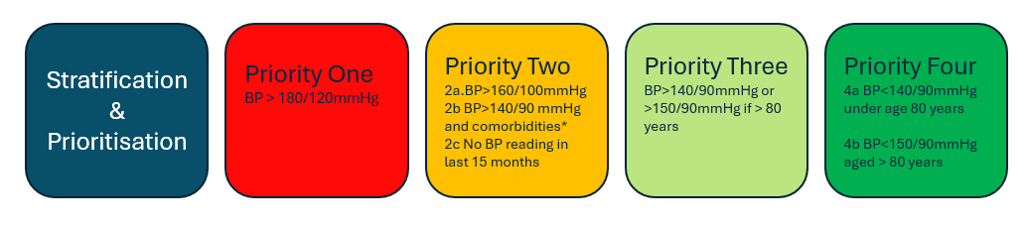
QI Project: CVD Prevention in People with High Blood Pressure
2. Review of current annual hypertension recall and prioritisation process for patients on the hypertension register aiming to improve patient response and attendance rates at their Annual Review, across the patient population to reduce health inequalities.
Identify patients at highest risk and invite them for review and optimisation.
*Co-morbidities/ risk factors
Established CVD (prior Stroke/TIA, heart disease, peripheral arterial disease) Diabetes eGFR <60 Obesity with BMI > 35
Public Health Wales
UCL Partners: Stratification and Management of High Blood Pressure
13
Notes:
13

Slide 14
QI Project: CVD Prevention in People with High Blood Pressure
3. Enhancement of hypertension annual review.
Improvements in processes to treat and optimise CVD risk factors (ABCD Plus), including support for health behaviours, are to be actioned and recorded. This will require consideration of wider needs for people to engage e.g., culturally sensitive support, or difficulties being experienced e.g., in relation to housing, financial wellbeing, mental health etc.
Within the Annual Review process follow an ABCD Plus approach (as described in the Background section above):
Review hypertension medication, (taking into account polypharmacy and possible frailty).
Undertake manual pulse palpation to assess presence of atrial fibrillation.
Test for total and HDL cholesterol.
Test for HbA1C as per NICE Guidance: NG28
Test for Urine albumin to creatinine ratio (ACR).
Measure and record patient’s weight and height.
Assess CVD risk using appropriate tools such as QRISK and review and adjust CVD risk factor medication accordingly. (taking into account polypharmacy and possible frailty).
Discuss health behaviours and signpost to support if available.
Further information to support practices in undertaking the project and suggested QI activity is available in the Public Health Wales guide: Supporting Healthy Behaviours: A Guide for General Practice.
Public Health Wales
14
Notes:
14

Slide 15
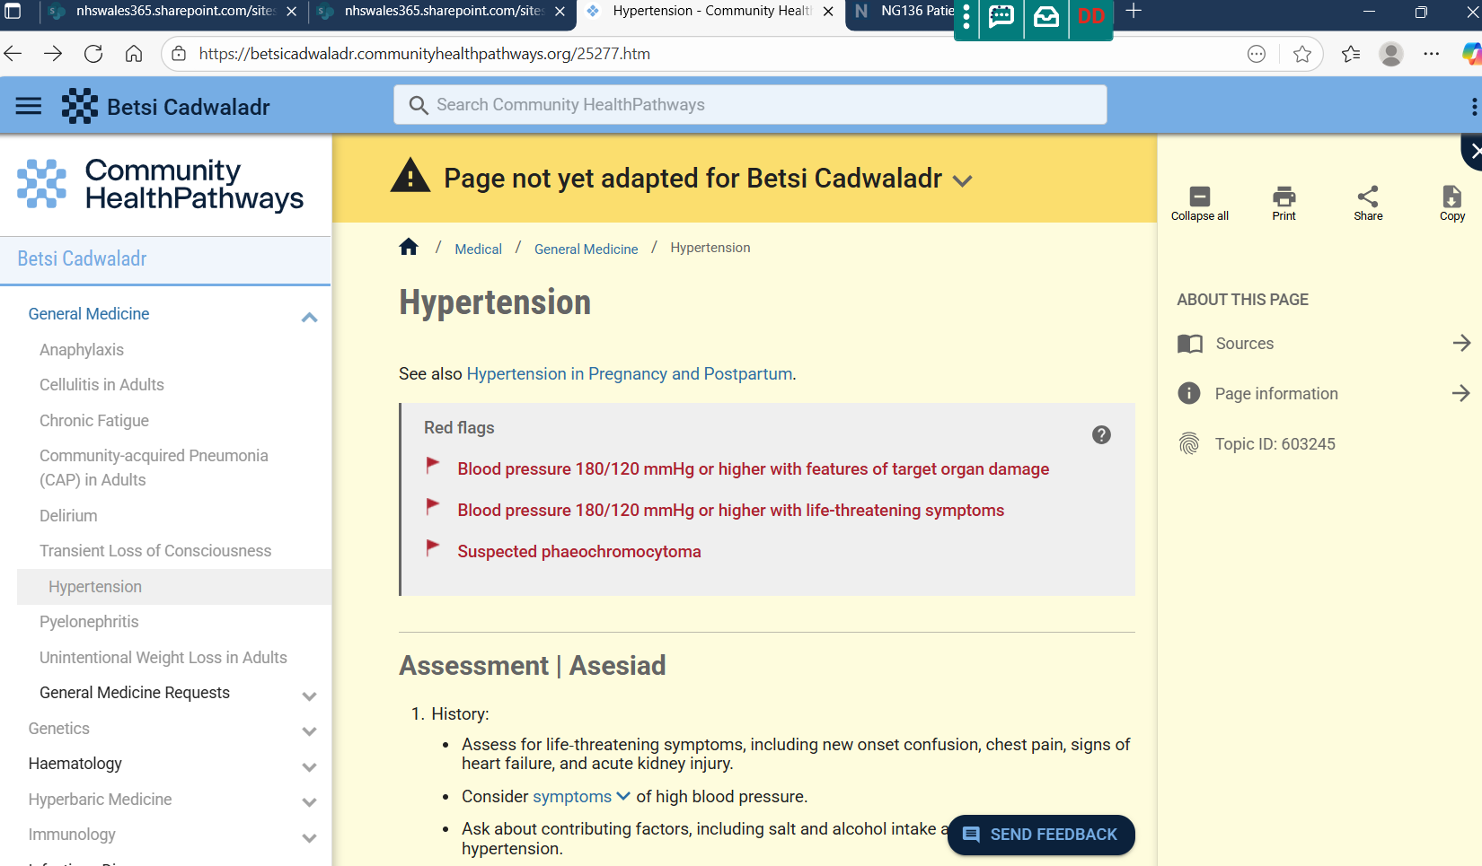

Slide 16
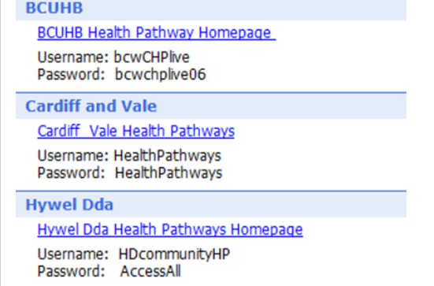
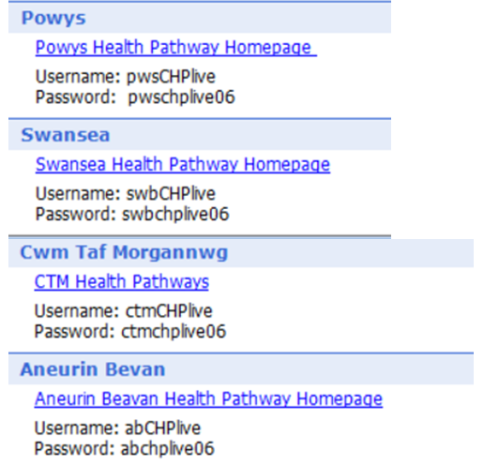
https://communityhealthpathways.org/
https://communityhealthpathways.org/

Slide 17

Don’t forget to include in Appraisal and CGPSAT!

Slide 18


CKD Optimisation QI Project
Alexa Wonnacott
Consultant Nephrologist CAVUHB /ABUHB
CKD Prevention lead Wales Kidney Network
GMS Webinar Sept 30th 2025
Notes:
18

Slide 19




Objectives
Background and importance of CKD in Wales
CKD QIP specifications
Top tips and FAQ
Useful Resources

Slide 20
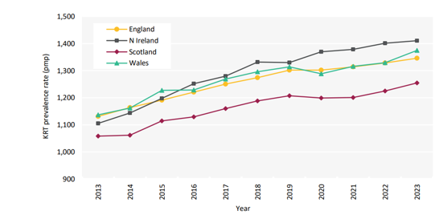

CKD in Wales
7.62% of the population with CKD stage 3-5
CKD rates rising: DM, HTN, obesity and an aging population
Kidney replacement therapy (KRT) rates rising and Dialysis units near max capacity¹
Patients with CKD 12 x more likely to die of CVD than need KRT in lifetime²
CKD predicted to be the 5th most common cause of early death by 2040³
Service costs in CKD – a snapshot in numbers:⁴
Annual spend on KRT services in Wales: £80 million
Total economic burden of CKD in Wales: >£320 million
Dialysis costs: >£30,000 per patient per year
1. UK Renal Registry (2023) UK Renal Registry 27th Annual Report – data to 31/12/2023, Bristol, UK. 2 Liu P et al. Predicting the risks of kidney failure and death in adults with moderate to severe chronic kidney disease: multinational, longitudinal, population-based cohort study. BMJ. 2024;385:e078063.. 3. Economics-of-Kidney-Disease-full-report_accessible.pdf 4. Wales Kidney Network data.
Notes:
20

Slide 21
Interventions recommended by NICE, UKKA & KRUK
Improved coding
Improved coding of patients with CKD to support accurate review and monitoring pathways, and enhance appropriate prescribing through automated decision support alerts
Early diagnosis and improved CKD management
Targeting eligible patients with CKD who are either untreated or not receiving standard care according to NICE recommendations
(e.g., BP targets, ACEi/ARB, statins)
Combat health inequalities
Ethnic minority groups and patients in the most deprived 40% of the population are disproportionately more likely to progress to requiring KRT
Use of SGLT2is¹
Increasing uptake of SGLT2i to:
Reduce CVD events and HF admissions by 23% Reduce ESKD progression by 37%
Modelling by KRUK suggests that improved implementation of interventions, plus increased transplantation rates, could cost-effectively save more than 10,000 UK lives between 2023 and 2033²
1. Staplin N et al. The Lancet. 6th Nov 2022. 2. Kidney Research UK. Kidney disease: a UK public health emergency. The health economics of kidney disease to 2033. 2023. Available at: https://www.kidneyresearchuk.org/wp-content/uploads/2023/06/Economics-of-Kidney-Disease-full-report_accessible.pdf;
Notes:
21

Slide 22

GMS CKD QIP specification: Aims
PRIMARY AIM: Reduce CKD progression towards ESKD and reduce CV morbidity and mortality in patients with CKD, by adhering to NICE recommended guidelines for the implementation of SGLT2 inhibitors*
*AWTTC National Prescribing Indicator ‘25-28
SECONDARY AIM: Collate accurate CKD registers, improve adherence to urinary ACR screening and promote education and awareness of CKD amongst patients and Healthcare providers (HCPs) inclusive of GPs, DSNs and practice pharmacists.
Notes:
22

Slide 23

GMS CKD QIP specification: Coding
“Develop, agree and implement a strategy to…”
Improve CKD coding accuracy
Tip:
Use DHCW searches to identify patients with :
2 consecutive eGFR < 60ml/min over ≥ 90 days with no CKD 3 code
Miscoded CKD stage by eGFR criteria
Notes:
23

Slide 24


GMS CKD QIP specification: CV Optimisation
Develop, agree and implement a strategy to…”
Improve prescribing rates of statins for all patients with CKD (unless C/I)
Tip: QRISK calculation not required in CKD
Use Atorvastatin 20mg 1st line for primary prevention
Secondary prevention lipid targets as per non-CKD population
Tip: ACEi/ARB 1st line in DM and any albuminuric CKD
Titrate ACEi/ARB to max tolerated dose
Exercise clinical judgement in context of frailty/multimorbidity
Target BP of:
< 140/90 if ACR <70mg/mmol
< 130/80 if ACR >70mg/mmol
Notes:
24

Slide 25
GMS CKD QIP specification: Cardiorenal Protection
Develop, agree and implement a strategy to…”
Prescribe max. tolerated dose of ACEi or ARB therapy in:
DM, CKD and ACR > 3mg/mmol
Non-diabetic CKD with ACR >70mg/mmol
Non-diabetic CKD, HTN and ACR >30mg/mmol
Tip:
Codes exist for “RAASi not tolerated” and “RAASi max dose achieved”- underused but helpful in determining next step optimisation
See Community HealthPathways CKD page for prescribing details including:
Sick day rule info with RAASi
How to monitor and what to do if Cr/K rise
Notes:
25

Slide 26
GMS CKD QIP specification: Cardiorenal Protection PRIMARY QIP TARGET
Develop, agree and implement a strategy to…”
Improve prescribing rates of SGLT2 inhibitors, to those on max dose ACE/ARB (where tolerated and indicated) where*:
eGFR 20-45ml/min
eGFR 45-60ml/min and either T2DM or ACR >22.6mg/mmol
*Unless contraindications to SGLT2i apply
Tip:
See Community HealthPathways CKD page for prescribing details including:
Sick day rules with SGLT2i
Contraindications and cautions
How to manage Insulin/SU to mitigate hypoglycaemia risk (only relevant if GFR>45)
Notes:
26

Slide 27


GMS CKD QIP specification: Screening and education
Develop, agree and implement a strategy to…”
Increase annual uACR & eGFR screening in high-risk groups, especially:
Patients with Diabetes
Patients with HTN
Tip: Very low national baseline rates of ACR screening in patients with HTN- easy to demonstrate significant improvement in this cohort, and covers CVD QIP target too!
Improve Community Health care practitioner awareness/education of CKD via completion of HEIW online training
Intended audience: GP’s, Pharmacists, DSNs, ANPs
Tip: May be especially useful for non-medical prescribers to identify atypical presentations in CKD, and who to refer
Notes:
27

Slide 28
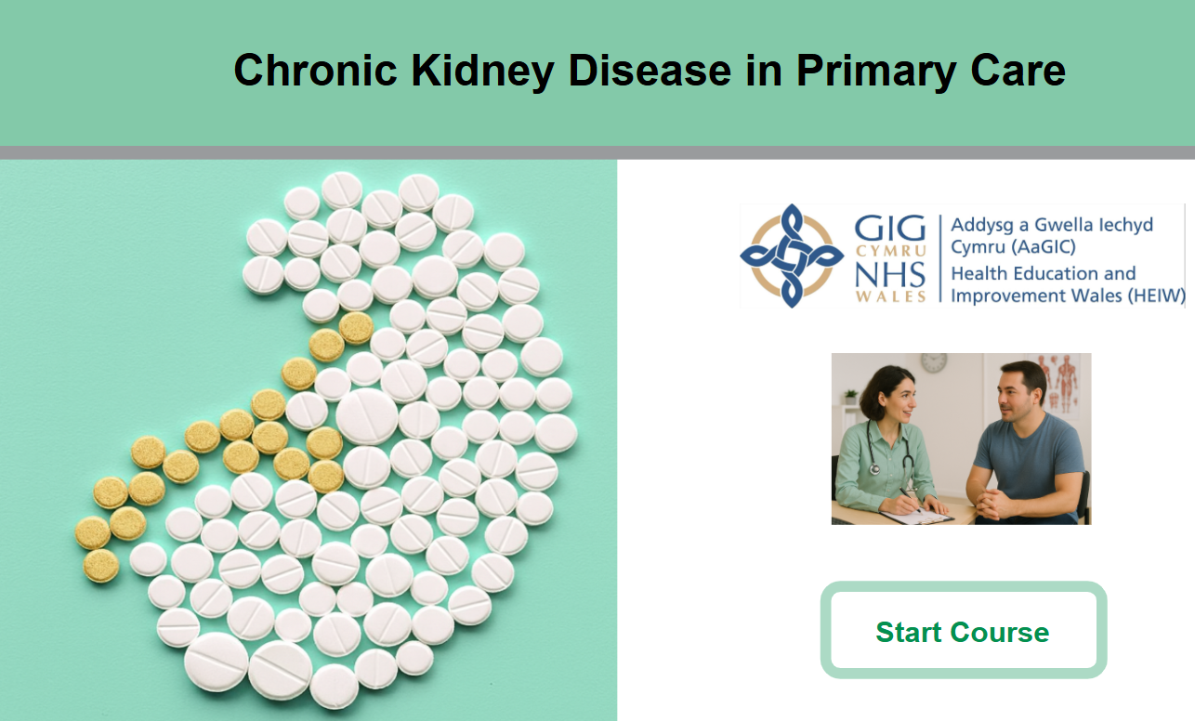
Useful resources: CKD e-module
Available at ytydysgu.heiw.wales
Also link via Primary care one page and Community HealthPathways CKD page
Notes:
28

Slide 29
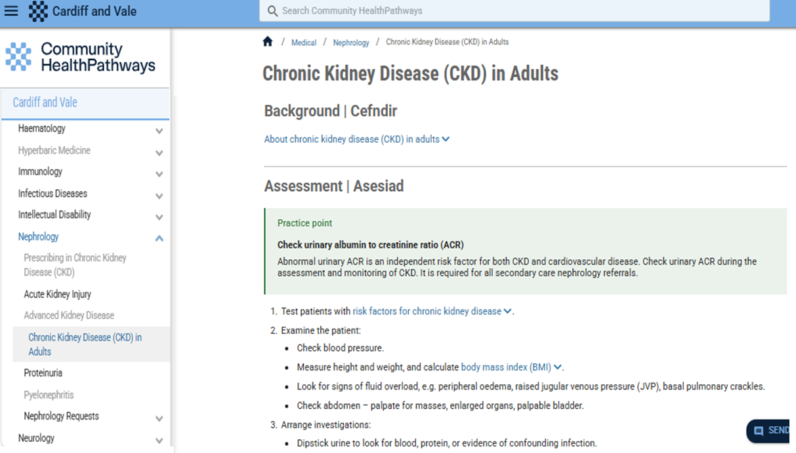
Useful resources: Community HealthPathways
How to identify/screen high-risk patients
How to interpret tests e.g ACR, eGFR
Monitoring frequency in CKD
How to use KFRE tool to predict 5 year risk of needing dialysis
Prescribing guidance on RAASi and SGLT2i
Referral criteria
Patient information links
Notes:
29

Slide 30

Useful resources: other
Kidney charities webpages for patient information (KCUK, Kidney Wales, Welsh Kidney Network page, Paul Popham)
Multilingual patient info available CKD information language support | Kidney Care UK
Example SOP of Pharmacy-led Diabetic kidney disease optimisation pilot project (ABUHB March ‘23-March ‘26) available via Primary Care One webpage
Notes:
30

Slide 31
CKD QIP FAQ
Does ACR need to be early morning sample?
No! Any wee will do!
See CHP guidance for borderline uACR and when indicated to repeat with EMS
Urine dip provides additional information on haematuria which may influence need for referral
Best evidence from trial data in those on max RAASi
If stable K and GFR >45, consider bigger “jumps” in RAASi titration
Added CV benefit of SGLT2i- get them in early (and up titrate RAASi later)
Small cohort in whom SGLT2i, but not RAASi, indicated
(GFR 20-45 without HTN, DM, raised ACR or HF)
Do we have to max RAASi before starting SGLT2i?
Do we need to worry about optimising CKD in elderly patients?
Consider wider CV morbidity and mortality benefit
SGLT2i provide significant QOL benefit in context of HF (within weeks)
Individualised decision to balance likely risk of side effect/tablet burden against life-time benefit
Notes:
31

Slide 32
Summary
Improving SGLT2i prescribing rates in CKD is the primary focus
Early identification and optimisation means less patients progressing to ESKD and fewer CV events
Make use of available digital resources/searches/templates to maximise efficiency and outcomes
Completing education module and upskilling the primary care workforce is key to achieve legacy of improved CKD care

Slide 33
GMS Contract CVD & QI Projects 2025/26 - Collection & Use of QI Data
Simon Scourfield
Head of Primary Care Information

Slide 34






Content
The Data Quality System
Simple Schematic
CVD QI (Audit+ & the PCIP)
CKD QI (Audit+)
Notes:
34

Slide 35








The Data Quality System - Simple Schematic
GP Practice based tool
Central Repository
Primary Care Aggregate Data Repository
Automated software updates
Automated aggregated data extract
External data transfer utility
Section 251
Pseudonymised

Slide 36
Supporting the GMS QI Projects
Audit+ modules built in line with specs from sponsors
Clinical queries will need to be directed to the sponsors
Technical queries: support@ishealth.co.uk
Practices can produce their own queries to support their QI needs
Notes:
36

Slide 37
Supporting the GMS QI Projects
Only Practices will see their own data
Ability for a Practice to grant others access within the PCIP
Data at Cluster, LHB and all-Wales level for all other PCIP users
QI points/payments based on QI poster requirement of GMS contract
Queries: DHCW.PrimaryCareInformationServices@wales.nhs.uk
Notes:
37

Slide 38
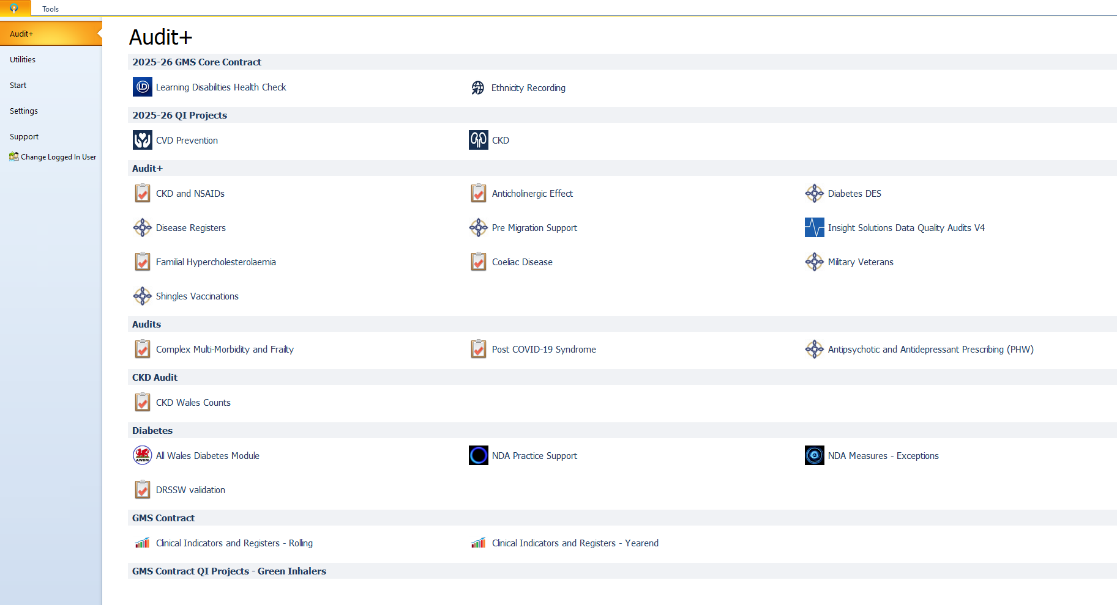
Notes:
38

Slide 39
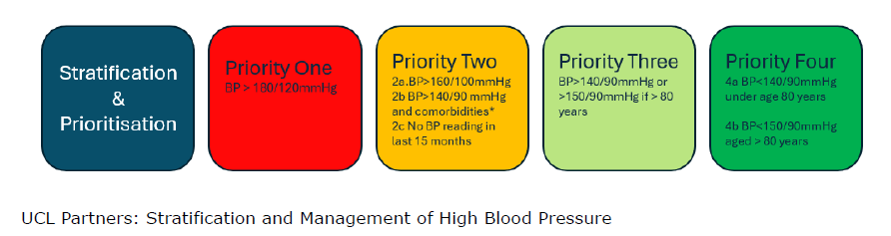
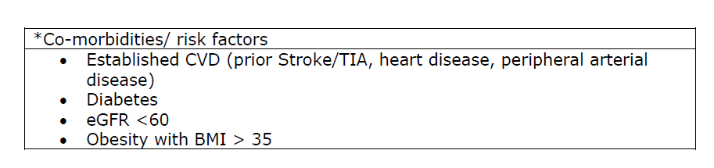
CVD Prevention in People with High Blood Pressure - prioritisation process for patients on the hypertension register

Slide 40
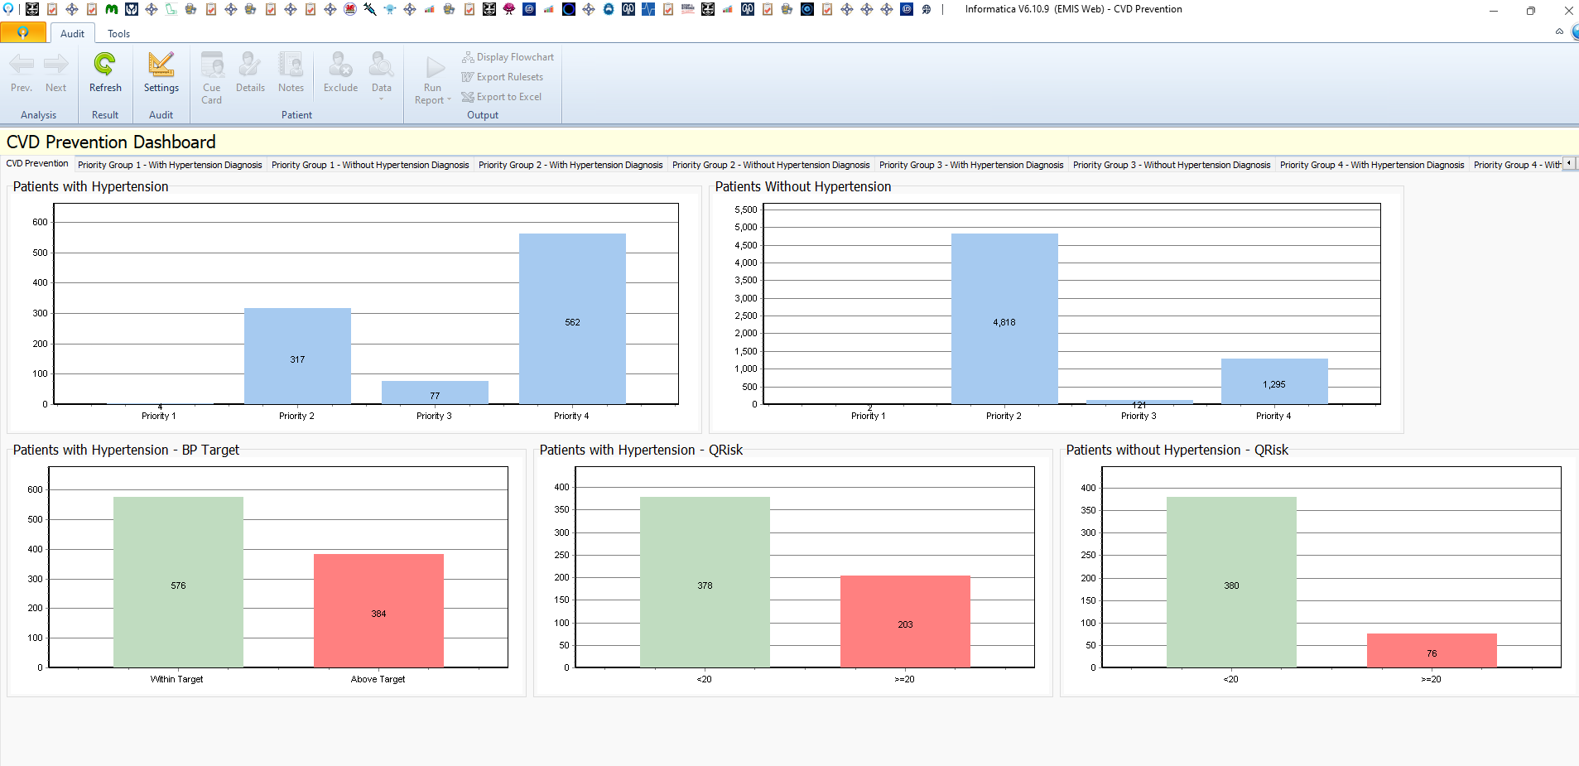
Audit+ Module – Initial Dashboard

Slide 41
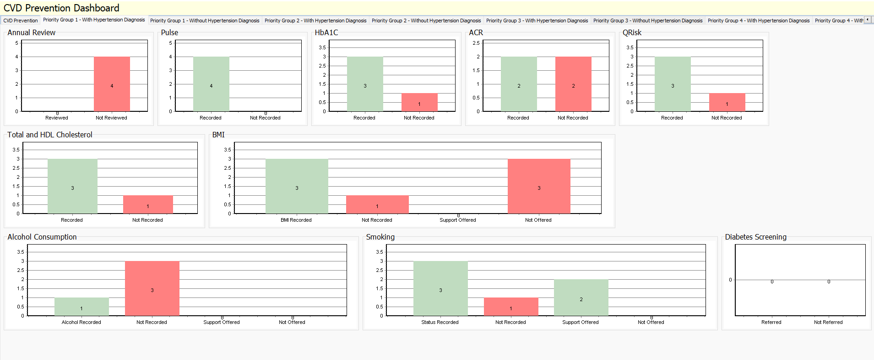
Priority 1 - BP >180/120

Slide 42
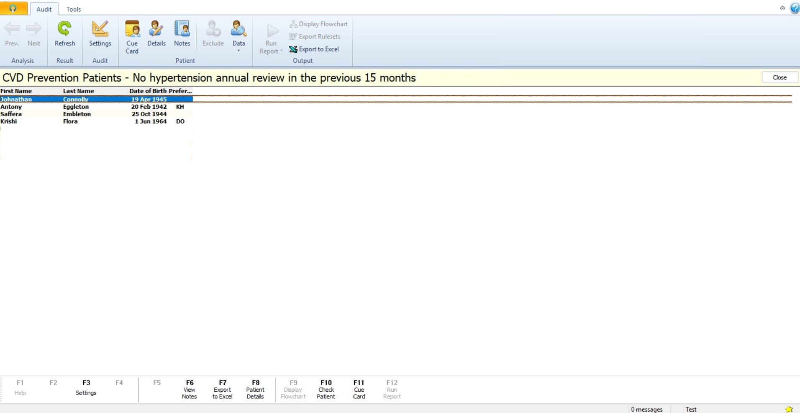
Dummy Data

Slide 43
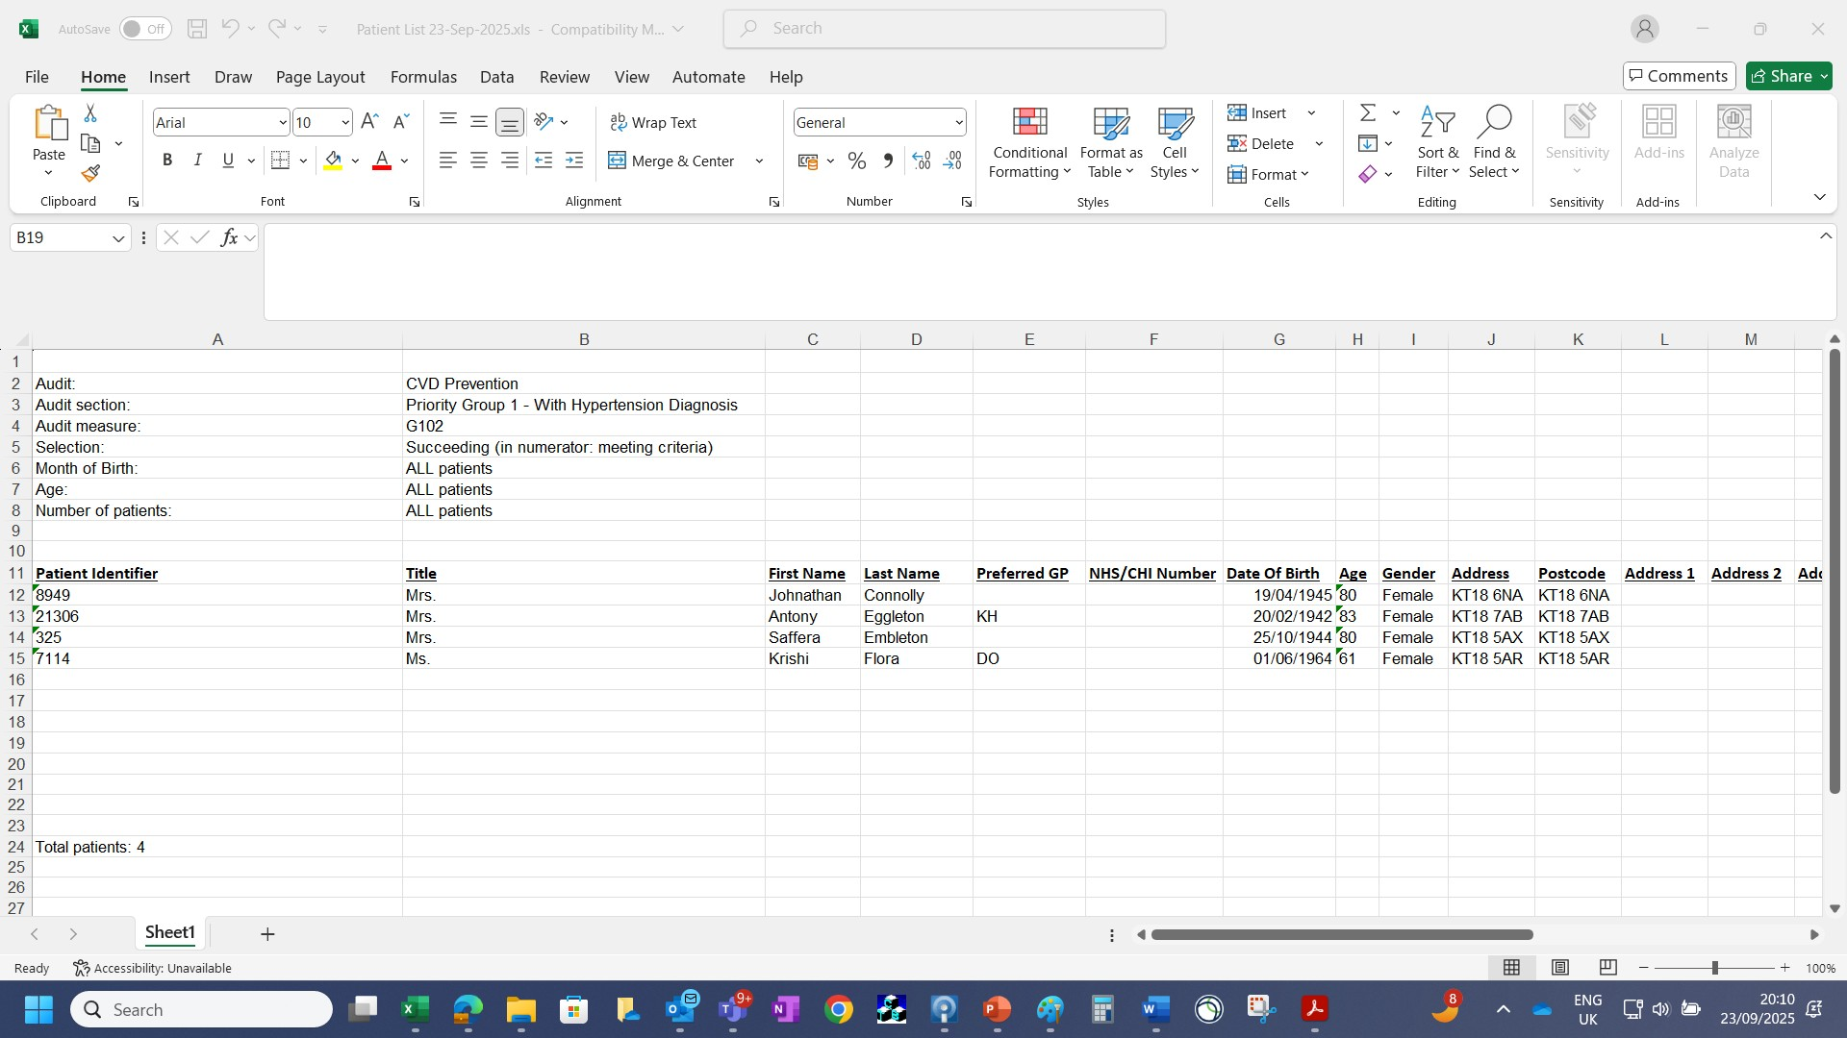
Dummy Data

Slide 44
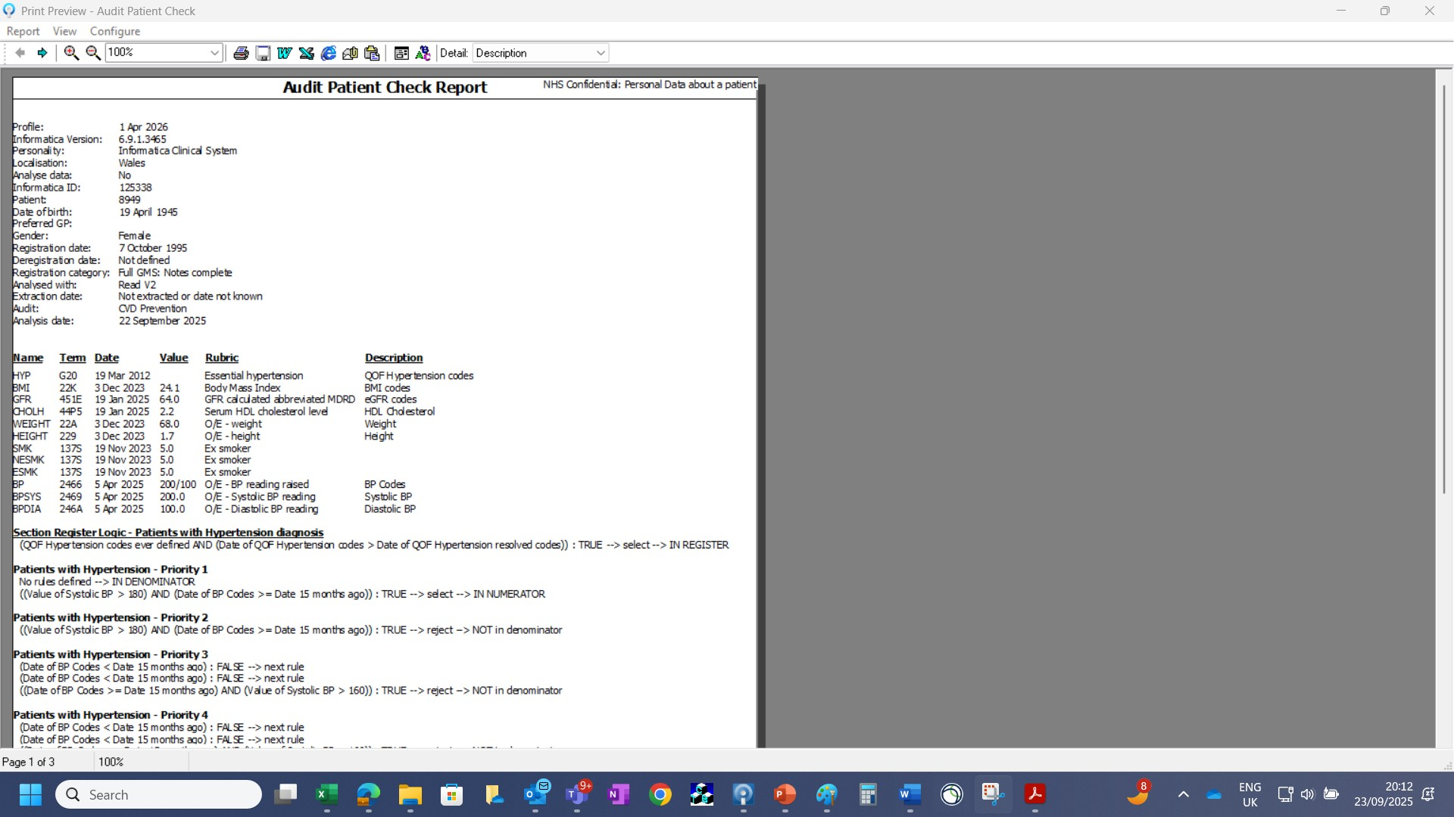
Dummy Data

Slide 45
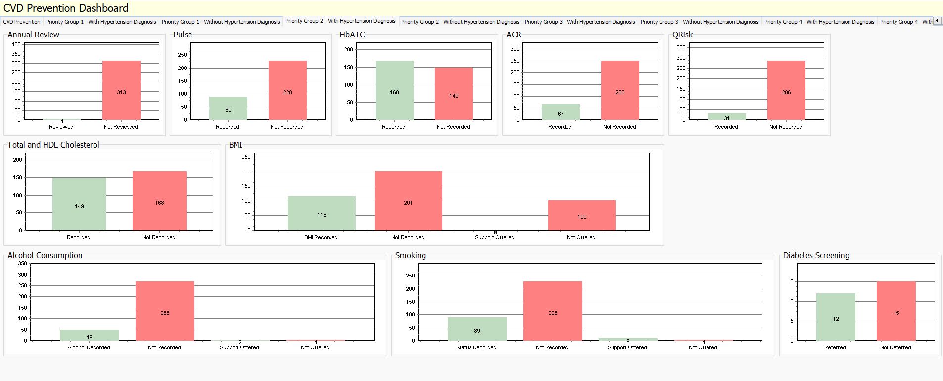
Priority 2 - (2a) BP>160/100 - (2b) BP>140/90 & co-morbidities - (2c) No BP reading in last 15 months

Slide 46
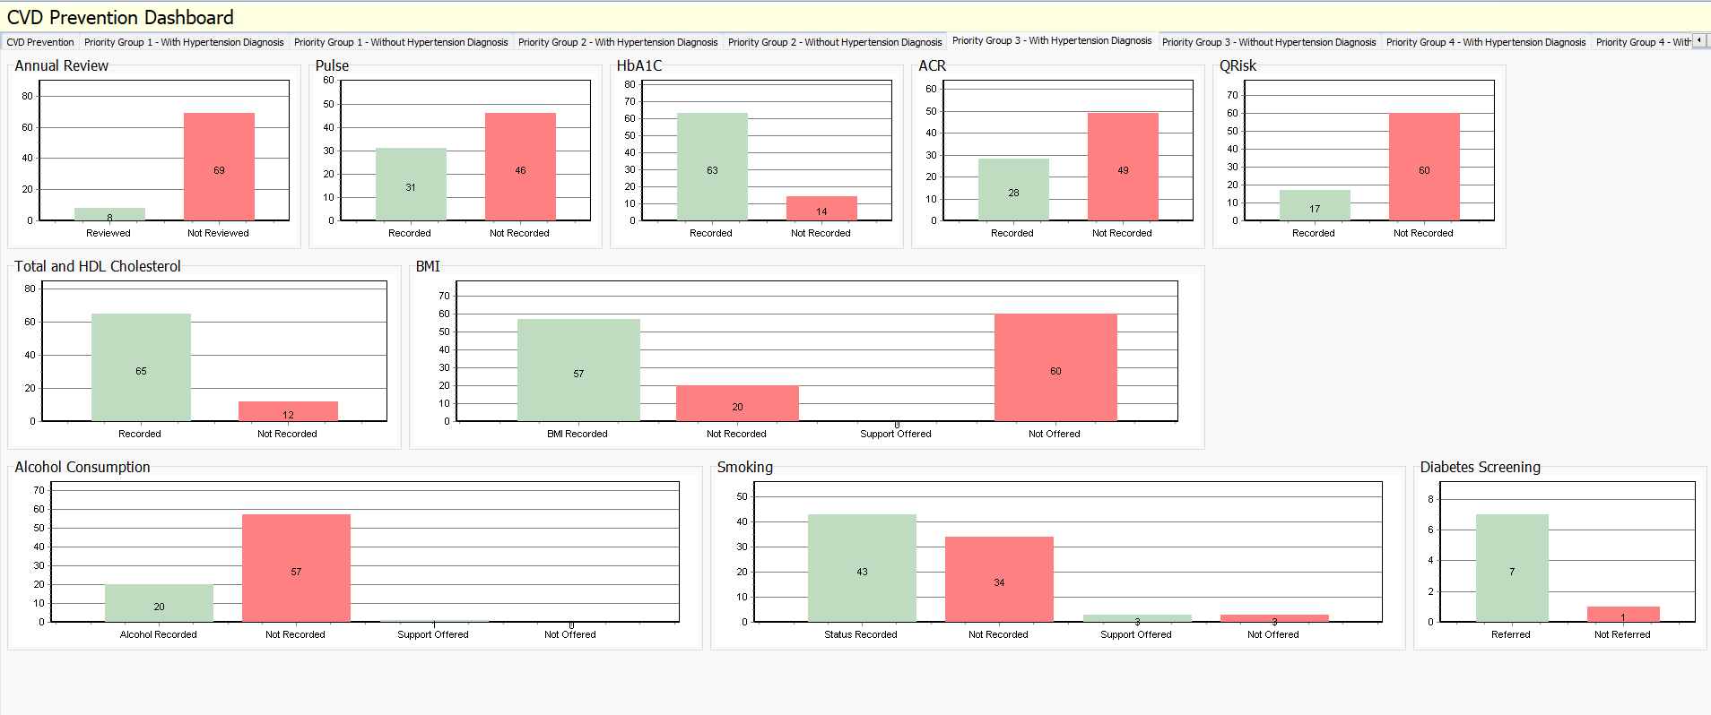
Priority 3 – BP >= 140/90 - BP >= 150/90 (> 80 years)

Slide 47
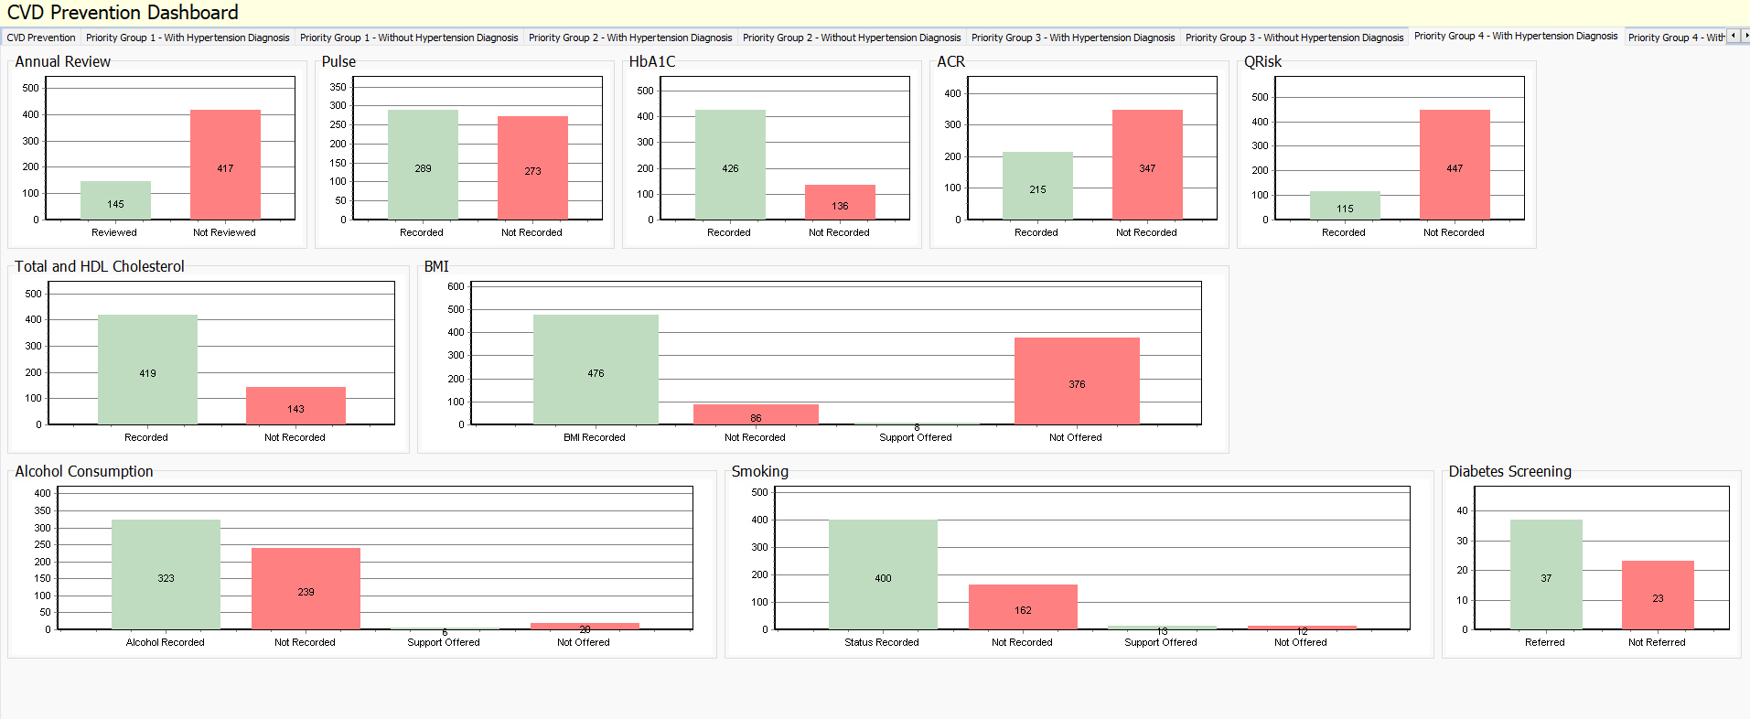
Priority 4 – BP < 140/90 - BP < 150/90 (>80 years)

Slide 48
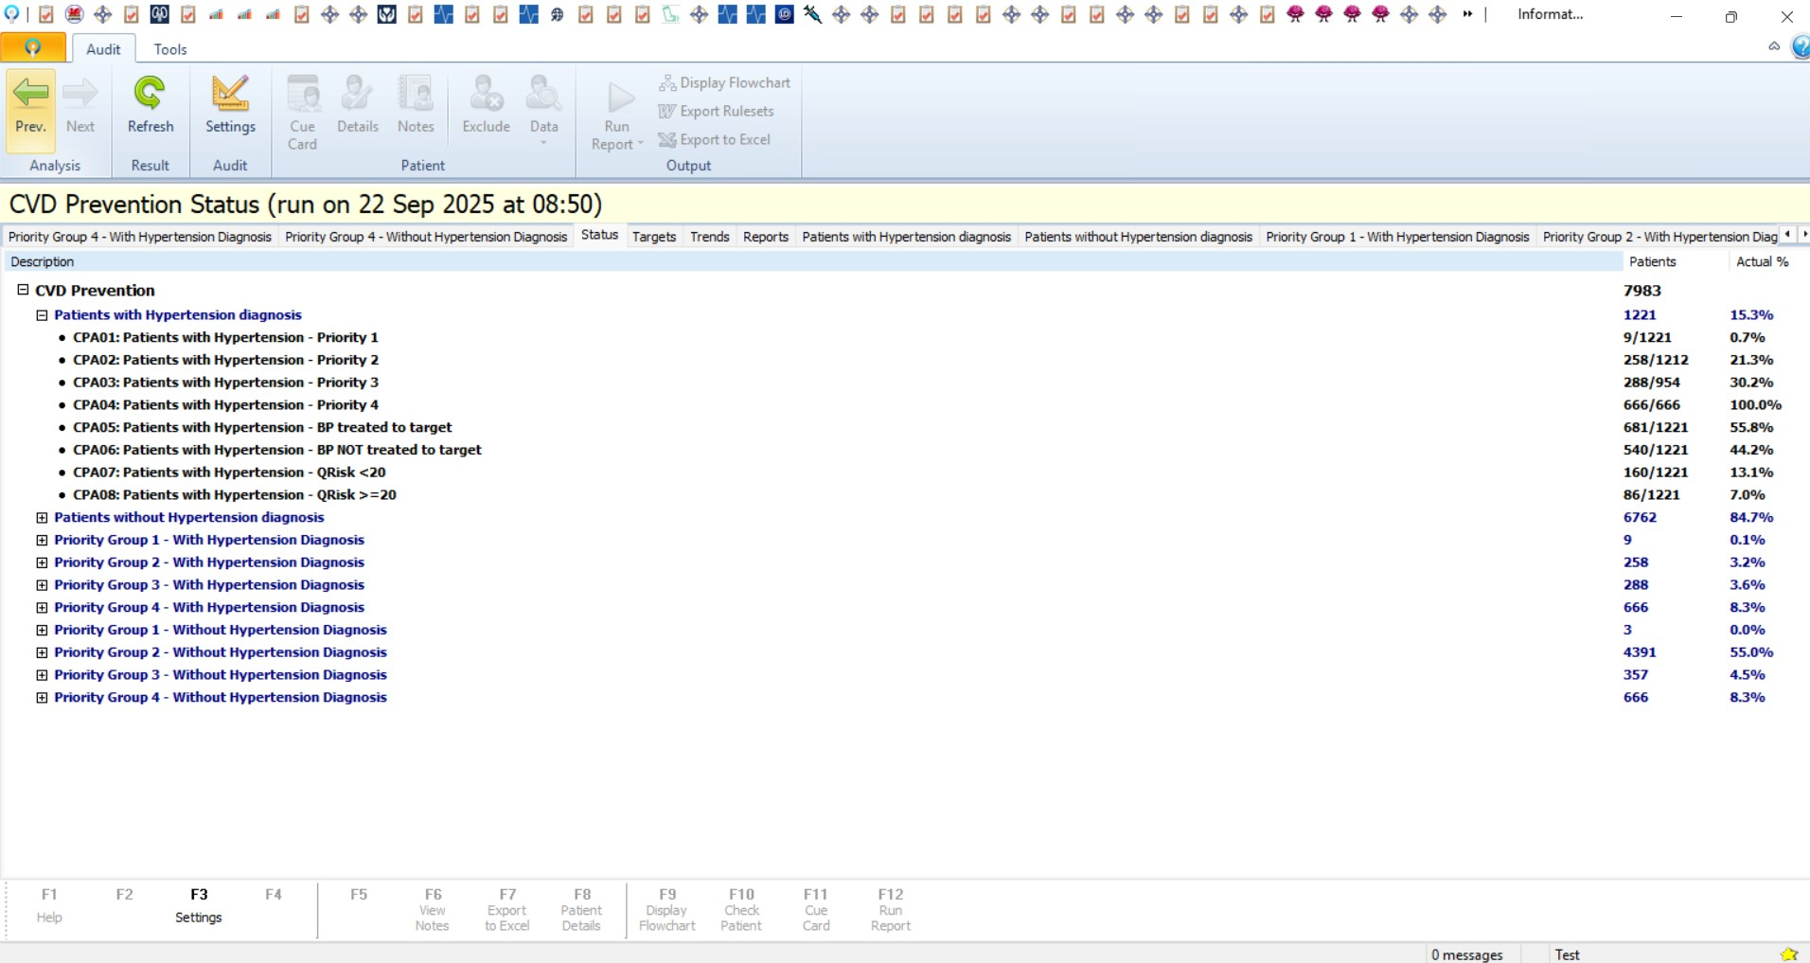
Looking at Previous Results in Audit+

Slide 49
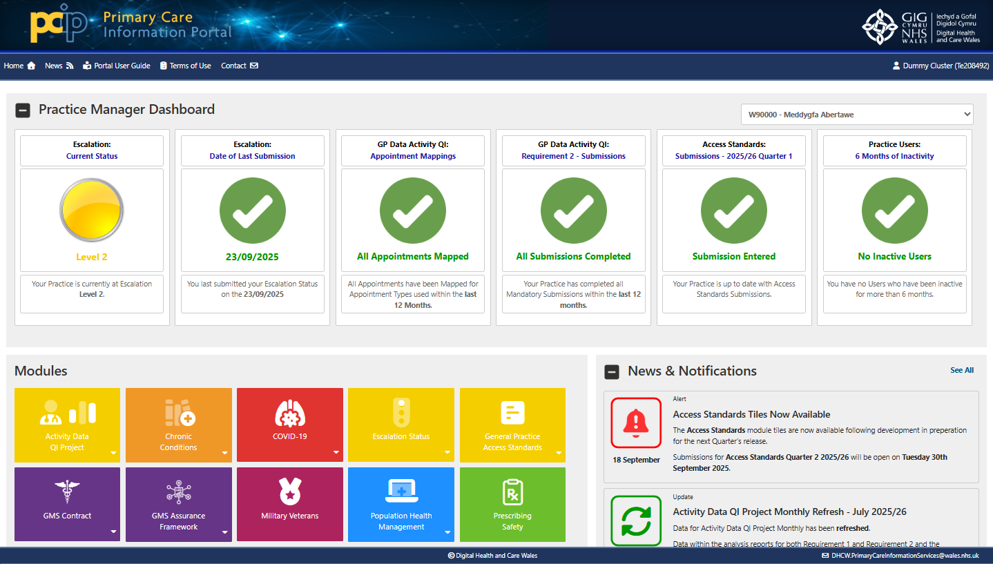
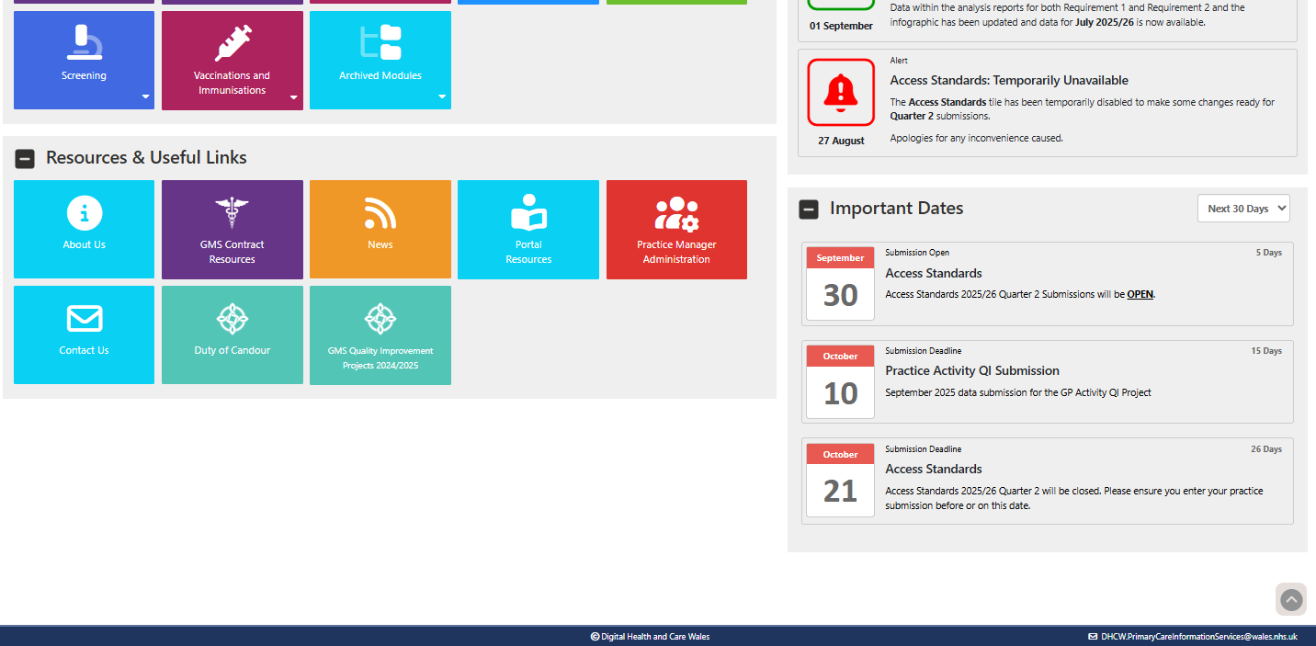
Primary Care Information Portal
CVD Prevention
- Screenshots

Slide 50
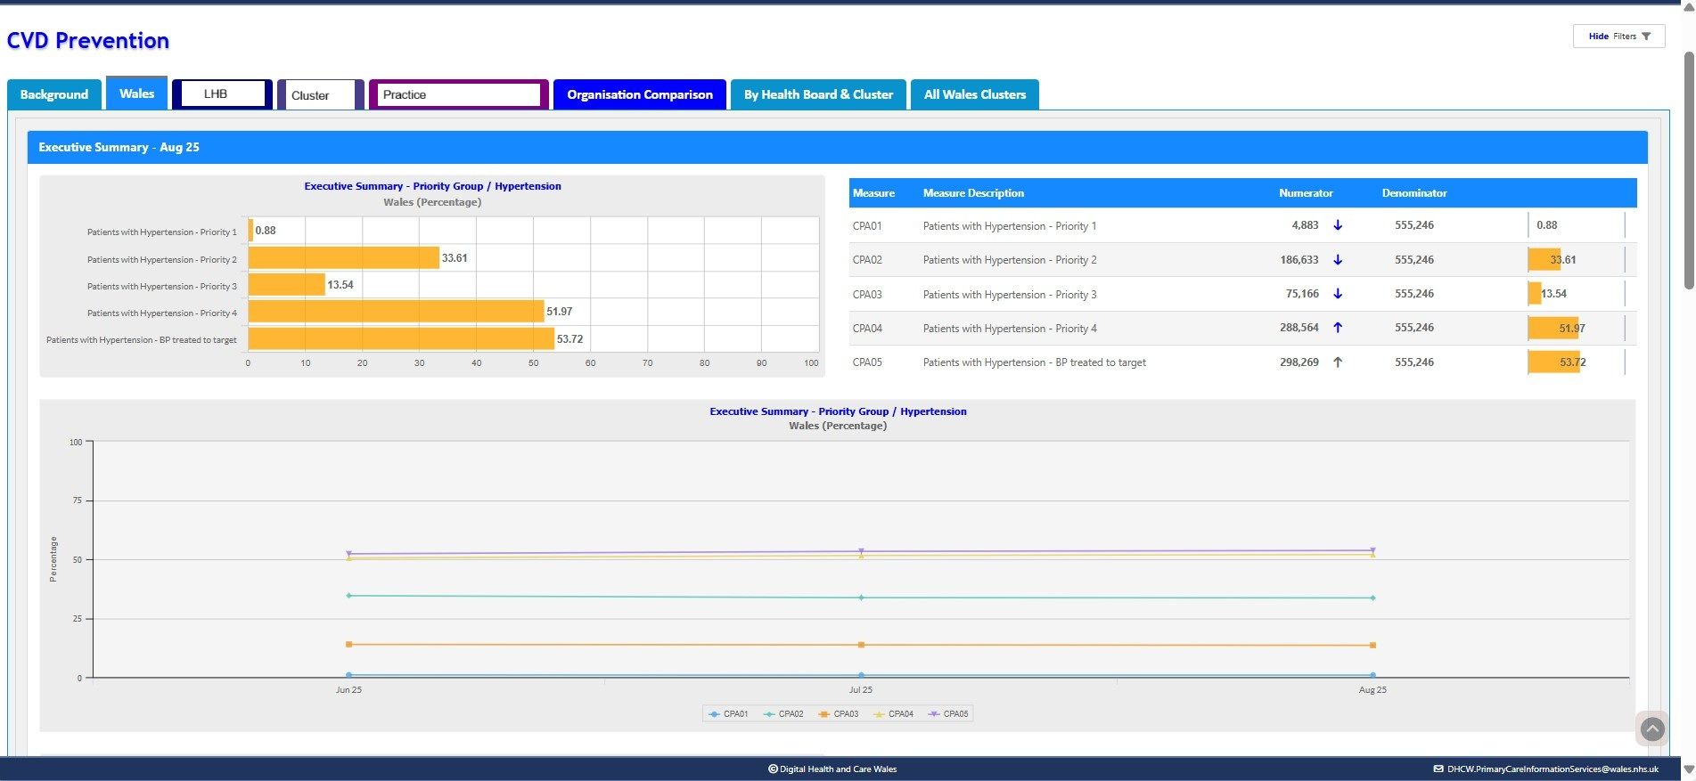
PCIP – CVD Priority Groups & Patients treated to target
Notes:
50

Slide 51
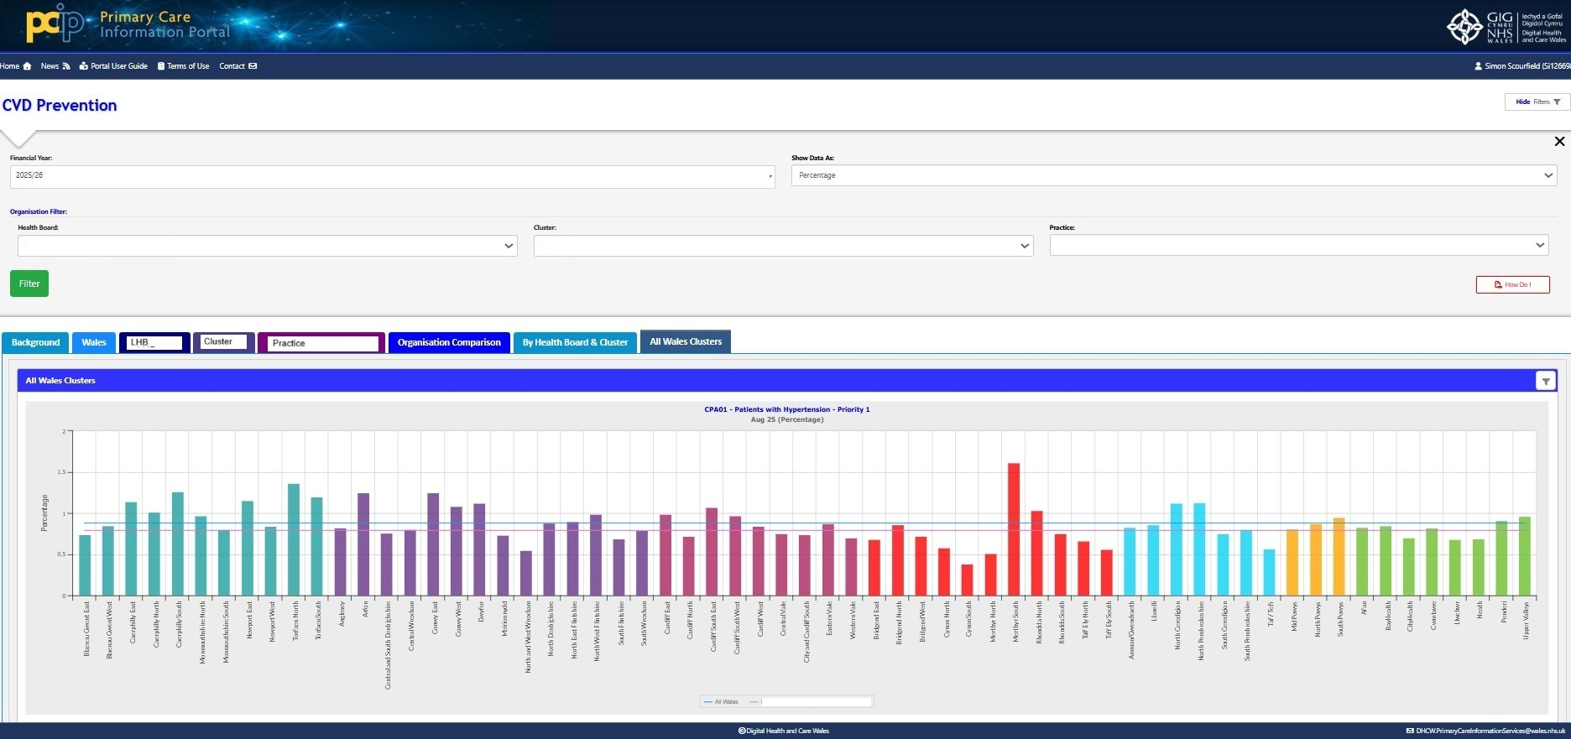
Patients with Hypertension – Priority Group 1 (Cluster level Comparison)

Slide 52
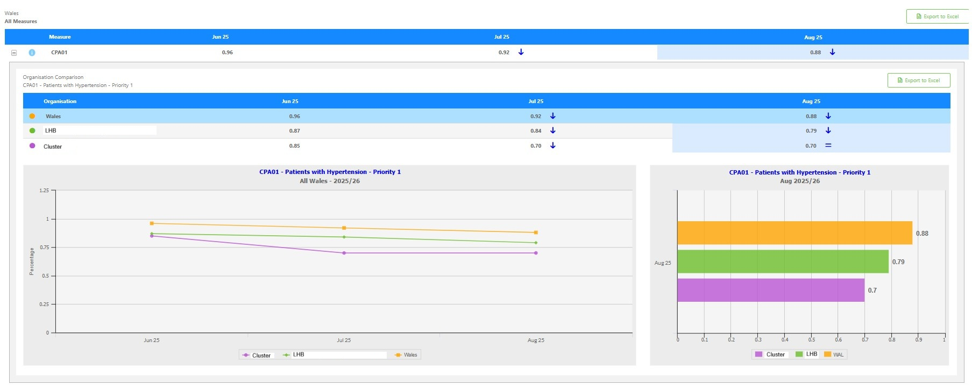
Patients with Hypertension – Priority Group 1 (Cluster, LHB and all-Wales level Comparison)

Slide 53
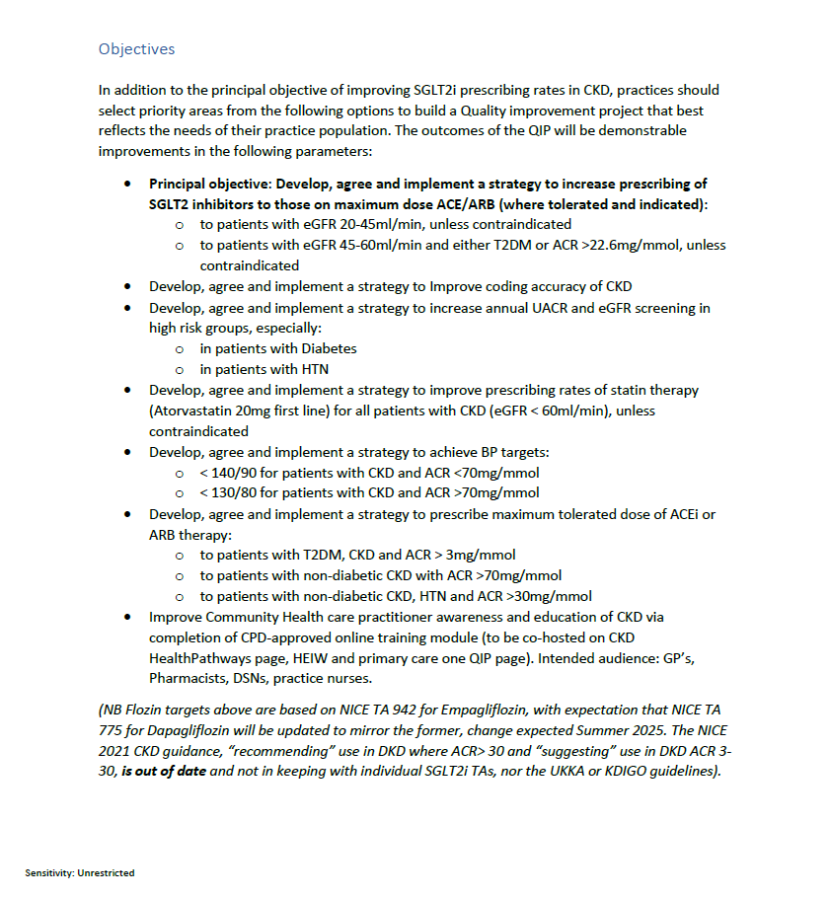
CKD QI Project
Screenshots - current deployed module
“Core” & “Detailed” modules to be deployed
- Currently in testing and validation process

Slide 54
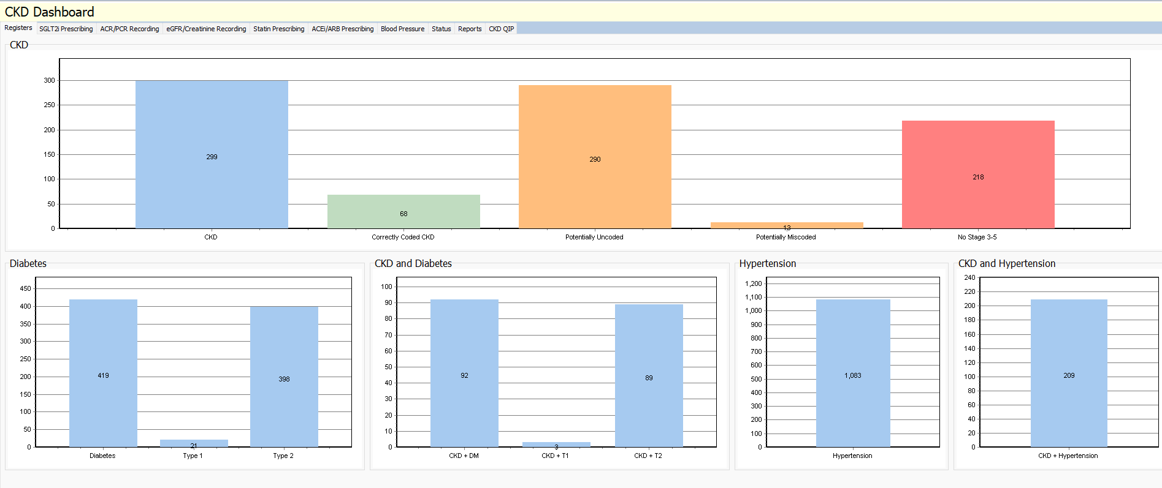
Audit+ Module – Initial Dashboard

Slide 55
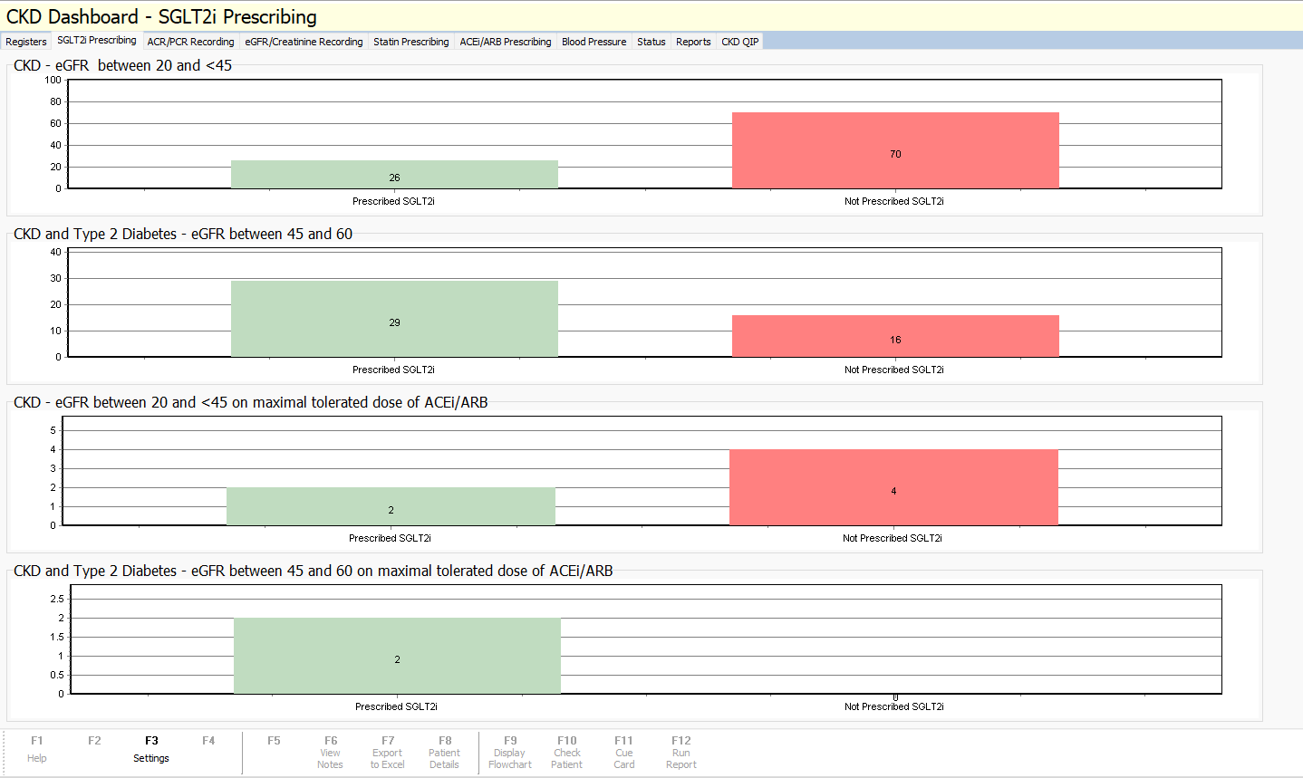
SGLT2i Prescribing

Slide 56
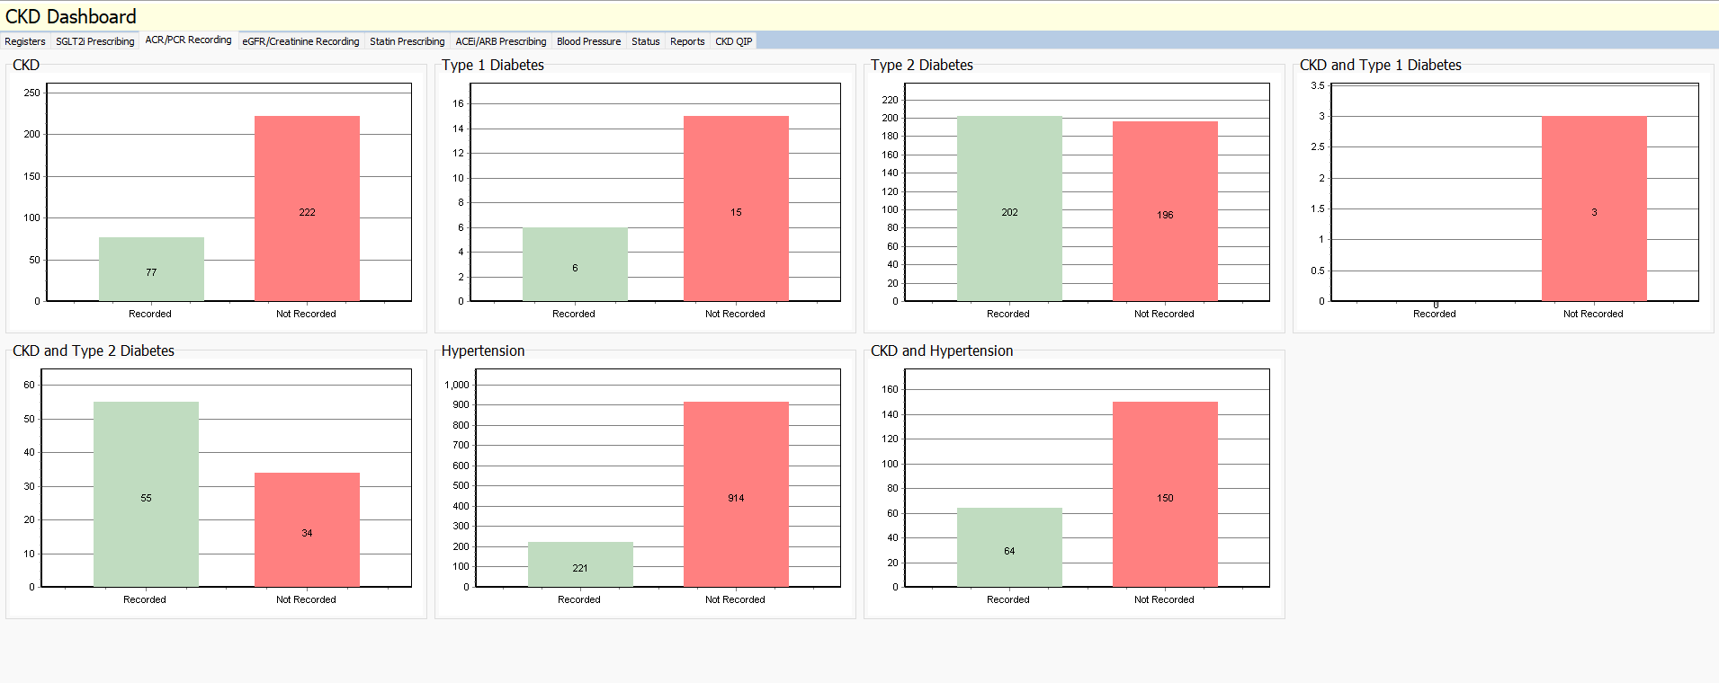
ACR/PCR Recording

Slide 57
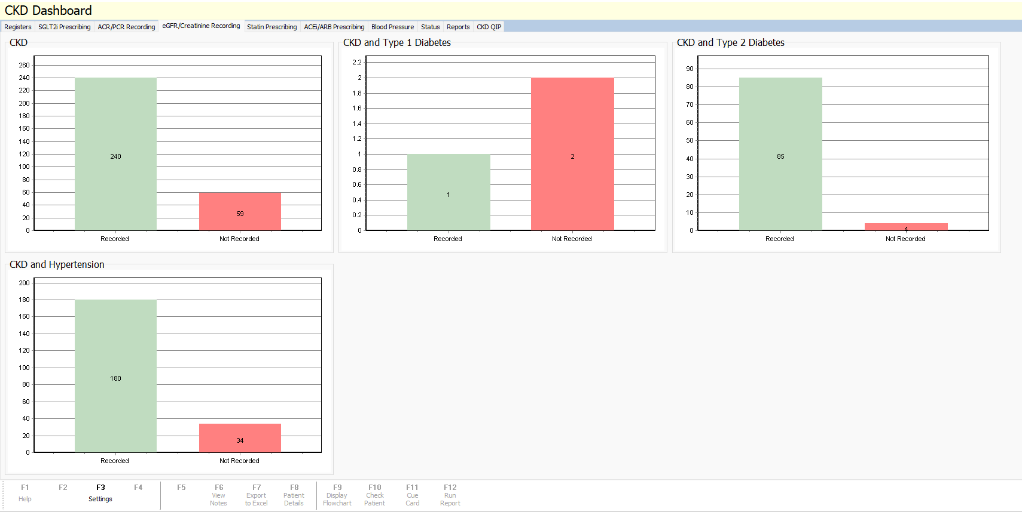
eGFR Creatinine Recording

Slide 58
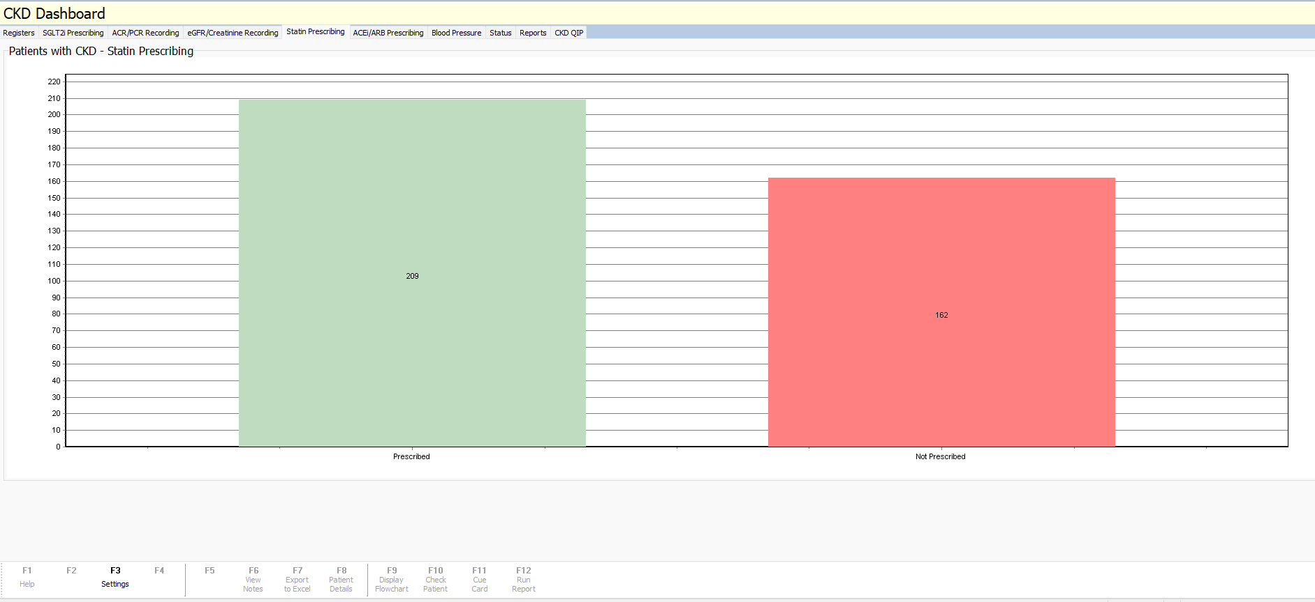
Statin Prescribing

Slide 59
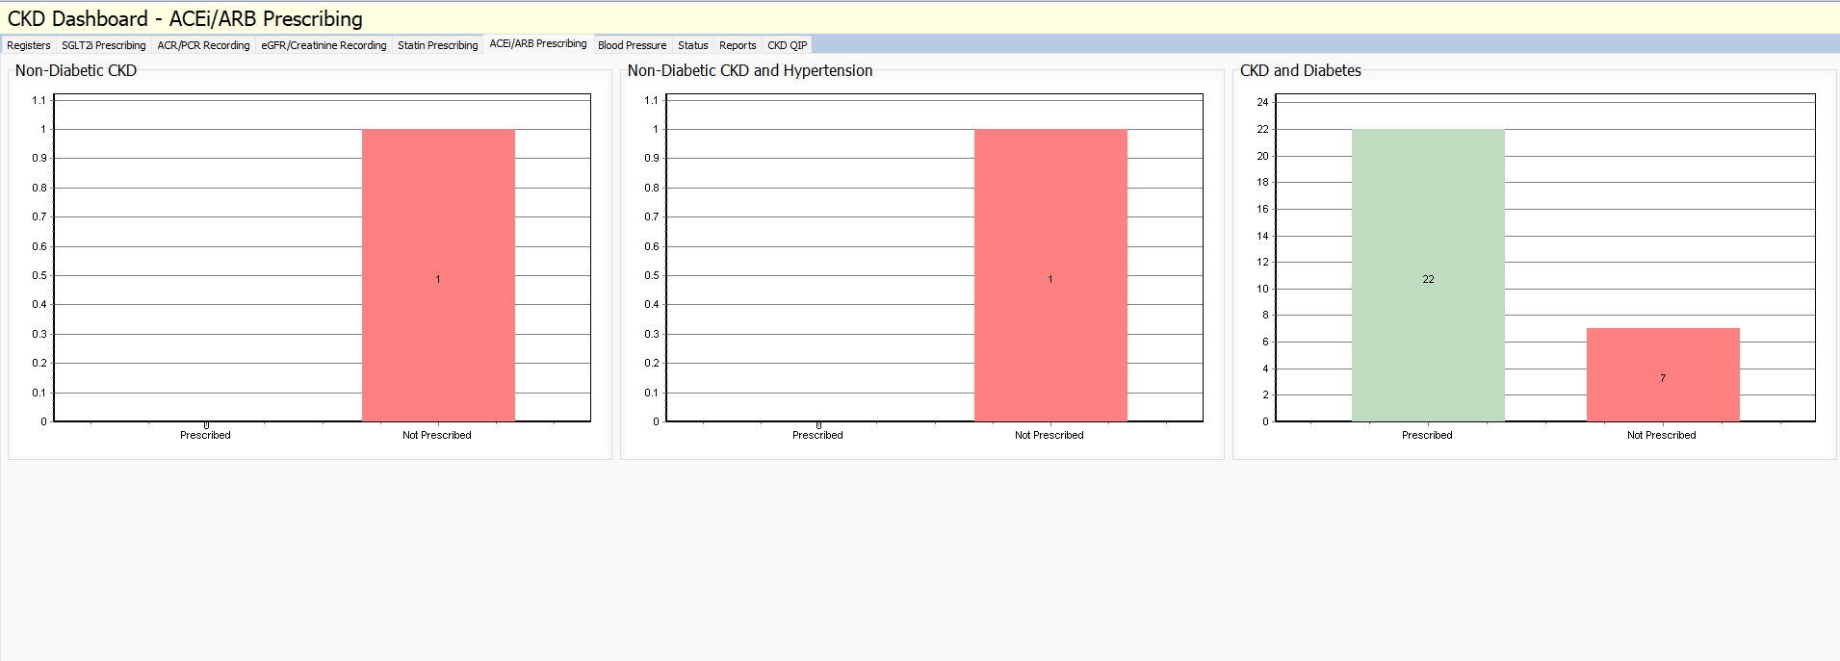
ACEi/ARB Prescribing

Slide 60
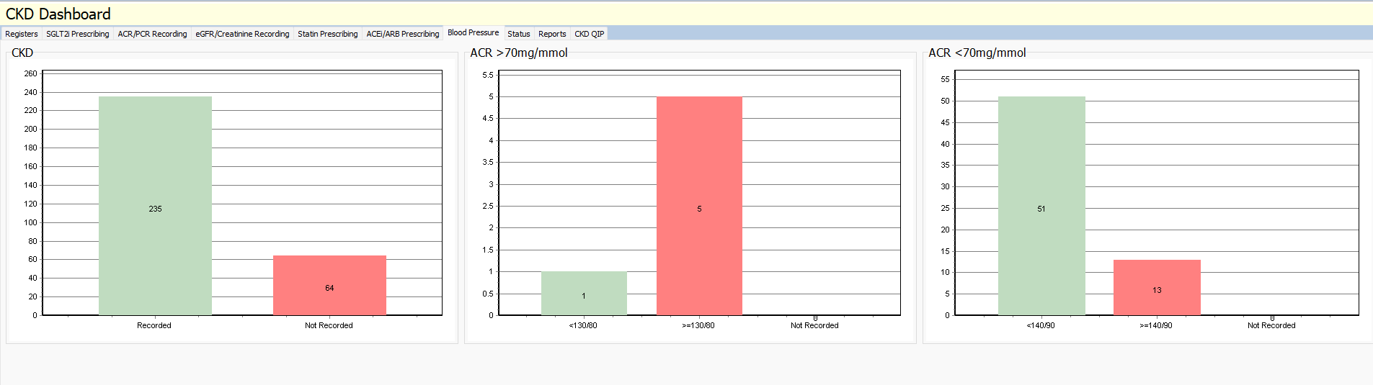
Blood Pressure

Slide 61
Improving CKD and CVD outcomes using a Quality Improvement Approach
Tom Damsell

Slide 62

Session Aim
This presentation will use a case study approach to illustrate 9 stages of a Quality Improvement project.
The session aim is to guide the submission of high-quality GMS Improvement Projects in 2025/26.

Slide 63

In a Nutshell
CVD and CKD place a heavy but largely preventable burden on our patients and services. Quality Improvement offers a practical, team-based way for practices to make measurable improvements in care.

Slide 64

The Quality Improvement Journey
The Problem Statement
Creating Conditions
Understanding the Problem
Selecting an Aim
Deciding Measures
Testing Changes
Displaying Results
Standardisation
Reflections and Planning Next Steps
A new poster template is available which will be structured around these nine stages, providing a practical framework to guide project design and delivery.

Slide 65
The Problem Statement
Clearly describe the issue and its impact on patients, staff, or systems — why it matters and what’s at stake.
A succinct problem statement focuses the project and conveys urgency to all stakeholders.
Example
In the practice, only 62% of registered hypertensive patients are at target BP (as of 15 Aug 2025), leaving ~38% of patients at higher risk of stroke and MI.

Slide 66
Creating Conditions
Create the conditions for change: strong leadership, a small cross-role team, patient insight, and simple communication that builds urgency and shared ownership.
Example
GP lead formed a small team (nurse, admin, manager), agreed roles, and shared the plan and rationale with the wider practice before starting weekly huddles and building a patient list.

Slide 67
Understanding the Problem
Take time to understand the problem so you fix causes—not symptoms—and make improvements that stick.
Quality Improvement uses structured tools to deepen understanding of the problem. For example, process mapping can show how care actually flows in your practice—steps, handoffs, delays. Fishbone diagrams and 5 Whys help identify and explore possible causes. Pareto charts use data to prioritise the most frequent or impactful causes that should be addressed first.
Example
The last 50 patients with raised BP reviewed and recall process mapped. This highlighted gaps in access to home BP kits, inconsistent documentation using the BP template, and delays in decision-making around medication changes during clinics.

Slide 68
Selecting an Aim
Thoroughly understanding the problem helps clarify what your improvement project must achieve to make a meaningful difference.
Making your aim SMART (Specific, Measurable, Achievable, Relevant and Timebound) will make it easier to track progress, evaluate success, and keep everyone aligned.
Example
Increase the percentage of registered hypertensive patients at BP target from 62% to 75% within 12 weeks.

Slide 69
Deciding Measures
What measures will you track to know if your change has led to an improvement? (Outcome Measures)
What will you measure to check whether you're doing things differently? (Process Measures)
What might be negatively affected by your change, and how will you monitor it? (Balancing Measures)
How will you ensure your measures are collected consistently, accurately, and over time (Data Collection Plan)

Slide 70
Deciding Measures
Example
Outcome Measure:
% of diagnosed hypertensive patients at target (latest valid clinic or averaged home BP in last 6 months, recorded on BP log).
Process Measure: • % of patients with raised clinic BP who return a valid 7‑day home average within 14 days (tracked on a simple return log) • % of eligible patients with treatment intensified within 28 days (noted on a tally sheet)
Balancing Measure:
DNA rate for BP appointments; average call‑queue time during recall weeks (from phone system notes or manual sample).
Data Collection Plan:
Define each measure clearly. Use simple tools (logs, tally sheets, system notes). Collect weekly. Review monthly for trends. Validate quarterly for consistency. Assign clear roles and ensure data is stored accessibly.
:

Slide 71
Testing Changes
In complex systems like healthcare, testing change ideas on a small scale first helps teams reduce risk, uncover unintended consequences, and adapt quickly before wider implementation. Iterative testing allows teams to learn and refine as they go, protecting patients, staff, and resources while building confidence in the change.

Slide 72
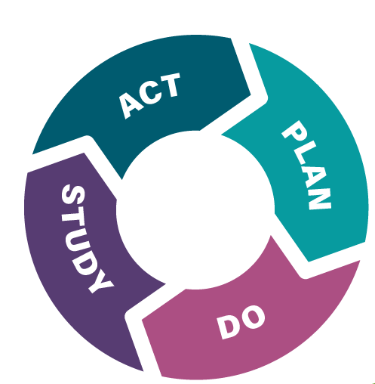
Testing Changes: PDSA Cycles
Plan your test. What is your change idea and what do you predict will happen when you test it?
Do the test and collect the data.
Study the data. Did the results match your predictions? If not, why not?
Act on what you have learned. Are you going to adapt your idea for another PDSA cycle, adopt it into practice or abandon it altogether.

Slide 73
Testing Changes
Example
Change idea: Use a simple text template to increase home BP kit returns.
Prediction: ≥70% of patients texted will return a valid 7-day home BP average within 14 days (vs. our current ~40%).
Test: Send the new text message to 10 patients with raised BP who have a kit at home. Track returns on the log.
Measure: % of those 10 who return readings within 14 days

Slide 74
Displaying Results
Use run charts to track progress over time. Time series data reveals patterns and the impact of changes, which static data — including before/after snapshots and aggregated averages — can hide. Plot a simple line with a median, annotate PDSAs, and use iterative testing to learn and adapt as you go.

Slide 75
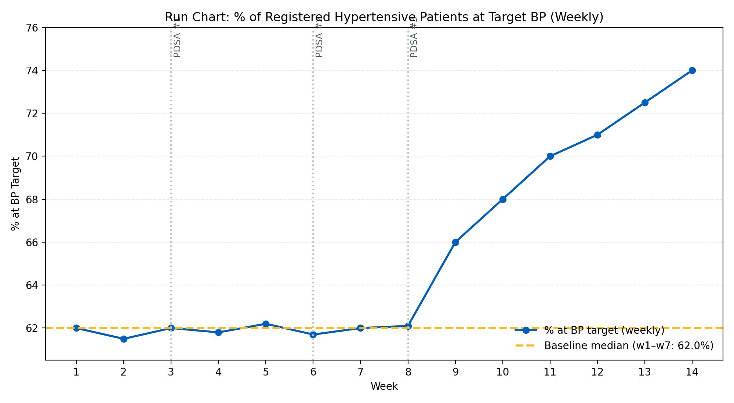
Displaying Results

Slide 76
Standardisation
Lock in what worked so performance doesn’t drift—create simple standard work, agree roles, and keep a light weekly check.
Example
Create a one‑page “BP Optimisation Workflow” showing:
Roles: Admin recalls patients, nurse logs home BP and follows up, GP adjusts medication.
Standard tools: Agreed text template, shared BP log, medication script.
Check: 10‑minute weekly huddle reviewing two measures—home BP return rate and % at BP target—with a plan in place in case they slip.

Slide 77
Reflections and Planning Next Steps
Reflect on what worked well and what didn’t, including any impact on access, workload, or equity. Capture lessons learned and unintended consequences. Use insights to plan the next 90 days—focusing on sustaining gains, spreading successful changes, and addressing remaining gaps.
Example
New workflow and text template increased home BP returns and treatment intensification, with early signs of improved BP control. Admin workload rose during recall weeks and some patients struggled with kit use. Over the next 90 days, the team will refine recall timing, offer brief kit support, and share learning with neighbouring practices.

Slide 78

Additional Resources
Academy Resource Library - NHS Performance and Improvement

Slide 79


Panel Q+A
GMS QI 25/26
Guidance, Templates & Resource

