Slide 1
Guidance on the Use of Structured QI Tools for Enhancing Understanding of the Problem
Charlotte Manning
Improvement Manager

Slide 2
The QI Tools
Process Mapping
5 Whys
Fishbone Diagrams
Pareto Charts

Slide 3

Process Mapping: A Two-Stage Process
1. Create the Process Map
The What
The When
The Where
The Who
The How
2. Analyse the Process Map
The Why
Increased
Understanding of the System

Slide 4
Process Mapping: Starting Broad
Map the process in
6 steps (high level)
GP
Diagnostics
Consultation
Discharge
Follow up
Where’s the issue?
Map that in more detail
Check-in
Observations
Performed
ECG performed
Echocardiogram performed
Echocardiogram reported
Patient to Consultant
And again, where’s the issue?
Map this in more detail

Slide 5

Process Mapping: The Key Principles
Make sure you’ve identified your problem first.
Be clear on where you are starting and stopping.
Look at what really happens, not what should happen.
Make sure you capture what happens most of the time, not the one-offs.
Follow the patient – look at it from their point of view or involve a patient!

Slide 6

5 Whys Case Study
Problem: Medication Round Interruptions
Why? Mainly doctors asking for notes or patient details
Why? Morning ward round is at the same time as medications round
Why? Because this is the time doctors have always done their ward round
Why? Because doctors have never been asked if they can move their ward round
Why? Staff interrupt us
Root Cause: Poor Communication

Slide 7
Benefits of a Fishbone Diagram
Promotes collaboration
Offers visual clarity
Allows you to categorise causes
Encourages the user to look broad as well as deep for causes
Equipment
People
Procedures
Discharge Delays
Measurement
Communications
Materials

Slide 8
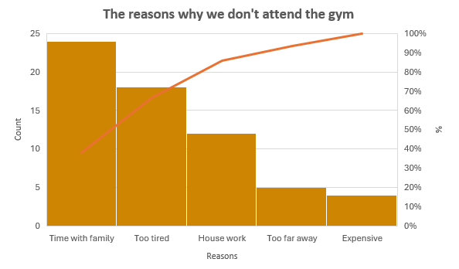
Benefits of Pareto Charts
Enables the prioritisation of issues
Offers Visual Clarity
Promotes data-driven decision making
Displays data in a persuasive way

