Slide 1



Resource pack:
GMS QI Projects 2025-26
This pack is intended to help practices with the Quality Improvement activity and templates to use for the QI posters
Complete pack and individual templates available here
April 2025
Prepared by the Primary Care Division, Public Health Wales on behalf of the GMS Quality Assurance Committee
.
Source: The contents of this pack have been derived from previous GMS QI projects and Improvement Cymru Academy resources.

Slide 2
Contents
 | Page
Top Tips for doing QI projects | 2
Top Tips for writing up the posters……………………………………………………….… | 3
Poster templates – all examples …………………………………………………………... | 4
GMS QI Blank Template PowerPoint……………………………………………………… | 5
GMS QI Blank Template Word style 1…………………………………………………… | 6
GMS QI Blank Template Word style 2…………………………………………………… | 7
GMS QI PPT - Instructions of what to include……………………….............................. | 8
Example of completed model poster – Green Inhalers – Phase 2……........................ | 10
Example of completed model poster – Unhealthy Behaviours…………....................... | 11
Further reading……………………………………………………………………………… | 12
Page 1

Slide 3
Top Tips for doing QI projects
Describe why the issue being tackled by the QI project is a problem for your practice.
Involve the project team in identifying the problem and writing the problem statement.
Decide on one problem at a time and do one test of change (PDSA) for each problem.
Develop your aim based on the question ‘What are we trying to accomplish? ‘
Aims should be SMART
Try not to be too ambitious and do multiple changes at the same time as you won’t know which change resulted in an improvement.
Be pragmatic about what can be achieved in the time you have. Test small cycles rather than whole scale change. Consider taking a sample of patients to test the change.
QI projects are usually more sustainable where a whole practice approach is taken.
Think about who else you may wish to involve outside of your direct practice staff e.g. community pharmacist, health board or cluster professional etc.
Take a baseline measure before you start so you can demonstrate a change. Be clear on the date / time of the baseline.
Tools can be found at the Resource Library and at Improvement Cymru Academy.
SPECIFIC | With specific goals you can outline the steps you need to take to achieve the.
MEASURABLE | You will need to decide a measure to achieve your goal. An example can be a date, time, percentage. This makes your goal tangible and traceable. This type of measure is an outcome measure.
ACHIEVABLE | Set an achievable target. If it’s too ambitious it can be overwhelming and if it’s too easy it can cause limitations within your project.
RELEVANT | Make it purposeful and think about the impact it will make within your control and influence.
TIME BOUND | A time-bound goal will allow you to work within a realistic timeframe.
Page 2

Slide 4
Top Tips for writing up posters
Be concise and use plain English.
Try to stick to 1 page of A4.
Word limit 1500.
Headers and Footer to be left in place.
Sections may be resized at the author’s discretion to make them taller.
Text (font) should be no smaller than 10pt (as in the templates).
Complete all sections.
In the Understanding the problem section write the statement in 18 words or less and make it specific to your practice.
Consider adding discussions at cluster and / or collaborative meetings about the posters in the Involving Others section.
Make the Aim SMART. SPECIFIC, MEASURABLE, ACHIEVABLE, REALISTIC and TIME BOUND.
Report the baseline measures to demonstrate the change and over what period this occurred.
Consider reporting small cycles of change (PDSA) in the DO section even if this means taking a sample of patients rather than a whole scale change .
Report what change the measures show in the STUDY section.
Where possible, use small images, graphs and / or data tables to show change. These can be placed within the appropriate boxes or sections, in line with text or in any gaps.
If using images or graphs don’t forget to add labels or axis so they can be interpreted, resolution is clear, and reference is made to the image / graph in the text.
Once you reflect on the project, report what you plan to do next in the ACT section.
Don’t forget to edit the practice, cluster, contact and health board information by deleting the yellow text and replace with your details.
Page 3

Slide 5
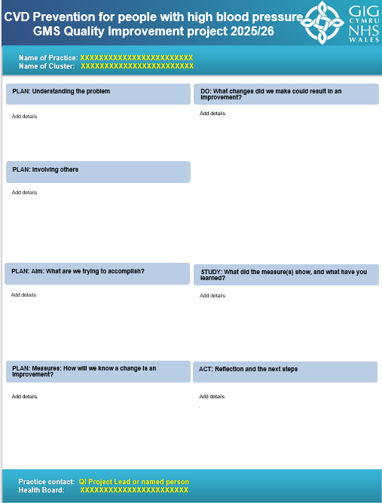
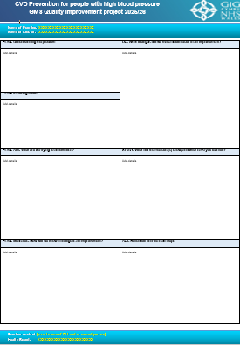
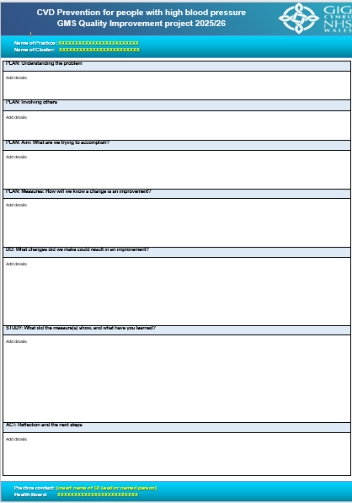
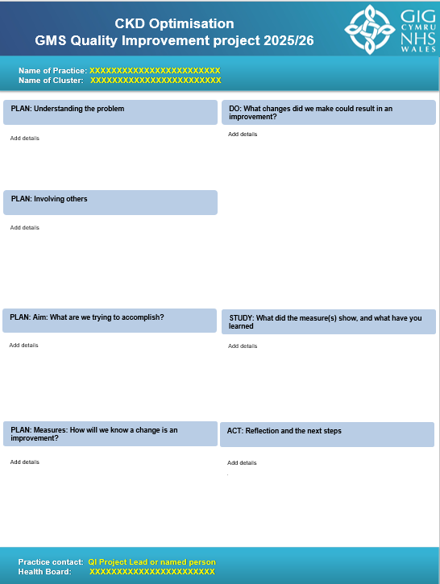
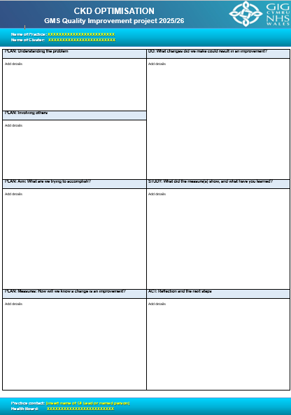
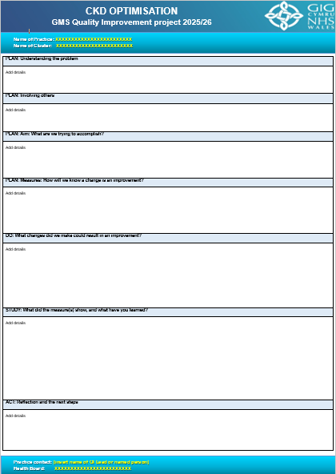
Poster Templates
CVD Prevention Posters
PowerPoint Template Available here | Word style 1 Template Available here | Word Style 2 Template Available here
CKD Optimisation Posters
PowerPoint Template Available here | Word style 1 Template Available here | Word Style 2 Template Available here
Page 4

Slide 6

PRESCRIBING SAFETY
GMS Quality Improvement project 2024/25
PowerPoint style
POSTER TITLE
GMS Quality Improvement project 2025/26
Name of Practice: XXXXXXXXXXXXXXXXXXXXXXXX
Name of Cluster: XXXXXXXXXXXXXXXXXXXXXXXX
PLAN: Understanding the problem
DO: What changes did we make could result in an improvement?
Add details
Add details
Add details
PLAN: Involving others
Add details
PLAN: Aim: What are we trying to accomplish?
Add details
STUDY: What did the measure(s) show, and what have you learned?
PLAN: Measures: How will we know a change is an improvement?
Add details
Add details
ACT: Reflection and the next steps
.
Practice contact: QI Project Lead or named person
Health Board: XXXXXXXXXXXXXXXXXXXXXXX
Contact information: Include website address, social media information such as Twitter handle, other useful contacts
Page 5

Slide 7
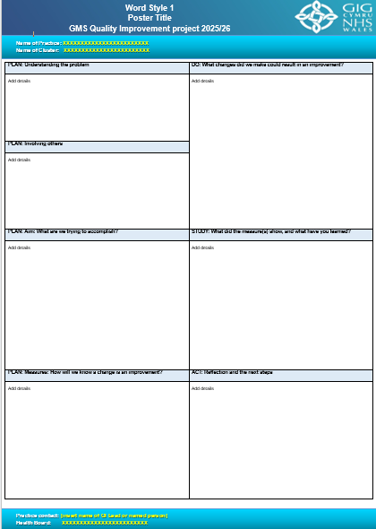
Link to poster template here Page 6

Slide 8

Link to poster template here Page 7

Slide 9
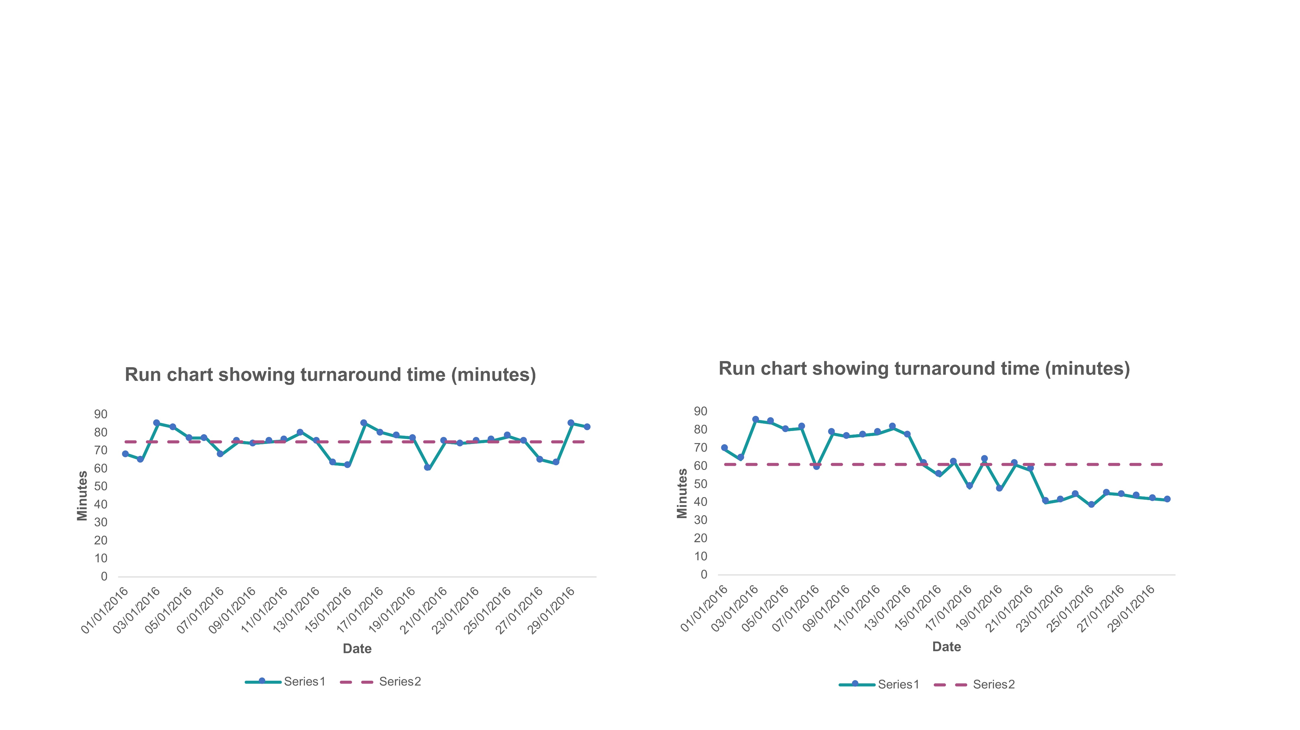
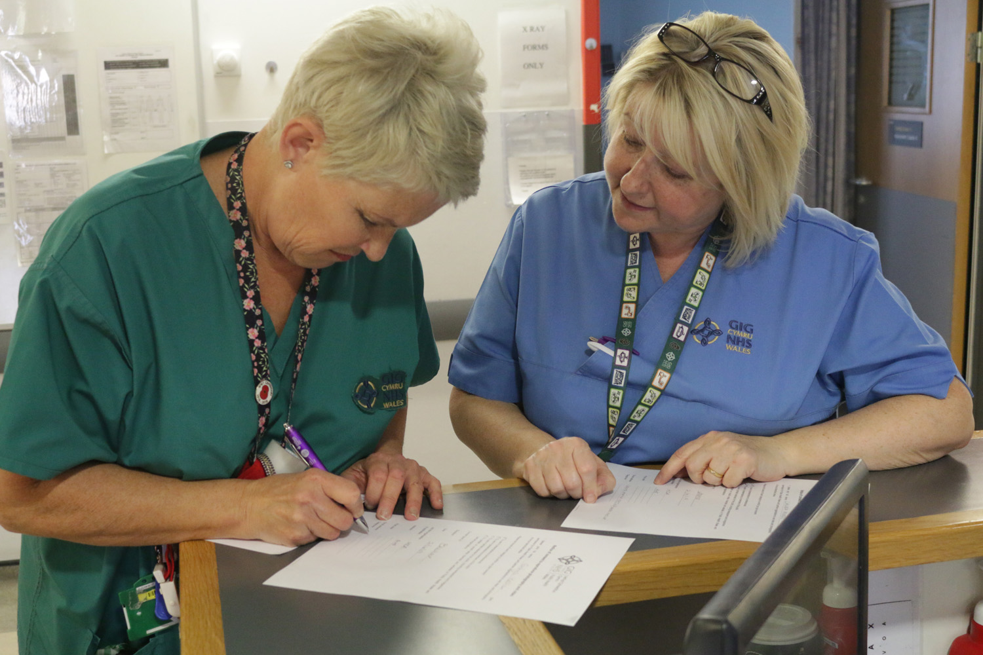
PRESCRIBING SAFETY
GMS Quality Improvement project 2024/25
POSTER TITLE
GMS Quality Improvement project 2025/26
Name of Practice: XXXXXXXXXXXXXXXXXXXXXXXX
Name of Cluster: XXXXXXXXXXXXXXXXXXXXXXXX
PLAN: Understanding the problem
DO: What changes did we make could result in an improvement?
Write a statement in less than 18 words describing the problem in your practice relating to the chosen themes of your chosen option.
The problem should seek to answer ‘‘What issue needs to be addressed and why?’
See Understanding your problem Toolkit and Understanding your system Toolkit
13. Describe the activity that was undertaken to test the change.
Describe a minimum of one test of change (PDSA cycle)
Explain how the project team were involved in identifying potential changes to test.
Record any problems, issues or unexpected that was observed.
Start looking at your data.
Demonstrate the results of the changes, using charts, tables or photographs.
Check the axis and labels of charts or tables are legible.
See Run charts Toolkit
Consider involving the whole practice in the QI project.
Identify project team by role within the practice.
Identify anyone not directly employed by the practice.
Explain how stakeholders have been identified and engaged.
Collaborative discussions.
Do not include personal identification, please see GDPR).
See Involving others Toolkit
PLAN: Involving others
Example Chart
Example Photo
Set a SMART aim linked to the problem identified.
- SPECIFIC: What is the specific population?
- MEASURABLE: What are you measuring?
- ACHIEVABLE: What are you trying to achieve?
- REALISTIC: Is it relevant / realistic?
- TIME BOUND: What is the timeframe?
See Developing your smart aim Toolkit
PLAN: Aim: What are we trying to accomplish?
Analyse the results.
Identify signals of improvement when the tests of change took place.
Evaluate the results and identify learning i.e. Adopt, Adapt, Abandon.
Evaluate the roles of those involved in the improvement project.
Identify priorities for future improvement projects.
STUDY: What did the measure(s) show, and what have you learned?
10. Decide what type of measure(s) or combination of measures to use.
- OUTCOME measures tend to be linked to the aim and the end result.
- PROCESS measures reflect what are you doing differently.
- BALANCING measures describe any impact elsewhere.
11. Are measures quantitative or qualitative or both?
(e.g. run charts or qualitative feedback over time).
12. Describe what baseline data was used and what it tells you.
See Family of measures & operational definitions Toolkit and Measurement Plan Toolkit
PLAN: Measures: How will we know a change is an improvement?
ACT: Reflection and the next steps
Describe key lessons learned from the project.
Consider embedding the successful change idea(s) tested during the QI project into routine practice.
What will you do next?
See Implementation Toolkit and Spread and Scale Toolkit
Practice contact: QI Project Lead or named person
Health Board: XXXXXXXXXXXXXXXXXXXXXXX
Contact information: Include website address, social media information such as Twitter handle, other useful contacts
Page 8

Slide 10
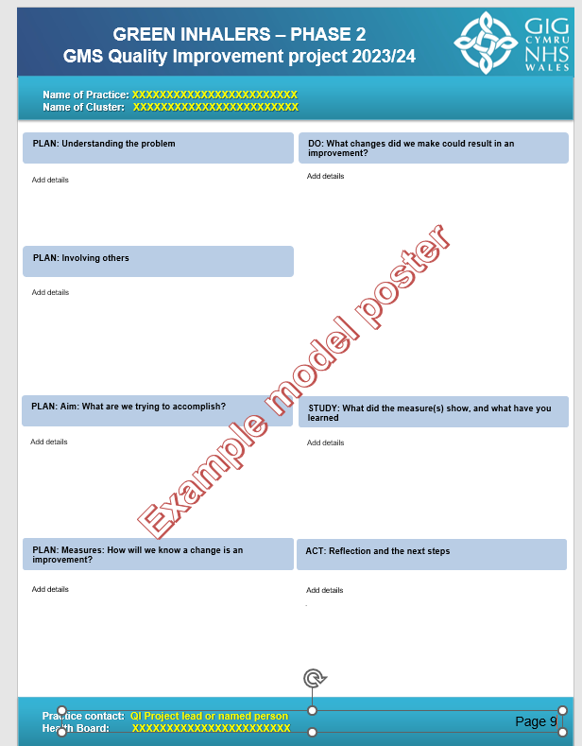

Model poster examples
Two posters have been mocked up as example model posters of good practice.
These have been based on the topic QI project areas from 2023/2024.
1. Green Inhalers – Phase 2
2. Unhealthy Behaviours
The content of these example model posters have been taken from different sections of a variety of original posters submitted as part of the GMS QI project during 2023/24.
These example posters can be read on Page 10 and 11 of this Resource Pack
Page 9

Slide 11
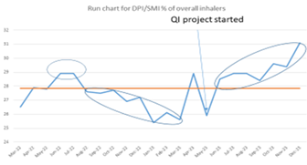
PRESCRIBING SAFETY
GMS Quality Improvement project 2024/25
GREEN INHALERS – PHASE 2
GMS Quality Improvement project 2023/24
Name of Practice: XXXXXXXXXXXXXXXXXXXXXXXX
Name of Cluster: XXXXXXXXXXXXXXXXXXXXXXXX
PLAN: Understanding the problem
Table 1 - % change in indicators between March 2023 & December 2023
The number of DPI and SMI inhalers (low GWP) has increased by 11.71% over a 10-month period. (Table 1 and Figure 1)
Carbon Footprint per 1000 patients (CO₂Kg) was reduced by 9.02% over a 10-month period. (Table 1 and Figure 1)
The number of patients at risk also reduced from 98 in April 2023 to 42 in March 2024.
Figure 1 – trend in DPI/SMI use March 2022 – December 2023
In March 2023, only 20% of inhalers prescribed by the practice were DPIs/SMIs against an 80% target.
STUDY: What did the measure(s) show, and what have you learned
 | Mar 2023 | Dec 2023 | Progress
DPI and SMI items as a percentage of total items | 20% | 32% | 12%
Carbon Footprint per 1000 patients (CO₂KG) | 1712 | 1558 | - 9.02%
PLAN: Involving others
The project was achieved by involving various people within the practice (Project Lead, clinicians, asthma nurse, dispensary team and patients) and the collaborative group. A collaborative meeting was held on Jan 18th, 2024, to review the progress of the project.
By the end of December 2023, we aim: (1) to increase by 100% the percentage of low Global Warming Potential (GWP) salbutamol inhalers (2) to reduce the practice’s carbon footprint due to inhalers per 1000 patients by 5% (3) to increase the number of DPI and SMI (low GWP) inhalers by 10%
PLAN: Aim: What are we trying to accomplish?
Example model poster
PLAN: Measures: How will we know a change is an improvement?
SPIRA data will be used to measure % of DPI/SMI prescribing and CO2 footprint.
We decided as a practice to use lower GWP inhalers first line when appropriate.
We developed a low GWP inhaler formulary which was given to the clinicians to consider when prescribing to patients for the first time or switching from a non-green inhaler.
A search was run to find high risk patients with high reliever inhaler usage and were reviewed by the asthma nurse. Those patients had their reviews prioritised.
Patients prescribed a reliever without a preventor were reviewed and a ‘Green’ preventor was prescribed if appropriate.
Patients prescribed a reliever on repeat without a diagnose of asthma or COPD were reviewed.
During asthma reviews patients were switched to a low GWP alternative inhalers if appropriate. Those that could not use the alternative were coded to say it was not appropriate so that patient is not recalled.
We have set up quarterly reviews between the lead clinician, asthma nurse and head of dispensing to discuss progress. This will continue during 2024 to help achieve our target for 2025.
We have advertised the importance of choosing “Green Inhalers” on our inhouse information TV and online on our Facebook page.
DO: What changes did we make could result in an improvement?
What we learned
The importance of getting engagement from the whole practice team when trying to implement change. It can be difficult to get practice staff to all attend a training event due to staff availability. Consider other ways of disseminating information e.g. emailing presentations/ recording event.
Using a mass communication approach to inform patients is an efficient way of providing education however it did not lead to a large change in the %DPI/SMI data although it is noted that this will take time to change.
Patients are responsive to change when they are provided with information in a way that they can understand and are provided the rationale for change. It is important to fully involve patients in decision making about their care.
Next steps
There is still a way to go to meet the WG target of 80% DPI/SMIs of overall inhalers by 2025 and to reduce patients being prescribed SABA inhalers however we have made a positive start and aim to continue in this direction by undertaking face to face reviews with patients and optimising their treatment in line with the All Wales COPD and asthma guidelines.
ACT: Reflection and the next steps
.
Practice contact: QI Project lead or named person
Health Board: XXXXXXXXXXXXXXXXXXXXXXX
Contact information: Include website address, social media information such as Twitter handle, other useful contacts
Page 10

Slide 12
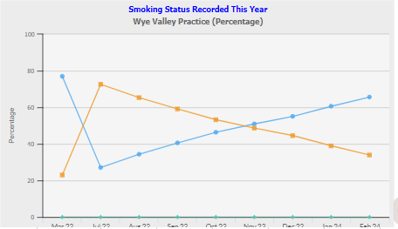
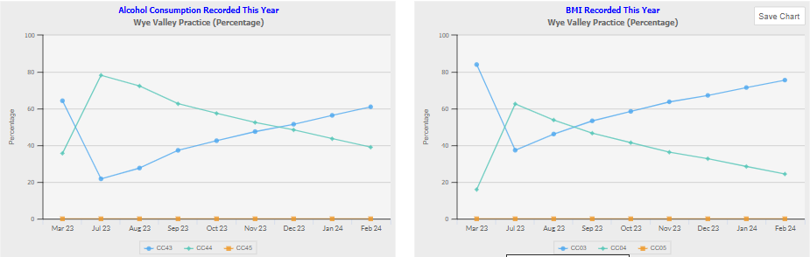
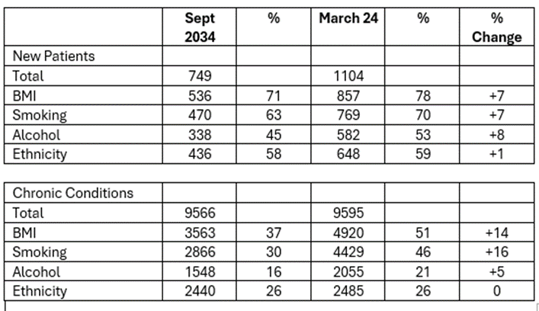
PRESCRIBING SAFETY
GMS Quality Improvement project 2024/25
UNHEALTHY BEHAVIOURS
GMS Quality Improvement project 2023/24
Name of Practice: XXXXXXXXXXXXXXXXXXXXXXXX
Name of Cluster: XXXXXXXXXXXXXXXXXXXXXXXX
PLAN: Understanding the problem
DO: What changes did we make could result in an improvement?
Recording of data concerning ‘unhealthy behaviours’ for both newly registered patents and patients with long term chronic conditions was varied.
Amendments were made to the new patient registration form.
Changed process for registration, including new online feature.
Amended Vision templates used in chronic conditions reviews to include unhealthy behaviours data.
The GP Project lead completed an educational module on hazardous alcohol behaviour and training was provided to the clinical team on motivational interviewing and brief interventions.
The nursing team had training on read coding etc when reviewing patients.
The health care assistants and reception team ensured the new patient questionnaires were completed and efforts to arrange face to face appointments for new patient checks were done. Every clinician completed the Vision ‘Carrot Screen’ at medication and chronic condition reviews which Read Codes the information we were looking.
Patient information offered via smoking cessation leaflets and directing patients to new website which includes new online information about unhealth behaviours and support available to patients.
Everyone in the Practice was involved. The whole clinical team, the reception team, admin team and management were aware of the importance of this work.
PLAN: Involving others
We decided to focus on recording data on alcohol, smoking, BMI, using agreed Read Codes for new registrations & existing patients with diabetes, stroke, heart failure, IHD, AF, Hypertension, Asthma and COPD.
We also agreed to document any interventions offered, such as a referral to the Healthy Weight: Healthy Wales, the All-Wales Weight Management Pathway, the National Exercise Referral Scheme, Help Me Quit or the All-Wales Diabetes Prevention Programme.
Due to the number of patients involved we will take a mixed method approach to collect this data through questionnaires and face to face appointments.
We decided to review progress at least quarterly from the start date of September 2023 but use March 2023 data as a baseline. .
PLAN: Aim: What are we trying to accomplish?
The data from the PCIP Dashboard for newly registered patients shows a slow but steady improvement in our recording of alcohol consumption (now at 42%) , BMI (45%) and smoking status (43%). In blue below.
The data from the PCIP Dashboard for chronic diseases shows an excellent improvement in our data collection (eg BMI 38% to 78%)
STUDY: What did the measure(s) show, and what have you learned
Example model poster
Smoking status recorded this year
Alcohol consumption recorded this year
PLAN: Measures: How will we know a change is an improvement?
We had not gathered data on this before, so had no baseline readily available.
We used data from the PCIP Dashboard for newly registered patients and Read Code capturing within new patient checks and all ‘chronic condition appointments’
We decided to agenda a discussion on our progress at every monthly clinical meeting to remind ourselves of the importance of this work. We then planned a formal data collection every 3 months.
BMI recorded this year
.
Reflection: We discussed the unexpected unintended consequence of patients not disclosing medical information to their clinicians if asked about their behaviours. For example, excessive alcohol consumption may present a risk to their driving or shot gun license - an issue of concern for many patients in rural Wales. As a result, we elected to document units of alcohol consumed rather ‘Harmful or Hazardous alcohol consumption’ unless there was clear evidence for these. We have delegated read-coding to upskilled non-clinical staff to ease the significant workload for clinicians, particularly for the new patient questionnaires.
Next steps: Although changes that have been made there is still work to be done as some patients are not being asked about their behaviours, we will continue to work on this. The challenge of significant workload may have also impacted our capacity to focus on this at every patient contact.
ACT: Reflection and the next steps
Practice contact: QI Project lead or named person
Health Board: XXXXXXXXXXXXXXXXXXXXXXX
Contact information: Include website address, social media information such as Twitter handle, other useful contacts
Page 11

Slide 13
Further reading & Resources
CVD Prevention for people with high blood pressure - QI Project
Practice Guidance Document – CVD Prevention in people with high blood pressure
CKD Optimisation - QI Project
Practice Guidance Document – CKD
QI in general
How to Improve | IHI - Institute for Healthcare Improvement (Video) Getting started with quality improvement (1 page graphic with links to Improvement Cymru Academy Toolkits) Improvement Cymru Academy and Resource Library GMS Quality Improvement 2025 – 2026 – Primary Care One
Please contact your health board if you require any further information not covered in this Resource Pack.
Page 12

