Slide 1





Addressing the health and wellbeing needs of Asylum Seekers and Refugees Webinar
Webinar
30th January 2025

Slide 2
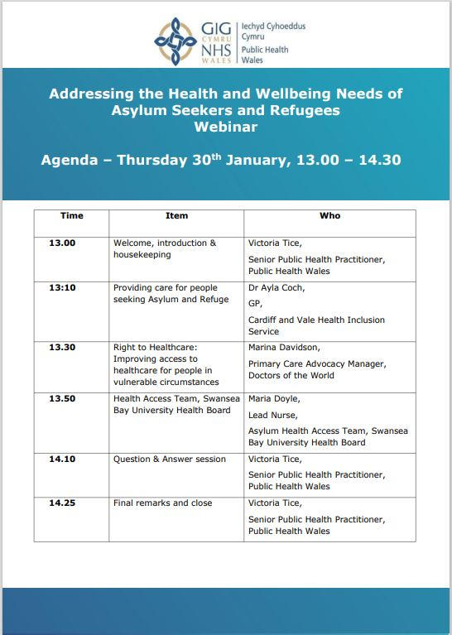
Agenda

Slide 3


Providing care for people seeking Asylum and Refuge
Dr Ayla Cosh
Clinical Director
Cardiff and Vale Health Inclusion Service

Slide 4
Context
What does CAVHIS provide?
Barriers to accessing care
Case Study

Slide 5
Refugee
A person who ‘owing to a well-founded fear of being persecuted for reasons of race, religion, nationality, membership of a particular social group, or political opinion, is outside the country of his/her nationality, and is unable to or, owing to such fear is unwilling to avail himself/herself of the protection of that country.’
Article 1, 1951 Convention Relating to the status of refugees
Asylum seeker
A person who is seeking protection under well-established international law and is awaiting a decision on their claim.
If accepted, they are granted refugee status.

Slide 6

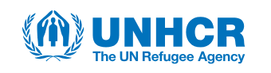
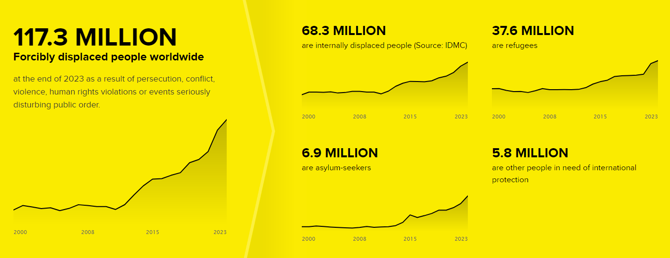
Last updated June 2024

Slide 7
73% Originate from 5 countries:
Afghanistan
Syria
Venezuela
Ukraine
South Sudan
47 million are children
2 million are born as refugees
75% are hosted in low and middle income countries
39% are hosted in 5 countries:
Turkiye
Islamic Republic of Iran
Columbia
Germany
Pakistan
69% are hosted in neighbouring countries

Slide 8
Factors impacting health
Home Country Experiences
Poverty/malnutrition - Health systems and access - Health literacy -Health beliefs
Infectious disease prevalence - Immunisation rates – non-management of chronic disease - FGM
Injuries (can be untreated)
Sexually transmitted diseases
Pregnancy
Interruption /collapse of healthcare services
Mental health eg acute stress reaction, PTSD
War
Violence/torture
Sexual violence
Imprisonment
Natural disaster
Threat
Event/
Journey

Slide 9
Mental and physical effect of event/journey/arrival
Loneliness, isolation, hostility, discrimination
Asylum claim takes priority over health
Diseases of poverty
Access barriers - poor understanding of health system, language/cultural differences, transport
Interruption in healthcare
UK Asylum System
£5.84/day per person for food, sanitation, clothing, travel, phone credit, nappies
Not allowed to work
Housing provided - ‘temporary’ and ‘permanent’ accommodation
Uneven distribution around the UK (0.3/1000 S.East, 1.3/1000 Wales, 2.3/1000 N.East)
End Dec 2021, 1179 people held in detention centres
In Wales, health care entitlements the same as local population

Slide 10
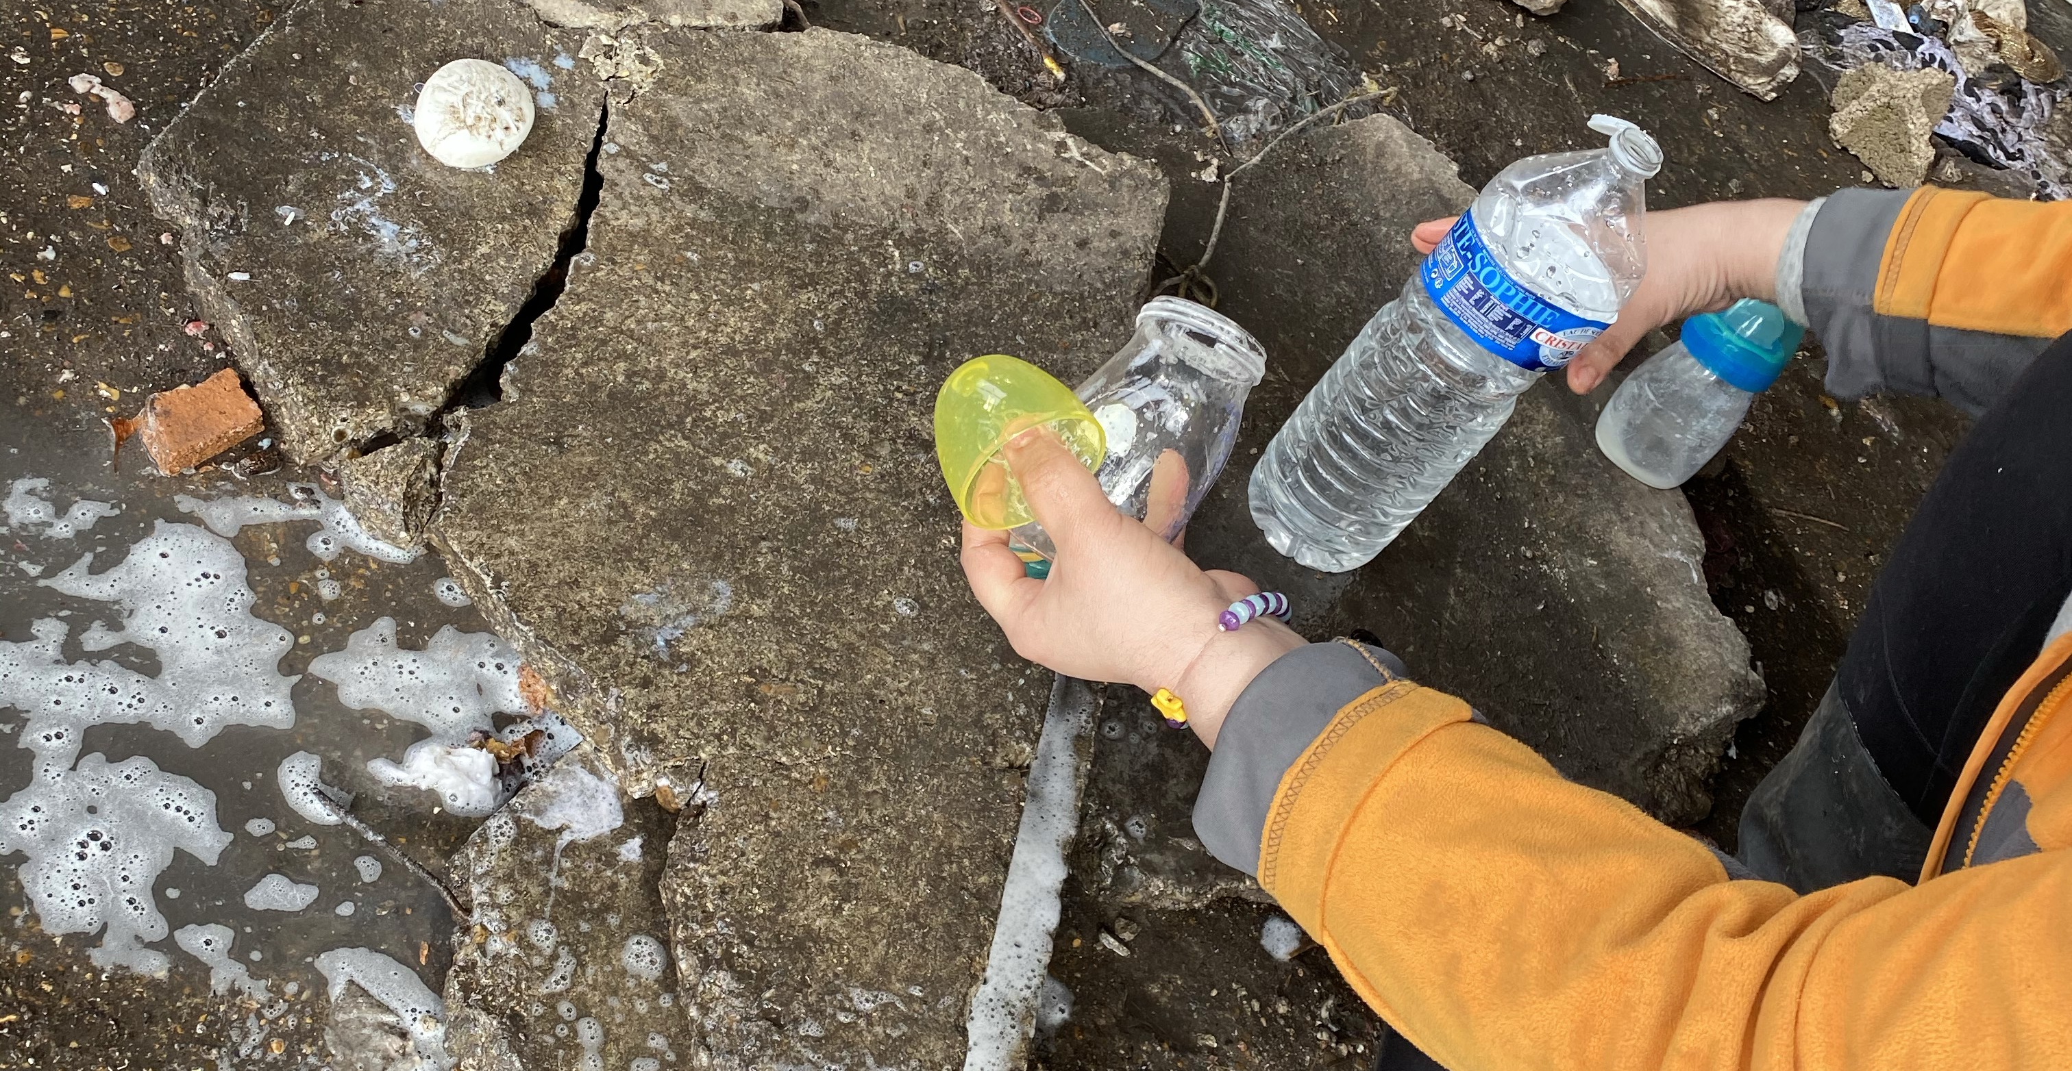
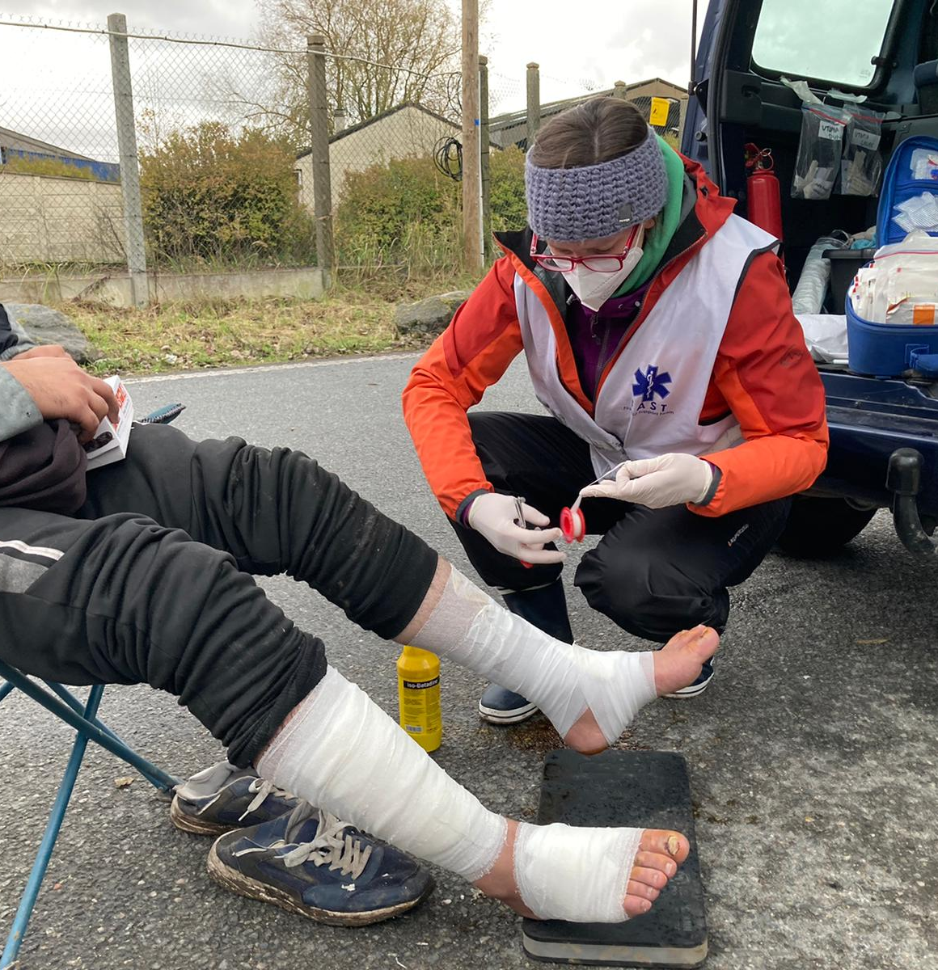
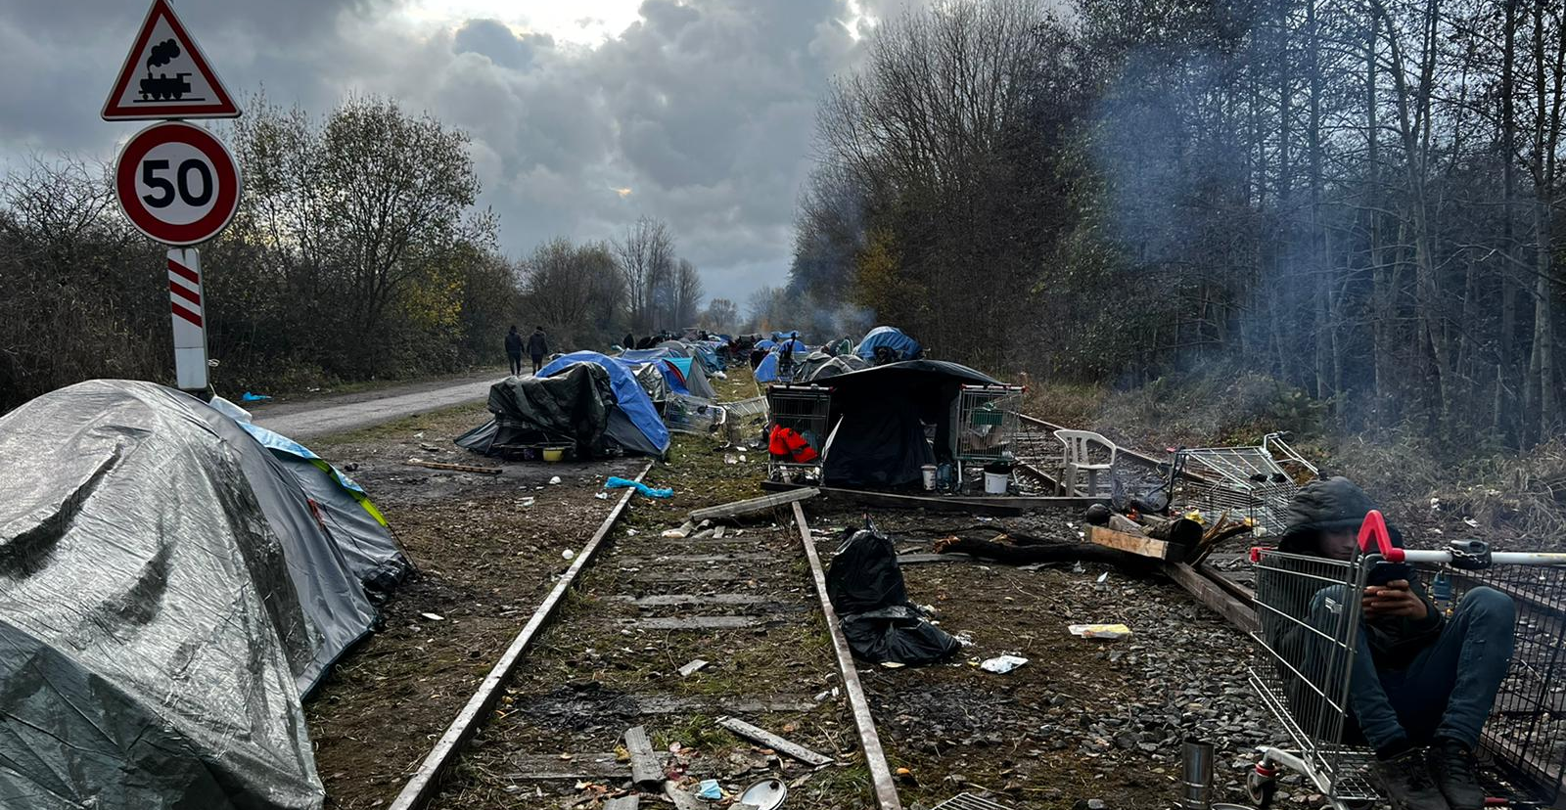

Slide 11
Cardiff and Vale Health Inclusion Service

Slide 12
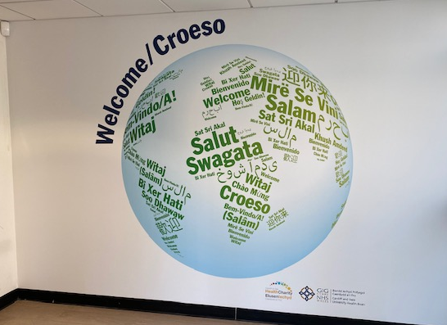

Slide 13
What is CAVHIS?
Evidence based Health and Public Health screening for: -
new arrived people seeking asylum,
people under Home Office refugee resettlement programmes,
survivors of trafficking and those who are destitute and facing ‘No recourse to public funds’.
General Medical Service care for individuals under Section 98 of the Immigration and Asylum Act 1999
Limited urgent primary care for multiply excluded single homeless individuals via outreach clinics into various frontline hostels.
An Alternative Treatment Scheme – primary care for individuals who due to episodes of violent behaviour, after formal risk assessment, are judged to need a security presence.
Spring 2025 – outreach to sex parlours/probation services/mobile RGT unauthorised encampments

Slide 14
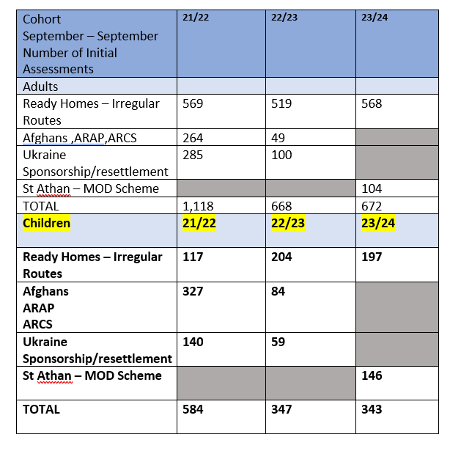
Common Languages
Albanian
Amharic
Arabic
Bengali
Dari
Farsi
French
Kurdish Sorani
Mandarin
Pashto
Portuguese
Punjabi Pakistani
Somali
Spanish
Tigrinya
Turkish
Urdu
Vietnamese
Number of Children screened

Slide 15

Process for newly arrived people seeking asylum and refugee resettlement schemes
Individual sent an invitation letter regarding assessment and screening
(Clear springs portal/language)
1 hour nursing appointment for comprehensive health assessment
Translators
BBV/TB/Parasite screening
Mental health screening
Vaccinations
Offer of third sector support
Normal screening, nil else needed
Exit to GMS – BRC to help register
Individual attends clinic
Welcome pack
Introductory letter
Registration – NHS number
Health Concerns
Needs further social/community/holistic support
GP Appointment
Exit to GMS –BRC to help register
Referred to British Red Cross
Secondary/community services Care appointment

Slide 16
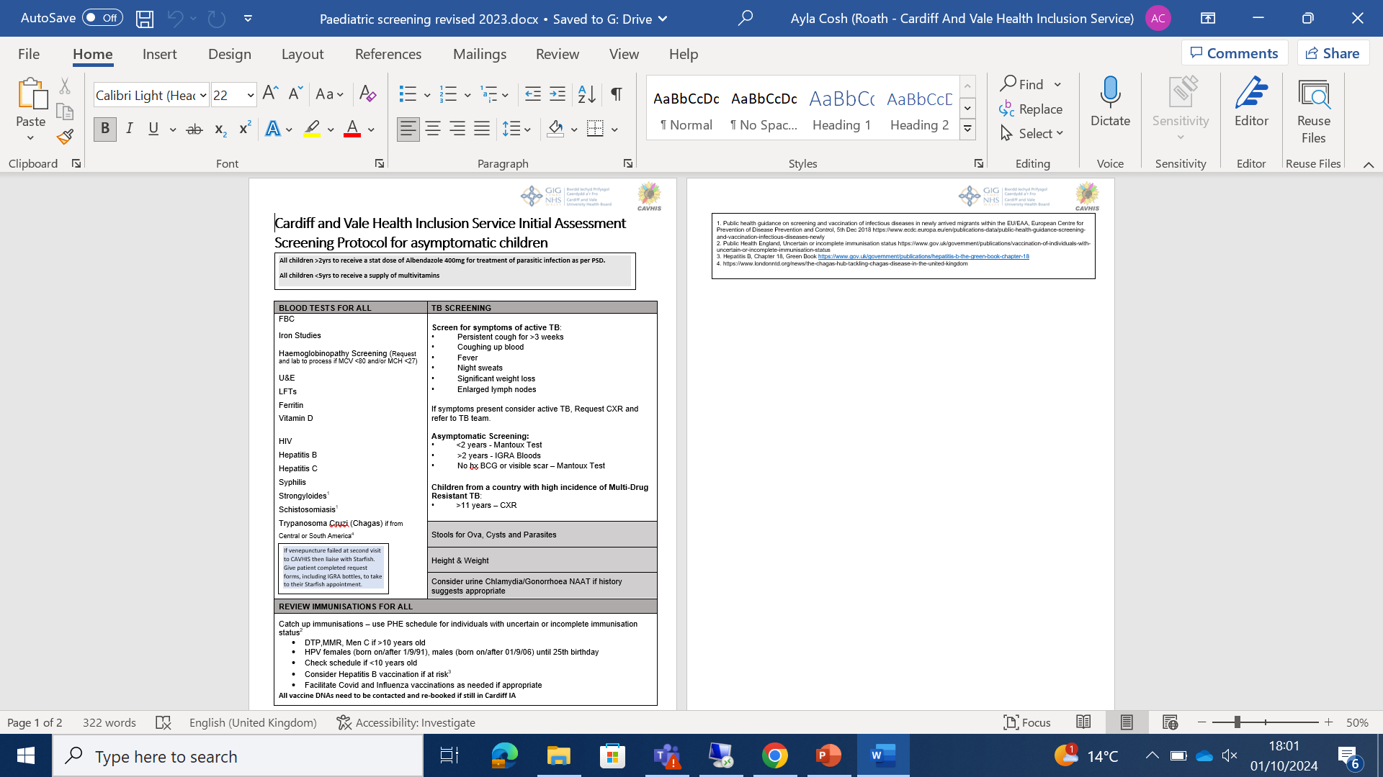
Differences with Adult Screening:
Exclude Vitamin D
Exclude Mantoux
Urine STI screening offered as routine
Exclude blanket Albendazole

Slide 17
Conditions seen
Iron deficiency anaemia
Haemoglobinopathies
Vitamin D deficiency
Parasitic infection
BBV
Helicobacter pylori (not screened for)
Latent TB
Dental decay
Un- diagnosed chronic conditions/developmental conditions
Traumatic stress + PTSD
Anxiety + Depression
Safeguarding issues

Slide 18

Barriers to accessing care - Groups

Slide 19
Barriers in registering with GPs
Language and literacy problems with filling in forms
Registrations being done at very narrow and specific time windows with minimal assistance.
IT Poverty and being asked to register on line
Lack of ID leading to refusal to register – photo ID, Passports
Practices declining to register asylum seekers or travellers
Nomadic nature of individuals due to sofa surfing, moving in and out of the city, often destitute – not staying within practice geographical areas
Individuals needing to/wanting to stay under the radar and using multiple aliases

Slide 20
Barriers to accessing care once registered - Patient:
How does it work?? Every practice different
Information in English/Welsh
Lack of translators being used
Directed to e-consult when are unable to read/write and don’t have IT
Long multiple option recorded messages on phoning practices which can be confusing and expensive with regards to phone credit
Fixed appointment times which are often unable to be kept due to difficult situations and health not being a priority
10 minute appointment times allowing little time to articulate problems via translation services

Slide 21
Barriers to delivering care – Health Professional
10 minute appointment times allowing little time to manage complex problems putting GPs under pressure
….. More pressure on unscheduled care services EU/CAV24/7 but no clear coding
Difficult to address probs opportunistically due to time constraints.
Minimal time to step back in acute services and think about an approach
Services spread across city and rarely co-located
Lack of understanding of the asylum system/context in which people present
Burn out – insoluble problems with no extra resource
Minimal coding… minimal evidence…. Minimal funding

Slide 22
Tekle
?19yr
PMH
Current
Health problems
Current situation
Eritrea – UK
Little English
Parents and older brother murdered.
PTSD.
No ID, HO documented his dob making him 19 when he said he was 16.
Undergone age assessment – stated to be 19.
Support removed.
No known PMH.
Never seen a health professional.
Beaten by police – in Libya – injury to left arm.
Chronic oozing wound on chest wall.
Injury to left arm – unable to use it properly.
Chronic oozing skin lesion on chest wall
PTSD/Traumatic stress
Low mood
Screening completed at CAVHIS
+ve IGRA but DNA TB app
In HO house under sec 95
Registered with a local GP but never been
Linked in with English classes/3rd sector but isolated
No phone

Slide 23
Wound on chest wall getting worse
Increasing in size, becoming inflamed with more exudate
Went to his GP to see Dr, turned away by reception and advised he had to phone to make an appointment.
Didn’t phone – doesn’t have a phone, gets anxious about speaking on the phone, difficult to due language barrier.
Goes back a couple of weeks later as getting worse – explains at reception
Given an appointment for week after
Misses this appointment, now feeling unwell. Pyrexial, off food, swelling of chest wall
Goes back with support from a friend and another appointment made for next day.
Feels too ill to wait – presents at CAVHIS – walks in as has been there before.
Pyrexial, tachycardic, large discharging swelling on anterior chest wall with cellulitis.

Slide 24
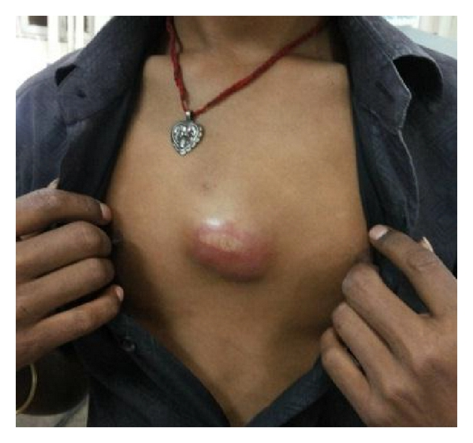
Admitted to hospital for IV Antibiotics for staph infection and drainage/packing.
What else did he have?

Slide 25
Tuberculous Abscess

Slide 26
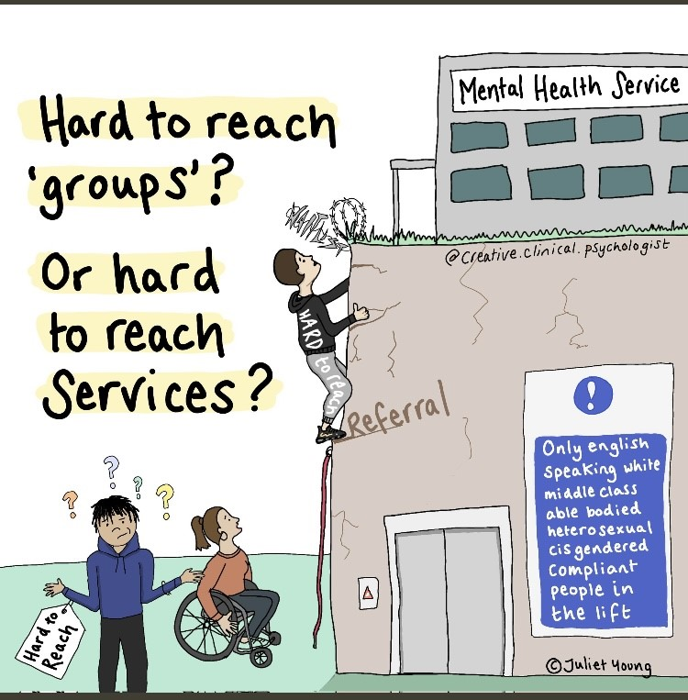

Slide 27
Thank You
SPASIBO
ASANTE
MERCI
DIOLCH
TACK
நன்றி
ευχαριστώ
ਤੁਹਾਡਾ ਧੰਨਵਾਦ
SHUKRAAN
GRACIAS
NA GODE

Slide 28
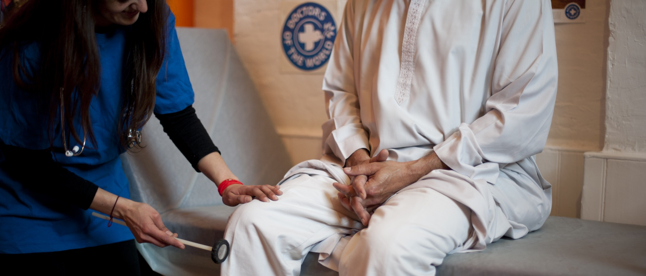

RIGHT TO HEALTHCARE
Improving access to healthcare for people in vulnerable circumstances
Marina Davidson, Primary Care Advocacy Manager Doctors of the World UK, part of the Médecins du Monde network

Slide 29


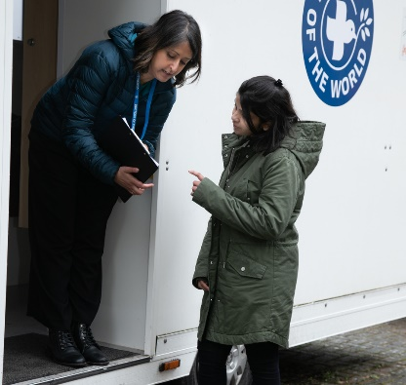
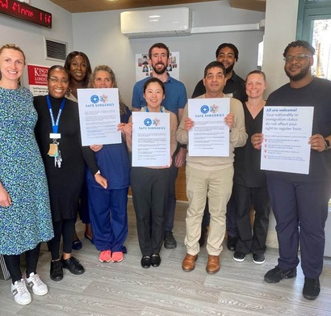
Our work in the UK
SUPPORTING GP PRACTICES
Safe Surgeries initiative: network of GP practices across the UK working to improve registration processes and reduce health inequalities
ADVOCATING FOR CHANGE
DIRECT SUPPORT TO INDIVIDUALS
Supported by our volunteer team of 35 Experts by Experience we aim to make systemic changes to how those currently excluded from healthcare can access health services
Our team of volunteer doctors, nurses and caseworkers provide medical advice and support to people in the UK who cannot access healthcare through our primary care clinic and advice line
Notes:
90% are asylum seekers, refugees or migrants.
70% are in unstable accommodation.
84% live below the poverty line.
On average, our patients have lived in the UK for over five years before accessing our services.

Slide 30

Importance of healthcare access
Human rights
UK is bound to give equal access to the right to health for all persons
NHS principles
Core principle of the NHS is that it provides a ‘comprehensive service, available to all’
Public health
Prevention and early detection of disease
Vaccination programmes
Health equity
Cost effective
Promotes a fairer society
Financial + human cost of delayed access to care and preventative interventions

Slide 31
Immigration status
Asylum seeker
A person who has left their country of origin and applied for asylum in another country but whose application has not yet been concluded.
Refused asylum seeker
A person whose asylum application has been unsuccessful
Refugee
Undocumented migrant
Someone who enters or stays in the UK without the documents required under immigration regulations.
Someone whose asylum application has been successful. The Government recognises they are unable to return to their country of origin owing to a well-founded fear of being persecuted

Slide 32

Social determinants of health
the conditions in which people are born, grow, live, work, and age, including factors such as, education, physical environment, employment, social support networks, as well as access to healthcare, that significantly influence health outcomes and quality of life.
Migration and displacement are social determinants of health…
Barriers to accessing services
Access to healthcare in country of origin
Circumstances of migration
Life experiences prior to migration
Circumstances in the UK
Every individual, no matter where they are from has unique health needs Asylum seekers, refugees and other migrants face similar health problems to the general UK population, but some factors may affect their health needs:
BMA Refugee and asylum seeker patient health toolkit

Slide 33
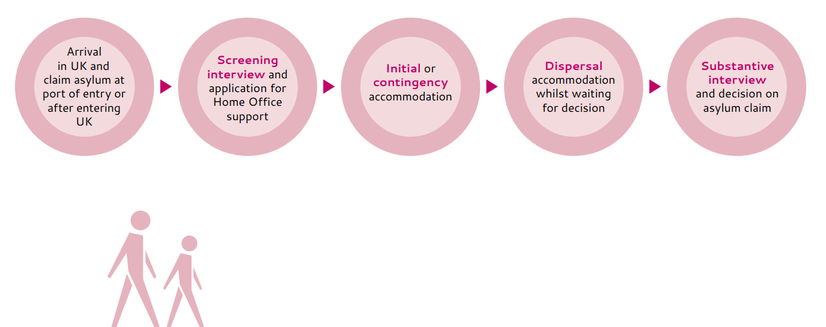
Asylum process
No recourse to public funds, no right to work (with few exceptions)
May be entitled to Home Office support (£8-£49 per week – catered/self-catered accommodation)
Frequent and short notice moves, barriers to healthcare access and poor nutrition
Waiting for an asylum decision can take years – prolonged periods of uncertainty, stress and impact on mental health
28 days notice to vacate Home Office accommodation after decision is made – homelessness risk
https://www.doctorsoftheworld.org.uk/wp-content/uploads/2023/07/Toolkit-for-ICBs-and-PC-commissioners-access-to-healthcare-for-asylum-accommodation-DOTW-2023.pdf
Notes:
Without the right assistance, challenges accessing employment, benefits and housing. Increased risk of homelessness, exploitation and destitution.

Slide 34



Entitlement to healthcare
In the UK, refugees and asylum seekers with an active application or appeal are fully entitled to free NHS care (primary and secondary care). This also includes refused asylum seekers in Wales
Immigration status and residency are not relevant to entitlement to primary care services
Proof of ID or address documents are not needed to register with a GP - if a patient is not able to provide identity documents, it is not reasonable grounds to refuse registration

Slide 35
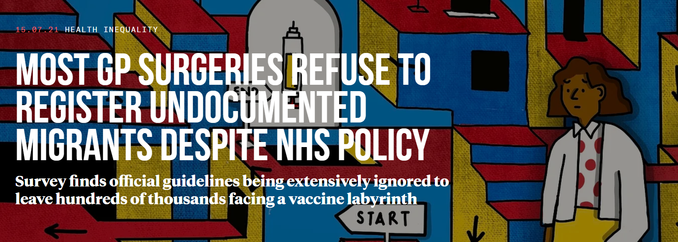


The Bureau contacted around 1/3 of GP practices in 10 locations across the UK. They asked about registering a hypothetical patient: “Rosa”, a woman in her 40s without ID or proof of address:
62% said they would not register the patient
14% were unsure
Only 24% of GP surgeries surveyed in the UK would register someone without proof of address, ID or legal immigration status
https://www.thebureauinvestigates.com/stories/2021-07-15/most-gp-surgeries-refuse-to-register-undocumented-migrants

Slide 36









Barriers to accessing healthcare
Accessibility: language, literacy, digital, telephone
Lack of knowledge on navigating the NHS/entitlement
Immigration status checks, fear of data sharing and Home Office reporting
Lack of ID or proof of address
Fear /experience of judgement and prejudice
Lack of funds for suitable transport to attend appointments

Slide 37


Barriers to accessing healthcare
Proof of ID or address?
People who are undocumented
Survivors of trafficking or modern slavery
Children born in the UK to parents without documentation
People who cannot afford to renew documents e.g. passport
People fleeing domestic abuse staying with friends, family or in a shelter
People working in exploitative situations whose’ employer has taken their documents
People seeking asylum and refugees who have lost documents during their journey to the UK
People who have submitted documents to the Home Office for application
People living on a boat
People with no fixed address (unstable accommodation, sofa-surfing, street homeless
Young people leaving care

Slide 38
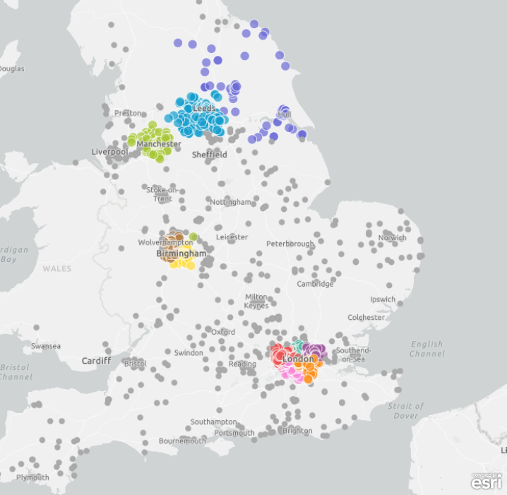
What can be done?
Building an expert community against health exclusion
A network of GP practices demonstrating adherence to NHS guidance and making commitments to tackle barriers to healthcare faced by underserved communities
Launched by DOTW in 2018, in partnership with primary care - recognising pressures and increasing workloads facing GP practices
Free training, resources and support
2,000+ Safe Surgeries across the UK…

Slide 39

What can be done?
Notes:
https://youtu.be/dQ7yLj-b8qY

Slide 40
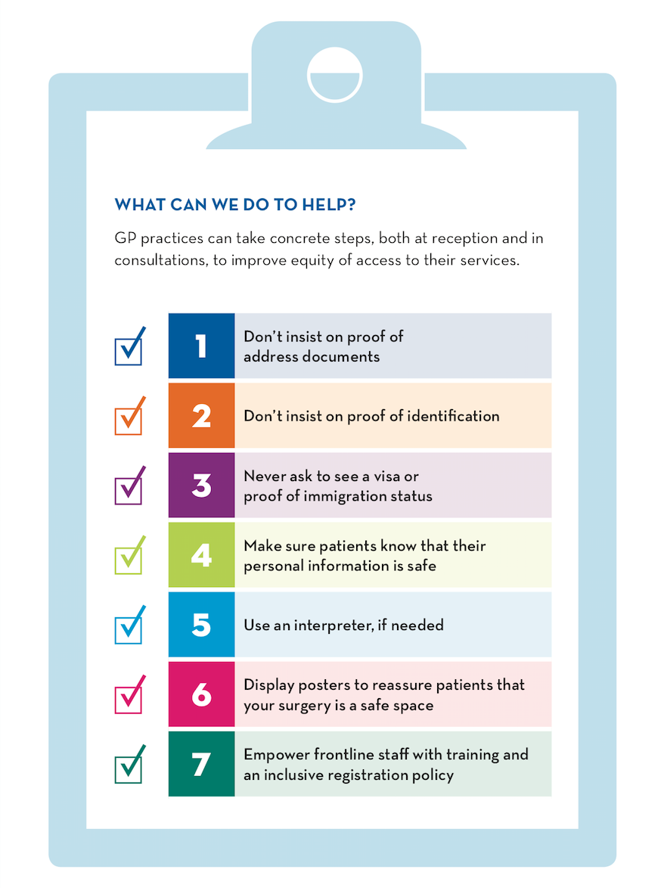



7 steps for safe registration
https://www.doctorsoftheworld.org.uk/safesurgeries/safe-surgeries-toolkit/

Slide 41
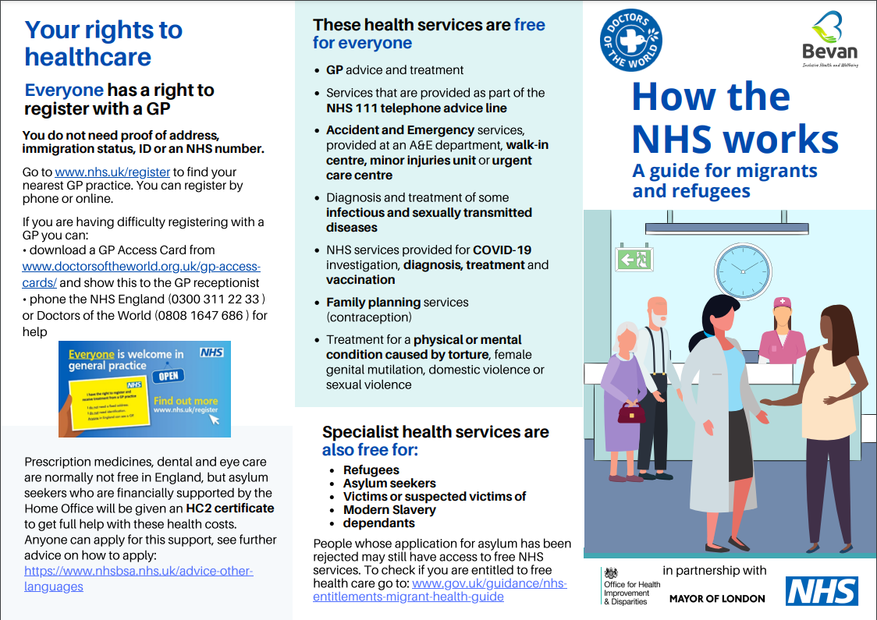
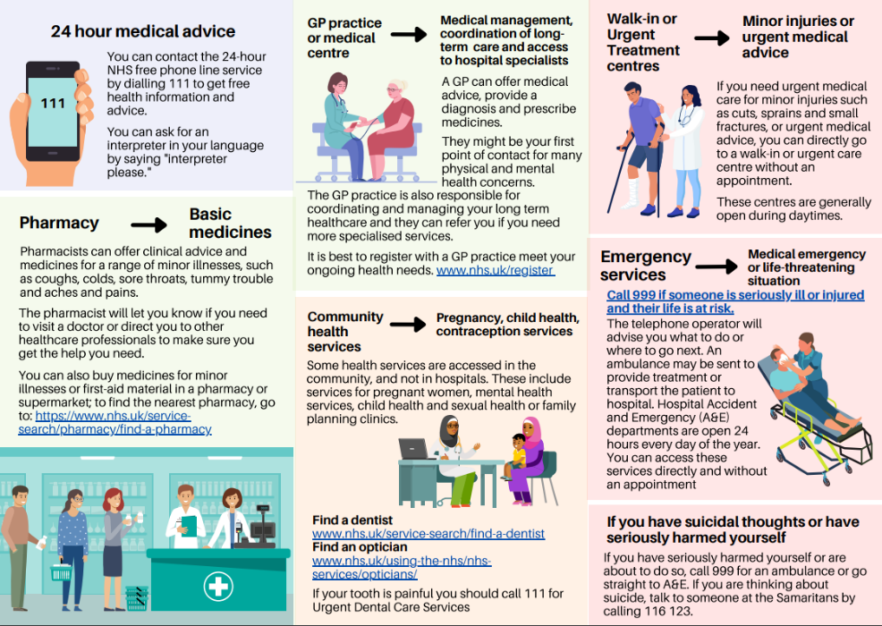
Translated resources
https://www.doctorsoftheworld.org.uk/translated-health-information/?_language=

Slide 42
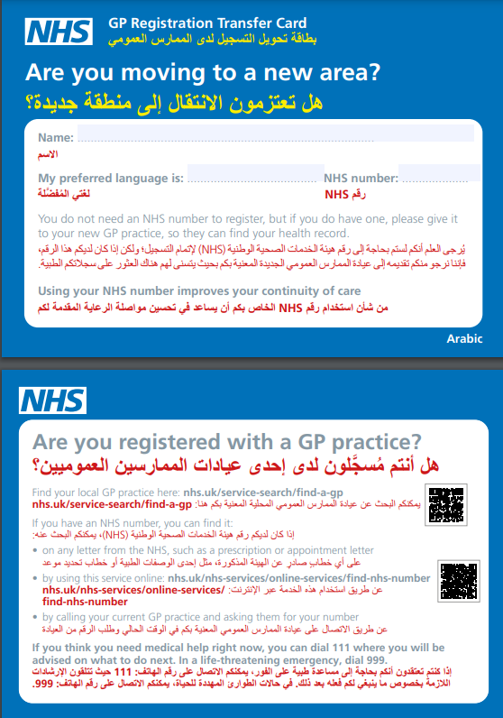
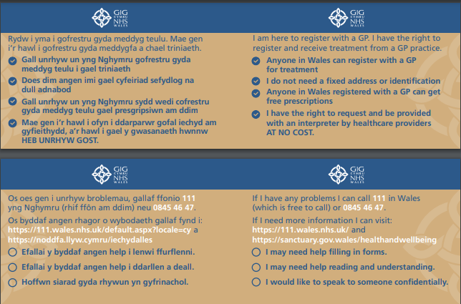
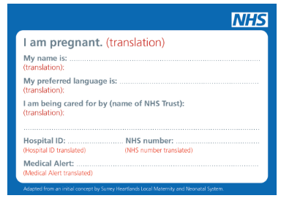
Translated resources
https://www.doctorsoftheworld.org.uk/gp-access-cards/

Slide 43
Secondary care charging
There are restrictions on some secondary care services depending on ordinary residence
People who are not classified as ‘ordinarily resident’ (no formal immigration status) are not entitled to most secondary care services
Exempt services: A&E and services for communicable disease, sexual health and family planning, treatment for sexual or domestic violence or torture.
Exempt groups: people seeking asylum and refugees, recognised victims of trafficking and others
Charges 150% of NHS tariff – average maternity bill between £7,000 and £14,000
Services withheld until payment unless ‘urgent’ or ‘immediately necessary’ - treatment to be provided regardless of ability to pay
GP practices must ALWAYS refer patients to secondary care regardless of immigration status
New guidance – updated September 2023 https://assets.publishing.service.gov.uk/government/uploads/system/uploads/attachment_data/file/1186860/nhs-cost-recovery-overseas-visitors_september2023.pdf
Notes:
4.4.2 Where a GP refers a patient for secondary services (hospital or other community services) they should do so on clinical grounds alone; eligibility for free care will be assessed by the receiving organisation.
4.4.3 The absence of any reciprocal arrangements between the nation-states, a patient’s nationality is therefore not relevant in giving people entitlement to register as NHS patients for primary medical services.

Slide 44

Charging as a barrier to healthcare
Fear makes people avoid healthcare
Exemptions to public health do not work: screening or vaccinations missed (not registered with GP)
Bills and debt collection (people driven into exploitative work to pay bills)
Debts reported to the Home Office and affects future immigration applications and right to travel
Confusion about the rules and poor practice
Incorrect billing
Immediately necessary or urgent treatment often delayed or denied
Patients billed for services that should be exempt e.g. asylum seekers or refugees
Notes:
Deterred from accessing NHS services – fear healthcare bills and immigration enforcement
Bad debt – drives people into exploitative work and relationships, child benefit used to pay NHS debt
Late accessing Antenatal care
NHS trusts incorrectly apply the charging regulations:
Fail to identify those who should be exempt from charge (asylum seekers, victims of trafficking, treatment caused by domestic or sexual violence).
Fail to assess whether the required treatment is ‘immediately necessary’ – withhold diagnostics or fail to assess likely timeframe for leaving the UK.
Provide sub-standard care
Care withheld or delayed whilst person advocates for their rights.
Cycle of requiring care to become “immediately necessary” before intervening
NHS debts are a barrier to regularising status - Those with outstanding debts over £500 are reported to Home Office.

Slide 45
Hospital Access Project
How we can support:
Advocate for those denied secondary care
Advice for individuals and their families to navigate a complex system
Write to OVMs and debt management companies for destitute people; proactively requesting manageable repayment plans
Signpost to debt advice, immigration advice and other support.
Explain the implications of not engaging with NHS debt
Report on the harm caused by NHS charging
DOTW’s casework team
Doctors of the World’s advice line on freephone 0808 1647 686
If you’re calling from an organisation, please call our clinic office line: 0207 0789 629 or email clinic@doctorsoftheworld.org.uk
More information here

Slide 46
Find out more https://www.doctorsoftheworld.org.uk/safesurgeries/ Translated health information https://www.doctorsoftheworld.org.uk/translated-health-information/ Contact us safesurgeries@doctorsoftheworld.org.uk DOTW clinic https://www.doctorsoftheworld.org.uk/patient-clinic/
Stay connected

Slide 47
HEALTH ACCESS TEAM
Swansea Bay University Health Board
Maria Doyle Lead nurse Health Access Team
Central Clinic Orchard Street Swansea SA1 5AT
SBU.Hat@wales.nhs.uk
01792 517882
Notes:
This slide can be used for presentations which are from a health board-wide perspective or for a whole HB audience as the graphic device to the right of the slide includes all four service group colours and red for the corporate team.

Slide 48
SERVICE USERS
Adults and children accommodated in Clear Springs Ready Homes, single sex shared houses and family houses.
Swansea 212 properties. 800-1000 people
Neath Port Talbot 13 properties. 30-50 people
Unaccompanied asylum seeker children (Section 76)
Swansea 17 properties
Neath Port Talbot 7 properties
Notes:
The purple line indicates Morriston Hospital Service Group, so this slide can be used for matters which relate to MHSG.

Slide 49
TEAM
Nurse led service Monday – Friday 8am-4pm
1 x Band 7 WTE RN/SCPHN HV
1 X Band 6 0.8 WTE RN
2 X Band 6 0.6 WTE RN/SCPHN HV/SN
1 X Band 3 0.6 WTE ADMINISTRATOR
Notes:
The blue line indicates Mental Health and Learning Disabilities (MHLD), so this slide can be used for matters which relate to MHLD.

Slide 50
NOTIFICATION
CLEAR SPRINGS READY HOMES PORTAL – new arrivals
Bristol, Gloucester, Cardiff, London. Predominantly single adult males.
LOOKED AFTER CHILD TEAM – New placements
GP ALLOCATION – Collaboration with Primary Care Services GP registration team, enhanced payment scheme.
LANGUAGE LINE – Arabic, Pashto, Kurdish Sorani

Slide 51
ClINICAL SERVICES
Initial Health Assessment - every new arrival asylum seeker to determine health needs including communicable and non-communicable diseases, mental health, sexual health and reproductive health, oral health and safeguarding.
Vaccination of individuals with uncertain or incomplete immunisation status
Latent TB skin test - for individuals born or lived in sub-Saharan Africa or countries where the TB incidence is more than 150 per 100,000 population.
UASC Support Looked After Child team for vaccination and latent TB screening
Notes:
The red line indicates the corporate team, so this slide can be used for corporate matters.

Slide 52
REFERRALS
Sexual health outreach for testing for HIV, hepatitis B and C, syphilis, chlamydia, and gonorrhoea. As well as cervical screening and contraception.
Mental health services – trauma informed approach to counselling.
Dental urgent care
GP appointment urgent care
Midwifery, health visiting, child health services, Secondary care.
Safeguarding - Female genital mutilation, Vulnerable adult, Vulnerable child
Notes:
The green line indicates the Primary Care and Community Service Group, so this slide can be used for primary care and community matters.

Slide 53
JOINT PARTNERSHIP WORKING
READY HOMES
LOCAL AUTHORITY LEADS
THIRD SECTOR
SBUHB SERVICES
SWANSEA UNIVERSITY – pre reg/post reg student short placements
Notes:
The yellow line indicates the Singleton and Neath Port Talbot Service Group, so this slide can be used for matters relating to SNPTSG.

Slide 54


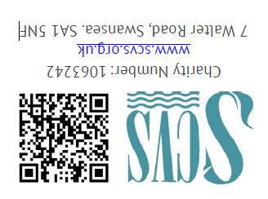





Slide 55
THANK YOU

Slide 56
Q&A Session

Slide 57
Thank you

