Slide 1





Addressing the health and wellbeing needs of Sex Workers in Wales
Webinar
27th February 2025

Slide 2

Agenda

Slide 3

Sexwork and Sexual Health

Slide 4
What is sex work?
Sex work is the exchange of sexual services (sex, erotic dancing, pornography, etc.) for money or something of value.
Sex workers have different reasons for doing sex work. Some are in circumstances that lead them to sex work even if it is not their first choice for earning income, and some choose sex work among other well-paying jobs. With the increasing levels of poverty in the UK there is an increase in sex work.
Some individuals are exploited, forced and/or coerced into prostitution — this is sexual exploitation and human trafficking, which are crimes

Slide 5
WHY USE THE TERM “SEX WORKER”?
First, it is the term sex workers all over the globe have said they prefer.
Second, the term sex worker helps us see that sex work, for many, is a job, not an identity.

Slide 6
What’s the difference between “sex work” and “prostitution”?
Sex work includes the entire field of sexual services, both legal and illegal, including pornography, exotic dancing, fetish work, web-based work, and prostitution.
Prostitution is the term used in law. The legal elements of prostitution are defined by statutes that vary across jurisdictions. Generally, prostitution involves the exchange of sexual services for monetary compensation or other forms of payment.
Many legal frameworks distinguish between individuals providing services, often referred to as sex workers, and those who facilitate or profit from the transaction, such as pimps or brothel owners.
Additionally, the definition of what constitutes a “sexual act” may vary, further complicating the legal landscape.

Slide 7
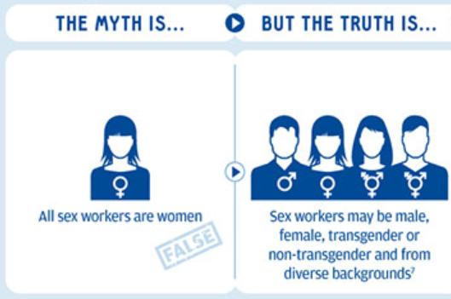
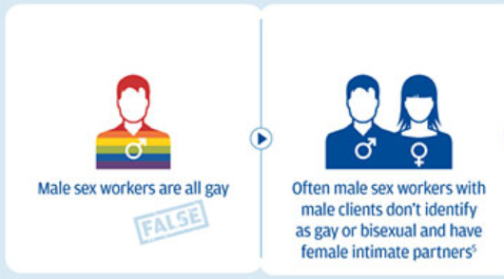
MISCONCEPTIONS ABOUT SEXWORKERS
Sources:
An action agenda for HIV and sex workers Beyrer, Chris et al. The Lancet, Volume 385, Issue 9964, 287 – 301
Male sex workers: practices, contexts, and vulnerabilities for HIV acquisition and transmission
Baral, Stefan David et al. The Lancet, Volume 385, Issue 9964, 260 - 273

Slide 8


Slide 9
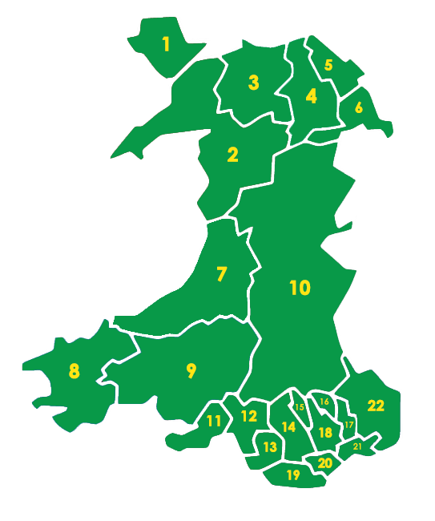
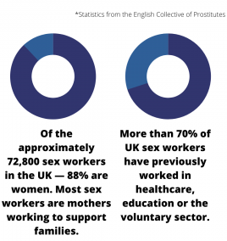
SITUATION IN THE UK
In Wales
EVERY LA has sex workers
(data from 2014):
it is estimated at least 2471 sex workers including:
1195 sex workers working online
912 working in brothels/massage parlours
263 working on the street
Street sex workers’ pathways into prostitution (approximately 70% were known to social services departments in some capacity)
Approx. 5% of students engaged in sex work with approx. 22% considering sex work. (2015)
Safety First Wales

Slide 10
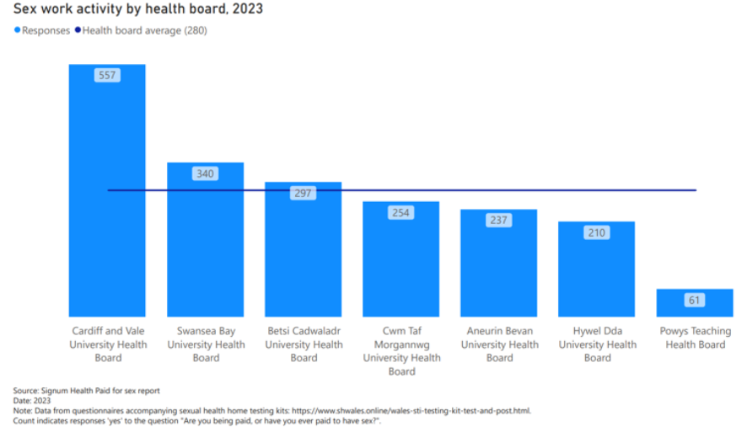

Slide 11
FOUR BASIC LEGAL FRAMEWORKS AROUND SEX WORK
 | Selling Sexual Services | Buying Sexual Services
Decriminalisation | Not a crime | Not a crime
Criminalisation | Criminal | Criminal
Legalisation | Not a crime when seller is licensed but criminal when seller is not licensed
Entrapment Model* | Not a crime | Criminal
*The Entrapment Model, also known as the End Demand Model, Nordic Model, Swedish Model, and Equality Model refers to the theory that criminalising clients and third parties (e.g., managers) will reduce demand in the sex trade, thereby “freeing” sex workers, who are often seen as victims.

Slide 12

REPRESENTATION IN WALES
Safety First Wales is a coalition of sex workers, health professionals, church representatives, anti-racist, anti-poverty, anti-violence, migrant and trans rights campaigners -- formed to decriminalise sex work in Wales and prioritise sex workers’ safety, health, and well-being.
Formal launch in the Senedd in November
https://safetyfirstwales.org/

Slide 13
DECRIMINALISING SEX WORK
Decriminalisation is the removal of criminal penalties for sex work.
The decriminalisation of sex work is rooted in the principles of promoting safety, reducing harm and enhancing the well-being of those engaged in sex work.
Decriminalisation is supported not only by sex workers themselves but also by organisations such as the Royal College of Nursing, Joint Council for the Welfare of Immigrants, Freedom United, Women Against Rape in the UK and internationally Amnesty International, the World Health Organization, Human Rights Watch, UNAIDS, International Lesbian, Gay, Bisexual, Trans and Intersex Association, Global Alliance Against Traffic in Women.

Slide 14
HOW IS DECRIMINALISATION DIFFERENT FROM LEGALISATION?
Legalisation of sex work would create a set of laws, codes, and regulations specific to the sex industry. People who buy or sell sex outside of these rules would be breaking the law and subject to arrest, conviction, and punishment.
Decriminalising sex work means that consenting adults who buy or sell sex are not committing a crime. There would still be laws against trafficking, rape, violence, and sex work involving minors.
The most appropriate model is an ongoing debate which underscores the importance of evidence-based policymaking that addresses the diverse experiences and needs of those involved in sex work.

Slide 15
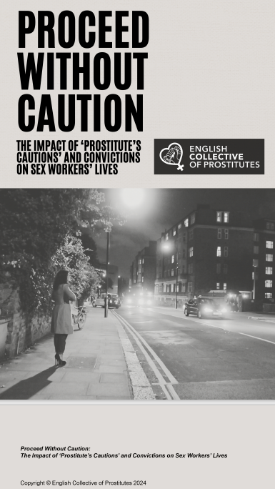
PROSTITUTE CAUTION V POLICE/CRIMINAL CAUTION
‘Prostitute cautions’ differ from police cautions in that the woman doesn’t have to admit guilt, there is no appeal and it stays on your record for life (or until you are 100).
“I had a criminal record check and it has a section called ‘miscellaneous’, which was a half-page all about my sex work. I appealed to have it taken off and they refused. It makes me look terrible; I was absolutely heart broken. If I apply for a job that will be on the back of it”.
key findings of the ‘Proceed Without Caution’ report:
two-thirds of the women interviewed said a ‘prostitute caution’ or conviction had been the reason they found it hard to leave sex work.
Almost all said that having a record deterred them from reporting crimes and violence and described discriminatory experiences with police, lawyers and even doctors.
two-thirds of women also said that having cautions or convictions on their record had a negative impact on their relationships with friends and family.
Interesting fact…….police don’t record prostitution charges and so there is no record on FOI requests!
Proceed-Without-Caution-Report.pdf (prostitutescollective.net)

Slide 16
HEALTH NEEDS OF SEXWORKERS
Current health service provision for sex workers focuses on sexual health to the exclusion of their other physical and mental health needs.
Mental health support for sex workers often does not consider their adverse experiences as a sex worker, or historic trauma.
Sex workers may need support with services such as housing as well as health related and there are systems gaps which means referrals between services are not streamlined.
Sex workers frequently hide their occupation out of fear of judgement, stigma and reduction in access to care and support – this may create further barriers to access to care services which offer holistic support to sex workers would benefit from ‘fast-track’ referral systems into wider services.
Services providing healthcare should take a wider perspective of sex workers health needs.
Source: An Analysis of the Health Needs of Sex Workers in Birmingham April 2024

Slide 17
HEALTH NEEDS OF SEXWORKERS – Barriers/Issues
Poor access to health services
Stereotyping & discrimination
Lack of joint working between services & organisations
Poor follow-up of patients
High attendance at A&E
Unsafe discharge from A&E and secondary care
Lack of standardised data collection
These issues also apply to the sexual health provision for several groups of vulnerable patients. However, for those who sex work this is especially important and a major public health issue as they report finding it difficult to access timely and responsive sexual health care.

Slide 18
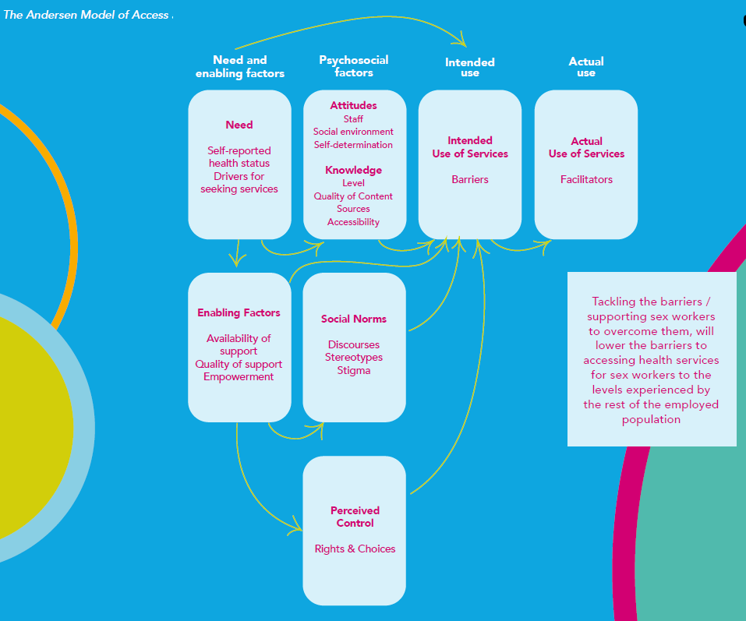
The Andersen Model of Access

Slide 19
THE ENTRAPMENT MODEL AND PUBLIC HEALTH
The Northern Ireland Department of Justice released a report in 2019 analysing three years of the impact of laws criminalising clients of sex workers in Northern Ireland.
Key findings include:
An analysis of 173,460 ads shows little effect on the supply of or demand for sex work;
From 2015 to 2018, there was an increase in reports related to assaults (from 3 to 13), sexual assaults (from 1 to 13), and threatening behaviour (from 10 to 42);
Sex workers are exposed to higher rates of anti-social and nuisance behaviour and report higher levels of anxiety and unease as well as increased stigmatisation.
Source: “Assessment of Review of Operation of Article 64A of the Sexual Offences Order (Northern Ireland) 2008: Offence of Purchasing Sexual Services,” Northern Ireland Department of Justice, September 17, 2019, https://www.justice-ni.gov.uk/sites/default/files/publications/justice/assessment-of-impact-criminalisation-of-purchasing-sexual-services.pdf.

Slide 20
DECRIMINALISING SEX WORK AND PUBLIC HEALTH
A 2018 Johns Hopkins Bloomberg School of Public Health meta-analysis reviewed over 130 studies conducted over 30 years and made the following key findings:
Repressive policing practices around sex work were associated with increased risk of sexual and physical violence at the hands of clients, third parties, and domestic partners.
Sex workers exposed to these policing practices were put at increased risk of infection with HIV and other STIs, and more likely to have condomless sex than those who had not been.
Repressive policing of sex workers, their clients, and/or venues disrupted sex workers’ support networks, workplace safety, and risk reduction strategies.
Source: Lucy Platt, Pippa Grenfell, Rebecca Meiksin, et al., “Associations Between Sex Work Laws and Sex Workers’ Health: A Systematic Review and Meta-Analysis of Quantitative and Qualitative Studies,” PLOS Medicine 15, no. 12 (December 2018), https://doi.org/10.1371/journal.pmed.1002680.

Slide 21
DECRIMINALISATION AND PUBLIC HEALTH
New Zealand’s Prostitution Reform Act 2003 is a notable example, decriminalizing sex work and establishing a legal framework to safeguard sex workers’ rights. The Act promotes welfare, occupational health, and safety while protecting against exploitation. It includes provisions for licensing brothels and regulating sex work to ensure safe conditions.

Slide 22
EVIDENCE FROM NEW ZEALAND
Evidence from New Zealand where decriminalisation was introduced in 2003 shows:
no rise in prostitution;
women more able to report violence without fear of arrest;
attacks cleared up more quickly;
sex workers more able to leave prostitution as convictions are cleared from their records;
drug users treated as patients not criminals;
condom usage has increased;
the rate of STIs has gone down.

Slide 23


Healthcare Needs of Sex Workers – Ensuring Comprehensive and Compassionate Care
Joanne Tilley
Clinical Nurse Specialist
Sexual Health
SBUHB
27.02.2025

Slide 24
Objectives:
Overview of Sex Work
Barriers and Complexities presented by this group
Sexual Health Outreach Service
Signposting
Learning points to take forward

Slide 25
Types of Sex Work:
“Sex work is a broad term used to describe a wide range of activities relating to the exchange of money (or an equivalent) for the provision of a sexual service” (British Medical Association 2021)
Street Sex work
Indoor Sex work – brothels, massage parlours, bars, casino’s etc
Escorts
Online Sex Work – webcam work
Phone Sex
Erotic dancing/stripper/pole dancing
Dominatrix
Pornographic Films
Sugar Dating
Sex Parties- black rooms, saunas etc

Slide 26
Statistics:
72,800 people involved in sex work in the UK (BASHH 2022)
In Wales approx. 3000 sex workers (SFW 2023) Figures from 2014 so likely to be substantially higher in 2024.
Sex Work identified in all 22 local authority areas of wales mostly in Cardiff, Swansea and Newport (SFW 2023)
85% were identified nationally as mothers who are working to support families (SFW 2023)
5% of student’s sex work (Swansea University – The student sex work project 2015)
Average age to enter street sex work is 21
SWAN Project Swansea – 1092 visits to the outreach van in 2022-2023 and 908 visits to date in 2023-2024
Reflect project Swansea – has supported more than 50 families since 2018 who have had children removed permanently into the care system

Slide 27


Barriers and Complexities:
Marginalisation
Stigmatisation
Mistrust of Professionals
Complex Health Needs
Digital Inclusion
Poor Mental Health/History of Trauma
Transient lifestyle
Homelessness
Substance Misuse
Criminal Justice System
Financial Issues
Exploitation
Unplanned Pregnancies / Children removed

Slide 28

Sexual And Reproductive Health
Compared to the general population – sex workers experience higher rates of all STI’S (BASHH 2022)
WAG Elimination Targets – HIV, Hepatitis B & C
BASHH Clinical Standards and Targets (clinical standards specifically for sex workers)
Faculty of Sexual and Reproductive Health Guidelines
Inclusive and equal service provision for those most vulnerable
Trauma informed Care - making every contact count
Average cost of Child taken into Foster Care £36,400 per year (Reflect 2018)
1:3 Women in England & Wales will have a termination of pregnancy (approx. 209,917 per year) (DOH&SC 2020)

Slide 29

Sexually Transmitted Infections
PrEP / Prophylaxis / Sexual Assaults
Outreach Services
Sexual Health Services
Contraception
HIV
Psychosexual Counselling
Gender Services
Pregnancy Advisory Service

Slide 30

Sexual Health Outreach Team:
X2 Clinical Nurse Specialists (7 sessions per week)
X1 Nurse Practitioner (2 sessions per week)
X3 Nursing Associates (2-3 sessions per week)
Cover all of SBUHB Footprint
Groups we Support :
Women's Aid Homeless Venues
Looked After Children Asylum Seekers
Sex Workers Probation Users
Drug Agencies Social Services
Specialist Midwives Schools
Specialist Young Peoples Clinic Police
Housing

Slide 31
Mission Statement for the Sexual Health Outreach Team
Our mission is to empower individuals and communities to achieve optimal sexual health and well-being through compassionate care, collaborative partnerships, and a commitment to continuous improvement. Guided by our health board’s core values:
• Caring for Each Other: We provide inclusive, respectful, and confidential support, ensuring every individual feel’s valued, heard, and understood.
• Working Together: We build meaningful relationships with communities, partners, and stakeholders to address sexual health needs and promote education and prevention.
• Always Improving: We embrace innovation and feedback to enhance our services, ensuring they remain evidence-based, accessible, and responsive to the diverse needs of those we serve.
Together, we strive to create a healthier, informed, and empowered future for all.

Slide 32

What we Provide in Sexual Health Services:
STI Screening
BBV Screening
Vaccinations (Hep b, Hep a, HPV, M.Pox)
All methods of Contraception (LARCS)
Pregnancy Testing
Referral to Pregnancy Advisory Service (termination of pregnancy)
Cytology
Psychosexual Counselling
PREP/PEP
HIV care/Injectable ARV Clinics
Gender Clinic
Onward referrals (primary/secondary care, third sector)

Slide 33

Our Role and Aims
Create safe non judgemental spaces
Build Trust and Rapport – long term relationships with patients
Patient centred Care – making every contact count
Trauma informed care – aware of the realities
Adaptation – of services/ways of working/easy access
Awareness of complexities/barriers and Signposting to specialities
Health Promotion & Harm Reduction
Multi agency working
Safeguarding- everyone's responsibility

Slide 34
What can your Service do?
BARRIERS | SOLUTIONS
Time Multiple Concerns | Bring patient back for a f/u to see same GP/Nurse Book a double slot
Accessibility to appointments Digital Inclusion | More flexibility with appointments Be practical – may not have transport, phone etc Get reception staff on board
Lack of engagement | Continuity of Care – see same person/build trust Link GP/Nurse in Surgery
Knowledge | Training of all staff in inclusion health complexities Multiagency Working
Complex Needs | Awareness + Signposting
Stigma and Attitudes | Trauma informed Care/Staff training Meaningful conversations/non judgemental
Clinical Aspects | Prioritise making every contact count Offer all Screening – STI’S/BBVS Contraception

Slide 35

Safeguarding:
Difference between Consensual Sex work and Sexual Exploitation/Modern Slavery (trafficking)
Sex Workers Operational Team (SWOT) MARAC
Police Reporting
DV MARAC (Dash RIC)
Adult at Risk Referral (Social Services)
IDVA
Everyone's Responsibility

Slide 36



Signposting:
Police/SARC
UGLY MUGS
Safer Wales
Swansea Women's Aid – SWAN Project, Daise, Chyps, Refuges, Safe houses
Thrive Women's Aid – NPT – SWAN Project
Barod/Adferiad – Substance Misuse
Platform – Mental Health Support
Sexual Health (SBUHB) – Swansea & NPT
Vulnerable Adult Teams (Primary Care)- Swansea & NPT
The Wallich – hostels, housing, outreach
Crisis – skylight centre
Reflect Project
YMCA – Good vibes
BAWSO
The Nelsons Trust Women's Centre

Slide 37

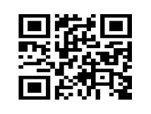
https://forms.office.com/e/sLMGU3dQPD0
Sexual Health Referrals
Clinics
Singleton Hospital
Neath Port Talbot
Dyfed Road
Pontardawe
Info Nation
Outreach Services
https://forms.office.com/e/sLMGU3dQPD
0300 555 0279
Pregnancy Advisory Service
01792 200303
Test & Post

Slide 38
Conclusion:
Sex workers are a complex group of patients that often have multiple healthcare needs
They can be hard to engage with for a variety of reasons such as stigma, marginalisation and fear of criminalisation
In order to deliver effective healthcare we must be adaptive, flexible and a willing to change how we deliver services
Prioritise needs
Always offer screening and contraception
Always check re: safeguarding
Think outside of the box. People don’t always present as “sex workers”
Liaise with other specialities/Signpost
Go the extra mile
Never underestimate the difference your making in each contact – this may be the only time they access healthcare

Slide 39
References/Resources:
BASHH (2022) Clinical Standards for the sexual health management of people involved in sex work 1st edn. Cheshire. British Association of Sexual Health and HIV
British Medical Association (2021) Briefing on sex workers. Available at: https://www.bma.org.uk/media/4562/bma-arm-briefing-sex-workers-arm2021.pdf
Safety First Wales (2023) Briefing. Available at: https://safetyfirstwales.org/briefing
Swansea University (2015) The Student Sex Work Project. Available at: Student Sex Workers: Reducing Stigma and Improving Well-being - Swansea University
Welsh Government (2023) HIV Actin Plan for Wales 2023-2026. Available at :HIV Action Plan for Wales 2023-2026 (gov.wales)
Welsh Government (2022) Eliminating hepatitis (B and C) as a public health threat: actions for 2022 to 2023 and 2023 to 2024. Available at: Eliminating hepatitis (B and C) as a public health threat: actions for 2022 to 2023 and 2023 to 2024 (WHC/2023/001) | GOV.WALES

Slide 40

SWAN Project and Sexual Health Services
Lynne Sanders
CEO

Slide 41

The SWAN Project
Established 2018
Average of 150 women a year supported
Central to multi-agency response to women exploited by the sex industry

Slide 42

Key issues for the women
Multiple disadvantage
Stigmatised
Mistrust of police
Lack of engagement with services
Poor physical and mental health
Substance users
Insecure housing/street homelessness
High levels of domestic abuse

Slide 43
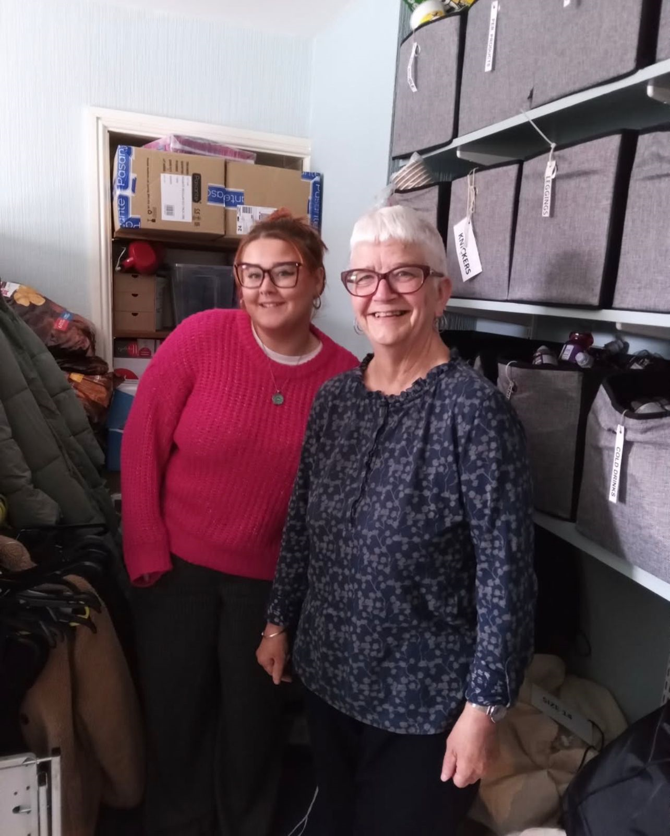
SWAN Project
Evening outreach service 4 nights a week - safeguarding, basic needs met & crisis support, fortnightly access to outreach sexual health service. Acts as front door into daytime service
Daytime support service offering strengths based, needs led , trauma informed support
Twice-weekly drop in sessions from April 2025

Slide 44
Key issues for women re. sexual health
Multiple buyers – no knowledge of sexual history/pay more for no use of condoms/high levels of physical and sexual violence/oral, vaginal and anal sex/ can be multiple men at once causing difficulty in protecting yourself/ can be deliberately infected by buyers – objectification
Reporting of offences low – buyers know they can get away with abuse/sexual violence; hence high levels experienced by women
Women on contraception, but can be desperate for money so take risks
Not a lot of options re. contraception– implants better, as do not remember to take pill
Catching Hep C
Lack of public bathrooms causes issues when using tampons and sponges
Women’s bodies not designed for having sex multiple times a day
Need for flexible, non-clinical, accessible sexual health service to encourage engagement:
Sexual health nurses visit brothels, hostels, temporary accommodation and will go to house if working from there
Most appointments at Orchard St clinic, rather than the main clinic
Multiple perpetrators – partner, ex-partners, pimps, drug dealers, organised crime gangs etc. demanding money
Need for substances if addicted (and for partner)

Slide 45

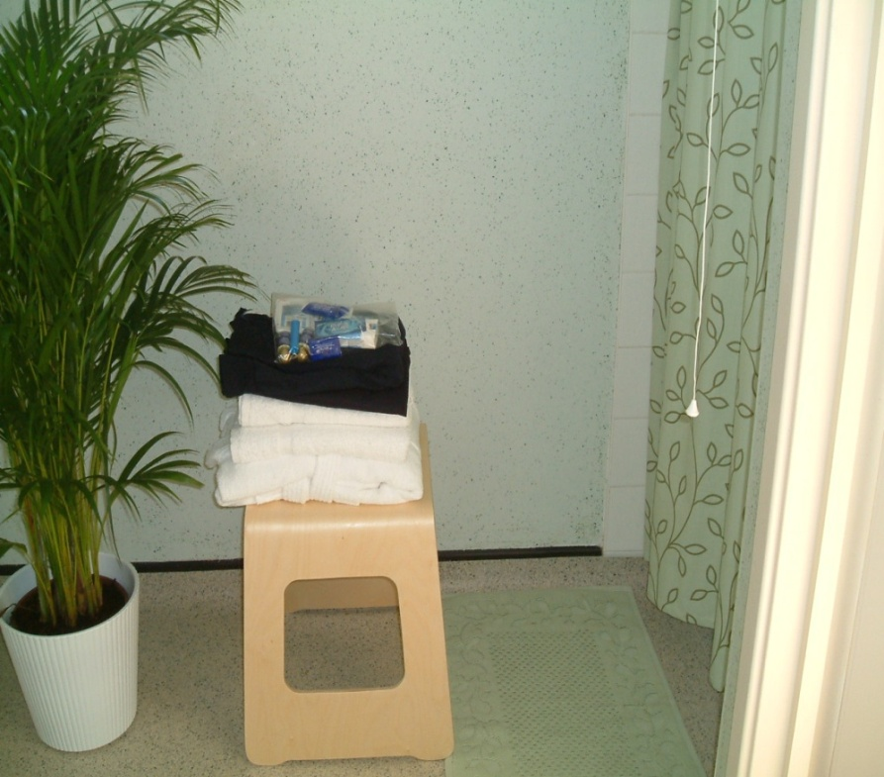
Joint work with sexual health nurses
Nurses advise SWAN if there are any health concerns, e.g. STI outbreak, to maximise safety of women
Ongoing liaison to arrange appointments for women
Safeguarding-joint visits, alert/liaison if missing woman, support sessions with SWAN if at risk, police intelligence officer
SWAN alerted if nurse needs to see woman urgently for treatment

Slide 46
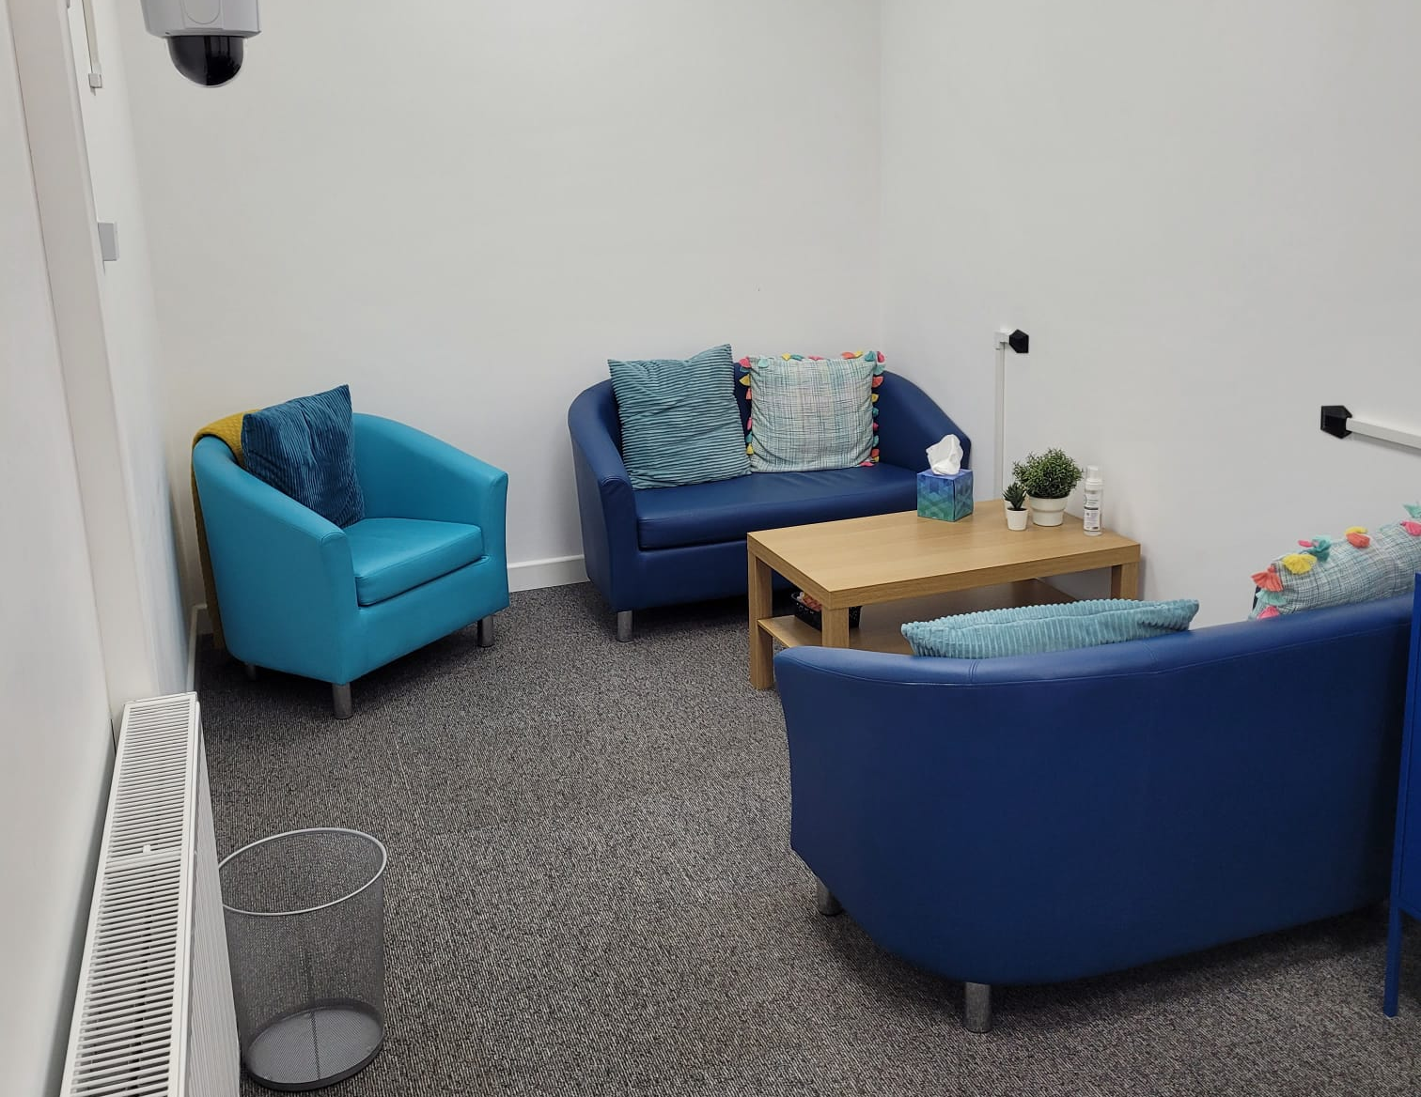
Cont’d
SWAN staff attend sexual health sessions at Dyfodol & Nelson Trust to see women
Access to gynae – nurses make referrals & chase up results etc.
Terminations- nurses meet women at hospital before termination to offer support
Wrap around service- liaison after joint appointment with woman to allocate actions, e.g. SWOT referral, housing referral etc.
2024 Sexual health support – SWAN daytime service 42 women; SWAN evening outreach service 33

Slide 47

Case study

Slide 48

SWAN contact details
To make a self-referral or agency referral
Swansea Women’s Aid
01792 644683
OR
swan@swanseawa.org.uk

Slide 49
Q&A Session

Slide 50
Thank you

