Slide 1



Slide 2
National Primary Care Workforce Conference
Developing a Strategic Workforce Plan for Primary Care
Welcome
The day will begin promptly at 10am
Please ensure that you have registered and
enjoy the refreshments available

Slide 3
National Primary Care Workforce Conference
Developing a Strategic Workforce Plan for Primary Care
Welcome and Introduction for the day
Alex Howells
Chief Executive,
Health Education and Improvement Wales (HEIW)

Slide 4
National Primary Care Workforce Conference
Developing a Strategic Workforce Plan for Primary Care
Opening Address
Eluned Morgan, MS
Minster for Health and Social Services

Slide 5
National Primary Care Workforce Conference
Developing a Strategic Workforce Plan for Primary Care
Primary Care in Wales
Nick Wood
Deputy Chief Executive NHS Wales

Slide 6
National Primary Care Workforce Conference
Developing a Strategic Workforce Plan for Primary Care
Developing a Strategic Workforce Plan for Primary Care
Sue Morgan
National Director and Strategic Programme Lead
for Primary and Community Care (SPPC)

Slide 7
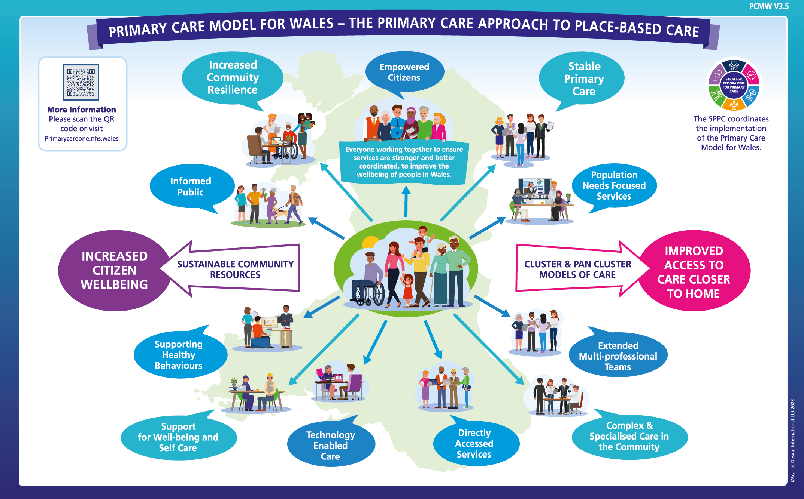

Slide 8

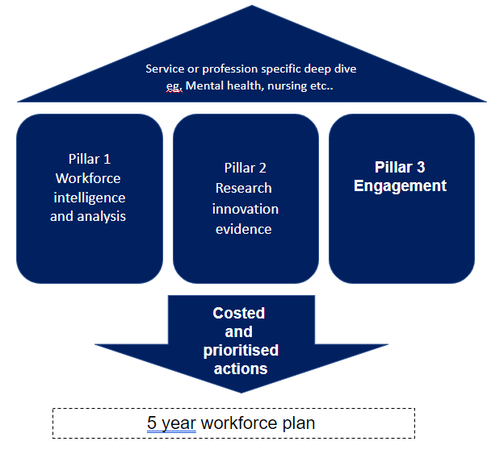
Strategic Workforce Plan for Primary Care
WHY?
Demand in primary care is increasing & will continue to change as our population ages
Recruitment challenges across the primary care workforce leading to sustainability challenges
Opportunities to deliver care differently which need additional skills & capabilities, different workforce models & new ways of working supported by advancements in technology
HOW?

Slide 9
Strategic Workforce Plan for Primary Care – Scope
This plan will focus on:
Delivery of primary care services at a practice, cluster or other geographical footprint (independent contractors/managed practices/HB employed models)
2. The workforce needed to deliver primary care to vulnerable groups (e.g. prison population)
3. The workforce needed to deliver urgent primary care (GPOOH) and first contact clinical services
(e.g. 111)
Social Care
A focus on the workforce that are directly working in primary care
Recognising there are other
areas of work being taken forward
to look at the workforce needed
to deliver wrap-around community services including those provided
in social care and by the independent and non-statutory services.
999 delivery
Third sector
Wider community workforce
Private sector

Slide 10
Timeline of Action
WE ARE HERE
2022
2023
PHASE 1
Initiation:
Initial horizon scanning / research
PHASE 2
Engagement & Data
PHASE 3
Shaping the plan
PHASE 4
Testing with stakeholders (consultation)
PHASE 5
Finalisation & Approval
PHASE 6
Implementation
Planning
Nov – Feb
March - June
June - July
July – Aug
Sept – Nov
Align with IMTP Planning 2024/2025
Ongoing dialogue – testing key themes
Actions and priorities

Slide 11
Where are we now?
Phase 3 Shaping the Plan
Engagement
Completed 7 Health Board engagement events – 7 minute briefs on website
National event – today!
Ongoing stakeholder engagement with key groups e.g 104 GP trainees (ST3)
Established a Focus Group
We have heard from over 1,300 people across Primary Care
330 people provided detailed feedback via a poll on our website
We have delivered 12 dedicated engagement events to date
We have attended over 75 different stakeholder groups over the past 6 months
Workforce Intelligence
Started to review available workforce intelligence (NB significant data lag in WNWRS data)
Strategy Mapping
Updated strategy mapping with latest research heiw.nhs.wales/files/pcws-strategy-map-eng/
NHS Long Term Workforce Plan, NHS England (June 2023)

Slide 12
National Primary Care Workforce Conference
Developing a Strategic Workforce Plan for Primary Care
Future Vision and Key Themes from the Engagement Phase
Dorothy Edwards
Programme Director National Programmes
Health Education and Improvement Wales (HEIW)

Slide 13







The next 10 years: Our vision for the Primary Care Workforce Our vision is to support primary care teams to deliver excellent care and to optimise the wellbeing of people living in Wales:
People will be supported by multi-professional teams working together to deliver holistic and integrated care
People will benefit from a consistent range of services available in primary care, with the size and shape of the workforce reflecting local population health needs delivering equitable outcomes
Technology and the use of data will play a bigger role and will help to deliver accessible, high quality care that is targeted at the needs of local people
People will be attracted to work in primary care and will have choice and flexibility to develop along their career pathway with access to high quality education and training
Our workforce will deliver care that applies a broad and holistic perspective to people’s needs focusing on prevention, care and treatment
Our workforce will have a greater range of skills available and will be supported to develop their skills to meet the needs of their communities
Our workforce will be supported to deploy their extended skills across a range of settings, blending work and lifestyle choices

Slide 14

Workload
Premises
Skills
“Clear career progression and mixed job plans with strong governance arrangements - primary and community care is not about a siloed specialist pathway but where most directly accessible support should be as where most of our population are - needs to be whole health and care system approach”
“Time to practice, time to learn, time to teach”
“Workforce is utterly exhausted, complexity and extent of demand does not match our staffing profiles and this is causing moral injury to staff through impeding their ability to provide the care and service they wish to give”
“I think there is still a lack of understanding of each others' backgrounds, training, skill, and scopes of practice. This needs to be overcome to allow better multi professional working and to avoid silos forming”
“Staff engagement is sometimes a barrier and this goes hand in hand with change management. It takes some time to implement change and we need to be creative in order to get staff onboard!”

Slide 15

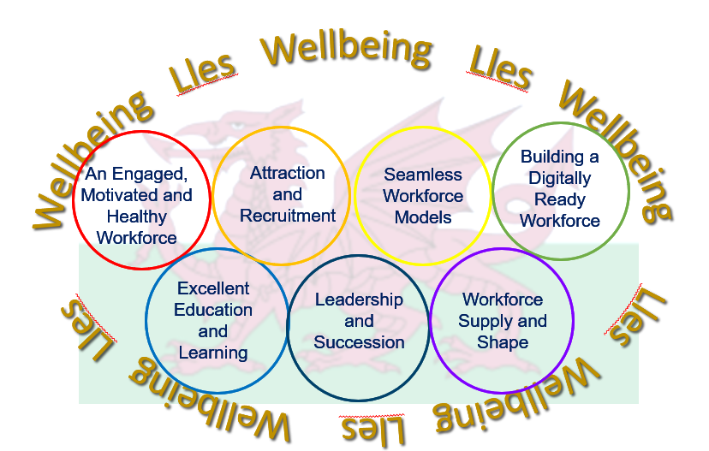


Ein Strategaeth Gweithlu ar gyfer Iechyd a Gofal Cymdeithasol Our Workforce Strategy for Health and Social Care
Golden Threads: Wellbeing, inclusion and Welsh language

Slide 16
Theme 1: An engaged, healthy & motivated workforce
Our ambition: By 2030, the primary care workforce will feel valued, fairly rewarded and supported wherever they work
Staff tell us they don’t always feel valued – by patients, colleagues or the wider NHS
Themes from engagement:
No consistent way of measuring workforce engagement in primary care
Unmanageable workload is impacting on the health and wellbeing of staff working in primary care
No consistent or equitable health and well being service for primary care
Staff are jaded and this is impacting on morale and people’s willingness to stay in their chosen profession
Other factors:
Career opportunities
Terms and conditions (reward and recognition)
Access to CPD
A supportive work environment
Good leadership/inclusive culture
Flexible working
Feeling valued by the public and other professionals
“we don’t need more resilience training we need people to help us do the work”
FOCUS FOR TODAY:
How could we better understand and measure staff experience
What are the wider conditions we need
Exploring national and local actions
Joint publication by Royal Colleges in Wales to mark NHS @75 “the people who care”

Slide 17
Theme 2: Attraction & Recruitment
Our Ambition: By 2030, the healthcare workforce within primary care will be well established as a strong and recognisable brand
Terms & conditions has been a key theme throughout the engagement
Themes from engagement:
People don’t understand the range of careers that are available in primary care; there are limited formalised work experience opportunities for younger people in particular
There are limited formalised training pathways into primary care
Capacity is needed to be able to place a larger number of students & trainees in primary care as part of their education journey at both undergraduate and postgraduate levels
Incentives to train in ‘harder to recruit’ areas in Wales have proved effective in both attracting and retaining trainees
There are examples of good apprenticeship development but these need to be scaled up and more healthcare apprenticeships offered
More ‘entry’ routes into primary care different educational levels and career stages
#TrainWorkLive campaign has been successful in attracting trainees to work in rural areas
FOCUS FOR TODAY:
What can we do to improve awareness of careers in primary care?
How can we increase education and training placements?
What careers pathways do we need to develop in primary care?
Only 5% of GP practices in Wales are able to offer a placement to nursing students

Slide 18
Theme 3: Seamless Workforce Models
Our Ambition: By 2030, multi-professional and multi-agency models will be the norm across primary care
Premises are a real constraint
Themes from engagement:
Developing the workforce that can deliver the preventative models that we need
Support and enthusiasm for multi-professional models across primary care
Time to supervise is a key issue
Need to balance top of license working with rewarding and fulfilling careers
Lack of understanding of different roles and scopes of practice
Continuity of care
Lack of protected time for multi-professional team development
More public education about roles and our messaging is important!
FOCUS FOR TODAY:
What workforce do we need to shift towards a preventative model of health care and build a common purpose around this?
What skills do we need?
How do we address the professional governance issues recognising that our supervision and professional development models need to adjust to a new world?
Notes:
People told us that they enjoy working in multi-professional teams
Egg-yolk analagu

Slide 19
Theme 4: Building a Digitally Ready Workforce
Our ambition: By 2030, we will have a digitally capable workforce in primary care which will be using technology and data to help the best possible care for people
Themes from engagement:
Fear of new systems - managing change and overcoming resistance to new systems; particularly reference to older generations not adapting well; technological phobia etc
Time & training (individual and team)
Don’t neglect basic skills
Recognition that AI could change
Data analysis in primary care not well developed
Information governance and GDPR
Game changes in primary care:
Telehealth/telecare –triage; medicines management; remote patient monitoring and prevention activities
Automation – automated documentation; empowering patients; time saving & productivity
It is estimated that AI could have a significant impact in automating tasks in primary care
Pilot digital capability framework to help individuals self assess their digital competency
FOCUS FOR TODAY:
How do we embed a ‘digital first’ mindset in our primary care workforce?
How should we maximise the significant datasets within primary to improve patient care
What roles do we need to realise the benefits of digital transformation?
Y Ty Dysgu is our Learning Management System hosting learning resources & programmes for health & care staff across Wales

Slide 20
Theme 5: Excellent Education & Learning
Our ambition: By 2030, staff working in primary and community settings will have the skills and capabilities needed to meet the needs of the people of Wales
Themes from engagement:
Lifelong learning & development
Clinical risk management
Lack of protected time for CPD and more consistent CPD offer
Expand clinical placements
Value of rotational training and education models
Need for specific education & training to support those working within inclusion health services
More inter-disciplinary training would prepare people to work as part of a team
More work- based learning opportunities including apprenticeships
Expand range of “new to primary care” programmes
Increasing workload
More people needed in workforce
Capacity for training limited
Pressure on existing workforce
Impacts on retention
Vicious circle
FOCUS FOR TODAY:
What’s our ambition for scaling up education & training in Wales ?
Do we need to reform or change our education and training programmes; how will changes in the future model of care impact on workforce models?
Priority areas for scaling up apprenticeship programmes & “new to primary care” initiatives
How do we ensure CPD arrangements are more equitable and value all staff?
Everyone should be supported to acquire & develop generic skills – MECC, Shared Decision Making, QI & Mental Health
Multi-professional Primary & community care framework & Academy infrastructure now in place

Slide 21
Theme 6: Leadership & Succession
Our ambition: By 2030, our leaders working in primary and community settings will display collective and compassionate leadership
Some people said that they feel unprepared to lead multi-professional teams
Themes from engagement:
Leadership skills development – embed early and support people throughout their roles
Particular groups highlighted – newly qualified GPs, those new to supervisory roles; practice managers
Rurality an issue in accessing leadership training opportunities
Equity issue – differences in leadership roles between primary and secondary care
Job plans should reflect general leadership vs professional leadership responsibilities
Don’t forget about non-clinical workforce
Leadership development often undertaken in own time
FOCUS FOR TODAY:
How do we creating a culture of compassionate and collective leadership in primary care?
Exploring our leadership offer – what more is needed
Priorities for succession planning in primary care
How do we grow our future leaders at a practice and system level?
Gwella is our leadership portal for NHS Wales. It contains a wealth of leadership resources including blogs, videos, articles, events, programmes and more

Slide 22
Theme 7 : Workforce Supply & Shape
Our ambition: by 2030, we will have a sustainable workforce in sufficient numbers working in primary care to meet the health and social care needs of our population
Growing disease burden – cancer, CVD, frailty, mental health conditions
Themes from engagement:
Shape and size of the workforce should reflect population health need to deliver equitable outcomes
Move from reactive/episodic care to support people who will have multi-morbidity and increasingly complex needs
Different skills and approaches will be needed to support preventative care e.g. health coaching/, lifestyle medicine
Ageing workforce profiles are a concern in some professional groups
Supply of the workforce is impacted by factors such as pension changes and retirement patterns
Retention is a key issue across all sectors
Need better data to plan
In Wales, the number of people ages 85+ is projected to rise by 127% over the next 15 years
FOCUS FOR TODAY:
Exploring the skillsets we need in primary care and where we need to improve supply:
Prevention; focus on lifestyle medicine; health inequalities
Managing complexity (management of risk, complex chronic condition management, polypharmacy)
Mental Health
Care coordination /navigator skills – to provide more joined-up care
Management of acute/urgent primary care in different settings
Data scientist roles (population health management)
Development of the MDT dental workforce
What can we do to retain our experienced workforce?
Dependency ratio increasing – where will our workforce come from?
Workforce want greater flexibility
Notes:
BMJ Open 2022 – survey of 783 doctors in training – 75% said they may want to work less than full time
Disease burden – 1 in 2 people will have cancer; significant increase in diabetes; more frail people and impact on mental health
Population changes – significant growth in SE region – driving more pressure onto primary care num
More stable in terms of numbers in other parts of Wales but significant issues in terms of the age structure and dependency ratio – Powys/HD and BCU will a higher dependency ratio – where will workforce come from

Slide 23
SUMMARY
The engagement has helped us to better understand the issues and also the impact of current pressures on our workforce
People have generously shared lots of ideas about what we can do differently and make things better
With your help, we can create a route map for the next 5 years

Slide 24
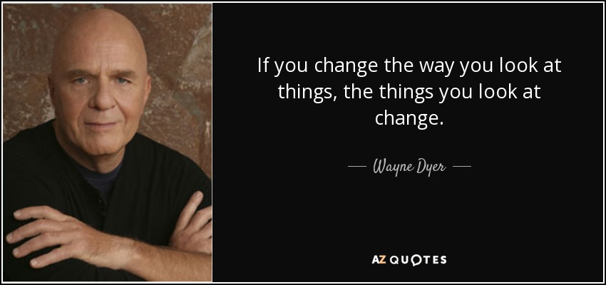

Slide 25

Notes:
Your badge shows which session you have been allocated to; please stay in your allocated groups so that we can get a balance across workshops
Lunch will be served in the foyer at 12.15 – the team will let you know when its ready
Second workshop will start promptly at 1pm
After that you will return to the main auditorium
Any issues in finding out where you need to go, our support team are all wearing red lanyards!
Please make your way to your workshop; look forward to seeing you all later this afternoon

Slide 26
National Primary Care Workforce Conference
Developing a Strategic Workforce Plan for Primary Care
Workshop Session 1
Seamless Workforce Models – Main Auditorium
Workforce Supply and Shape – Main Auditorium
Attraction and Recruitment – Muller Hall
Excellent Education and Learning – Muller Hall
Leadership and Succession – Wallis Room
Building a Digitally Ready Workforce – Aylward Room
An Engaged, Healthy and Motivated Workforce – Barnardo Room

Slide 27
National Primary Care Workforce Conference
Developing a Strategic Workforce Plan for Primary Care
Lunch is now available in the Foyer
At 1pm, please attend your next Workshop

Slide 28
National Primary Care Workforce Conference
Developing a Strategic Workforce Plan for Primary Care
Workshop Session 2
Seamless Workforce Models – Main Auditorium
Workforce Supply and Shape – Main Auditorium
Attraction and Recruitment – Muller Hall
Excellent Education and Learning – Muller Hall
Leadership and Succession – Wallis Room
Building a Digitally Ready Workforce – Aylward Room
An Engaged, Healthy and Motivated Workforce – Barnardo Room

Slide 29
National Primary Care Workforce Conference
Developing a Strategic Workforce Plan for Primary Care
Welcome Back
Nicola Prygodzicz
Chief Executive, Aneurin Bevan University Health Board
Lead NHS Chief Executive for Primary Care

Slide 30

National Primary Care Workforce Conference
Developing a Strategic Workforce Plan for Primary Care
Inclusion, Welsh language and Wellbeing
Dorothy Edwards
Programme Director
National Programmes, Health Education and Improvement Wales (HEIW)

Slide 31
National Primary Care Workforce Conference
Developing a Strategic Workforce Plan for Primary Care
Inclusion, Welsh language and Wellbeing
Menti.com
Code 8908 6753

Slide 32
National Primary Care Workforce Conference
Developing a Strategic Workforce Plan for Primary Care
How is Wales doing?
Shared learning from primary care systems in Europe
Dr Karen Gully
National Professional Advisor Strategic Programme for Primary Care, SPPC
Rebecca Pearce
Directorate Manager/ Senior Programme Manager Urgent Primary Care, Aneurin Bevan University Health Board
Gemma Nosworthy
Primary and Community Care Academy Manager,
Betsi Cadwaladr University Health Board

Slide 33

Background
WONCA: World Organization of National Colleges, Academies and Academic Associations of General Practitioners/Family Physicians​.
The Strategic Programme for Primary Care (SPPC): an All-Wales approach to support all health, social and wellbeing providers, and other stakeholders, to share local initiatives, products and solutions that could add value to the delivery of primary care services on a “once for Wales basis.”​
The Primary Care Model for Wales values the skills of the whole workforce and recognizes the need to maximise the potential of advanced practice knowledge and skills.​
The Welsh Delegate Group: SPPC sponsored multi-professional group attending the WONCA Europe Conference 2023.

Slide 34
WONCA 2023 Europe Themes : Making Choices in Primary Care
Sustainable healthcare​ Shared decision making​ Diagnosis​ Analysis of routine data, artificial intelligence​ Societal impact​ Access to innovations​ Goal oriented care​ | Interdisciplinary collaborative care​ Advanced care planning​ Decision support​ Population management and cooperation with public health ​ Prevention​ General practice best interventions​ Making good choice in general practice​ ​

Slide 35
Reflections of the Welsh Delegate Group
Universal challenges – workforce shortages, ‘burnout’ and continuing unmet needs.​
Multi professional group attending the conference was useful for shared learning, debate and ideas generation.
​
Medical focus of the conference – missing opportunities to engage the whole team.​
Very limited reference to Multi-professional workforce including Practice nurses, Pharmacists and AHP’s.
​
Focus on delegation of GP tasks – Few examples of integrated teams or advance practice across Europe. ​
Contrast with International Conference on Integrated Care which better reflects Welsh achievements. ​
Group consultations a useful driver for multi-professional working. ​
Team working reduces professional isolation and provides a better working environment. ​

Slide 36
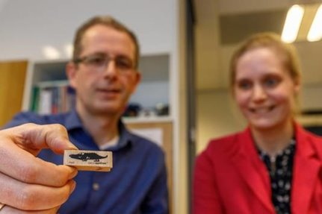
Preventing burnout and improving retention

Slide 37
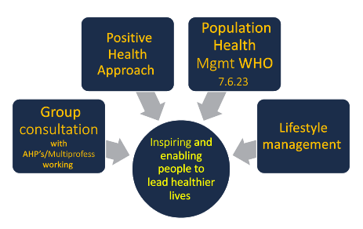
1. Positive Health (Institute for Positive Health) – spider web of 6 determinants of health & self perception of own health leading to what is really important to you? Do you want to change anything?​
Identify who / what can help improve the situation.
2. PHM Strengthen primary care by providing data-driven, people centred and proactive approach to managing health and wellbeing of a defined population- used to address health inequalities at a community level.
Population health management in primary health care: a proactive approach to improve health and well-being: primary health care policy paper series WHO.
3. Group consultations in primary care for Chronic pain, PTSD, Stress etc​
facilitate trans-disciplinary teamwork​
empower patients​
increase efficiency and quality of care

Slide 38
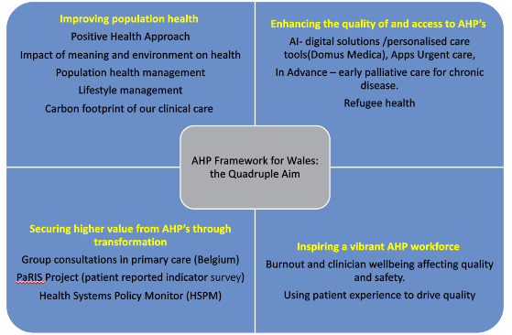

Slide 39
Important that we continue to explore new ideas ​
Managing self and patients should be included in the curriculum​.
Longitudinal Integrated Clerkship in the community delivering a Home Visiting Service to teach the Social Determinants of Health learning outcomes.
Recruitment initiatives included offering “free accommodation” for GPs to work in rural / isolated areas.​
Postgrad GP Programme in Spain requires Trainee GPs to spend a proportion of their Training Programme in a rural practice.
​
Netherlands strategy to build up single handed practices– in the belief that the smaller practice model offers a more sustainable approach and achieves full continuity of care resulting in better health outcomes for patients.
​
Newly qualified GPs supported through a buddy / grandparenting scheme and several single-handed practices form a small ‘cluster’ to cover for annual leave etc.​

Slide 40

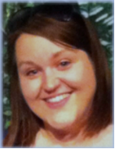

Research & Evaluation
Recruitment & Retention
Education & Training

Slide 41
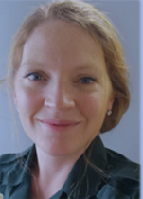
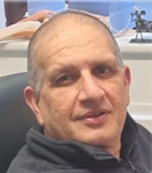
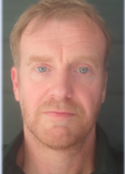
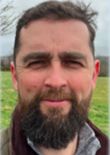
Key developments: Digital and AI
Netherlands – use of AI to triage patient and support GPs to run practice more effectively (https://westerdokters.nl/intro/?lang=en)
Increased automation of services
Future in so many areas of global industry
Importance of ‘bringing along with you’ – digital not an after thought, needs to be aligned
London – Ensuring infrastructure around roll out of digital, example where system became overwhelmed by digital requests, demonstrates need and buy in?
Ensuring maintenance and support around system to ensure system is current
Non-recurrent funding can be challenging when rolling digital system out
Recognition of generation and use of digital more common place

Slide 42
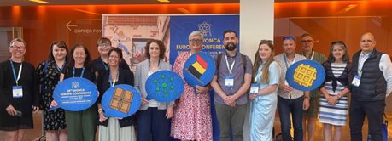
Conclusions​
Explore, learn and present as multi professional teams
Actively develop multi professional working e.g., using group consultations- and designing estates for MPT working
Share the knowledge and achievements we already have
Have confidence in the PCMW and develop the processes to mainstream what works
Simplify pathways and remove bureaucracy
Commit to digital
Notes:
Have confidence in the Primary Care Model for Wales, promote this more assertively and share Welsh achievements.
​
Simplify and streamline existing pathways, being vigilant for unnecessary bureaucracy. ​
Use digital support to streamline services and support the ‘no wrong door’ message, improving clinician wellbeing, patient journey, data capture and integration of systems to avoid duplication and error​.
Encourage opportunities to present work, to reinforce confidence and further develop ideas.
​
Engage all professional groups in identifying needs and designing local solutions.​
Use group consultations to support holistic care and build effective teams.
Develop the process to mainstream successful Cluster projects at pace and scale.
​
Use a Population Health Management (PHM) pro-active approach at the community level to reduce inequities. ​
Plan estates alongside workforce and training strategies. ​

Slide 43
National Primary Care Workforce Conference
Developing a Strategic Workforce Plan for Primary Care
Reflections on the day
and priority areas to take forward
Dorothy Edwards
Programme Director
National Programmes, Health Education and Improvement Wales (HEIW)

Slide 44
National Primary Care Workforce Conference
Developing a Strategic Workforce Plan for Primary Care
Reflections on the day
and priority areas to take forward
Menti.com
Code 6898 1186

Slide 45
National Primary Care Workforce Conference
Developing a Strategic Workforce Plan for Primary Care
Next Steps
Alex Howells
Chief Executive
Health Education and Improvement Wales (HEIW)

Slide 46
National Primary Care Workforce Conference
Developing a Strategic Workforce Plan for Primary Care
Summary and Close
Nicola Prygodzicz
Chief Executive Aneurin Bevan University Health Board
Lead NHS Chief Executive for Primary Care
Alex Slade
Director of Primary Care and Mental Health, Welsh Government

Slide 47
National Primary Care Workforce Conference
Developing a Strategic Workforce Plan for Primary Care
Thank you for attending and contributing today
Copies of the presentations an videos from today will be uploaded onto the SPPC website in due course.
There are refreshments available in the Foyer

