Slide 1
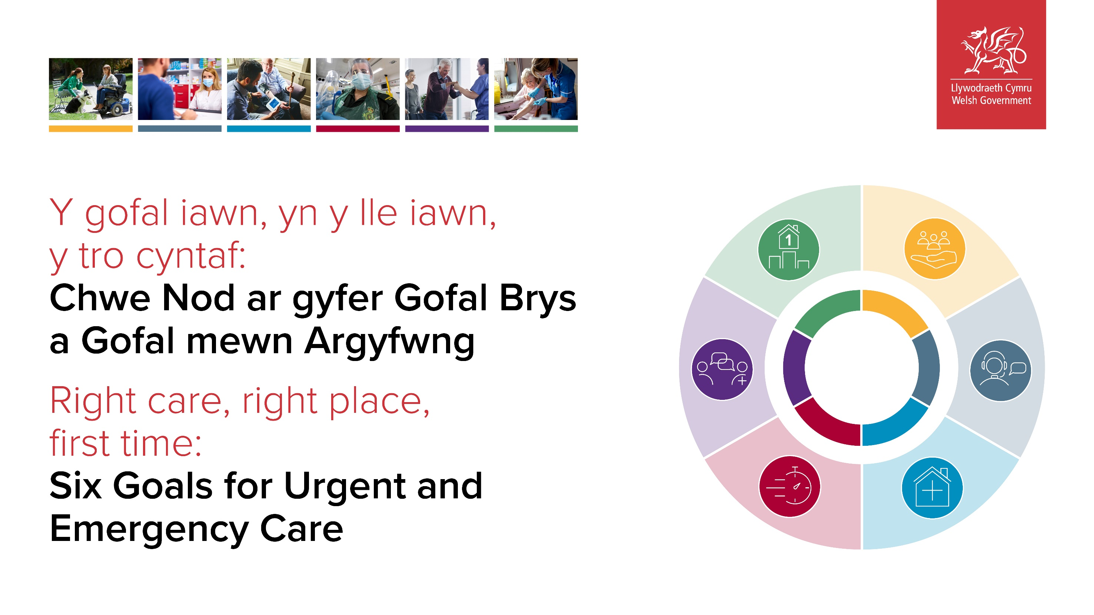

Slide 2

ACCELERATING IMPLEMENTATION LOCALLY, REGIONALLY AND NATIONALLY
Vision and priorities for 2022-2026
Putting Six Goals into practice: Programme enablers
Six Goals Programme Investment Plan
Local Six Goals Programme expectations
Six Goals Improvement Triumvirate Teams
Reporting and review

Slide 3
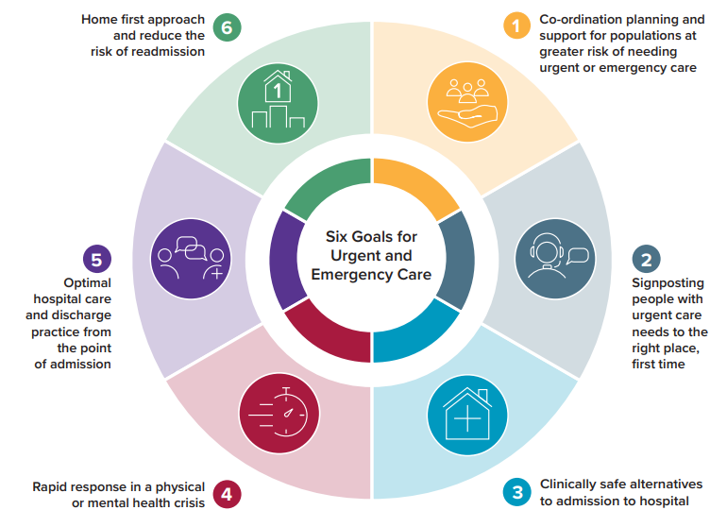
RIGHT CARE
RIGHT PLACE
FIRST TIME
For optimal patient and staff experience, clinical outcomes and value.
through
achieving

Slide 4
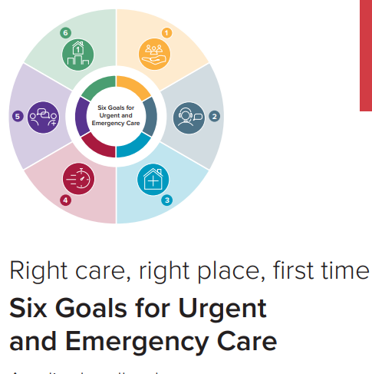


through achieving six goals
by doing the following consistently well
Vision
enabled by
Coordination, planning and support for people at greater risk of needing UEC (Goal 1)
Cluster-led risk stratification
Equal access to UEC for all
Reducing high intensity use of UEC services
Four enabling work-streams:
Workforce education, development and training
Digital change, information and technology
Measurement for improvement and value based healthcare
Behaviour change, communications and marketing
RIGHT CARE
RIGHT PLACE
FIRST TIME
For optimal patient and staff experience, clinical outcomes and value.
Signposting, information and assistance (Goal 2)
24/7 URGENT CARE MODEL
NHS 111 Wales and pathways
Enhanced Directory of Services
Urgent Primary Care Centres (UPCCs)
Clinically safe alternatives to admission (Goal 3)
Same day emergency care pathway
Intermediate care (step-up) pathway
Specialty advice and guidance lines
Rapid response in crisis (Goal 4)
Optimal 999 pathways
Quality, safe and timely care in Emergency Departments
£25m six goals delivery fund targeted at priorities
Optimal hospital care and discharge practice from the point of admission (Goal 5)
National funding for local six goals triumvirate improvement programme teams
Reducing length of stay and bed occupancy
SAFER patient flow guidance
National programme enabling support
Home first approach and reduce the risk of readmission (Goal 6)
Discharge to recover then assess pathways
Rehabilitation and reablement

Slide 5
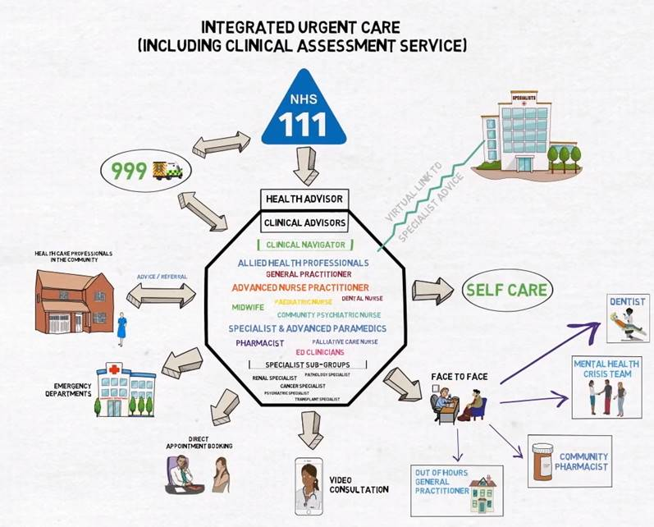
INTEGRATED URGENT AND EMERGENCY CARE MODEL - FUTURE STATE?

Slide 6
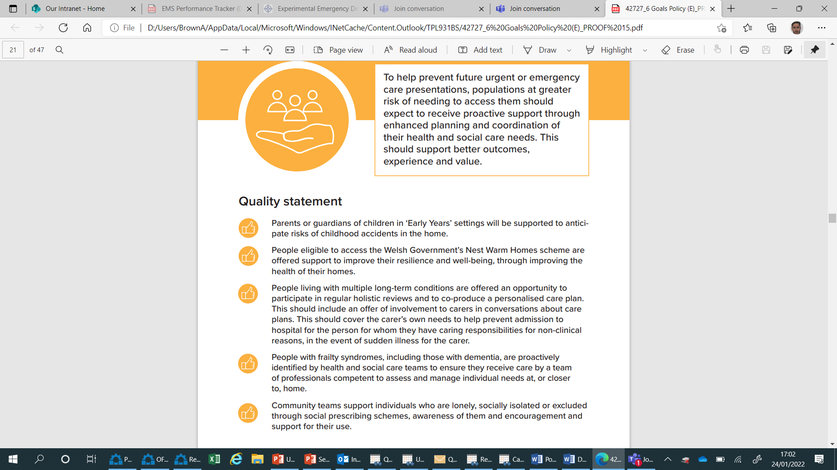
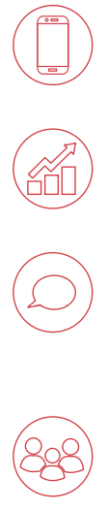
NATIONAL PROGRAMME ENABLERS
£25m to support Health Boards and partners deliver integrated 24/7 urgent and emergency care model
Digital change, information and technology work-stream
National Goal action plans to enable local, regional and national delivery
Measurement for improvement and VBHC work-stream
Behaviour change, communications and marketing work-stream
Funding for Six Goals Improvement Triumvirate Teams with connectivity to national networks for sharing and learning
Workforce education, training and development work-stream
Links to research and academia to support continuous evaluation, learning and improvement

Slide 7
Programme INVESTMENT PLAN
£100s millions already spent on urgent and emergency care in Wales.
£25M Six Goals Programme investment and enablers will support HBs and partners in ensuring core funding delivers right care, right place, first time.
Other funds in support of UEC:
Regional Integration Fund (£143m)
Mental Health Services Improvement Fund (£10m)
NHS 111 Wales (£15m)

Slide 8

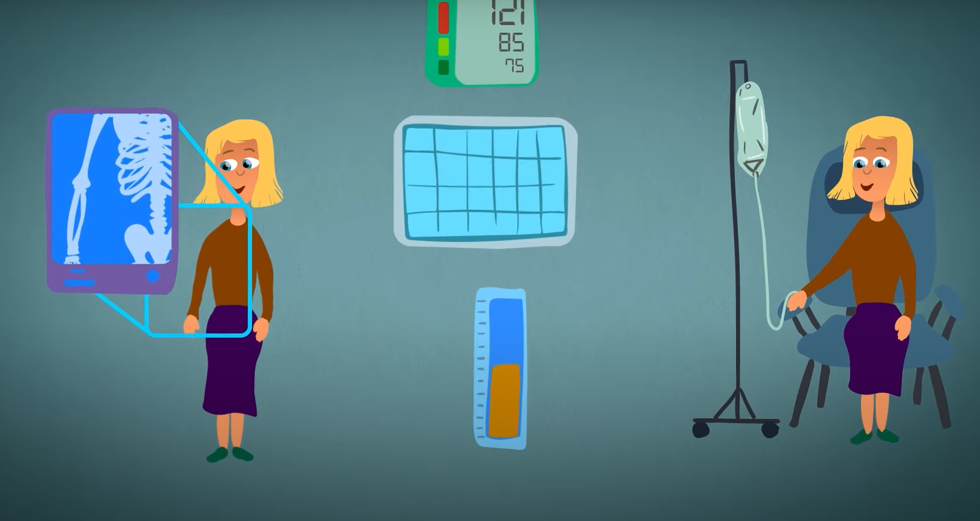
INVESTMENT PRIORITIES FOR 2022/2023: FOCUS ON GOAL 3
Urgent Primary Care Centres / services
Same Day Emergency Care seven days a week / twelve hours a day
Care closer to home
Reduce ambulance patient handover delays
Clinically safe reduction in admissions and ED attendances

Slide 9
SIX GOALS PROGRAMME – local governance
Health Board
Executive Board
Six Goals Programme Board
Executive chair
Whole system membership
Regional Partnership Board
Six Goals Programme Plan
Including investment plan
Driven forward by Six Goals Improvement Triumvirate Teams

Slide 10
SIX GOALS IMPROVEMENT TRIUMVIRATE TEAMS
HEALTH BOARD 6G IMPOVEMENT TRIUMVIRATE TEAMS
UEC CLINICAL / PROFESSIONAL LEAD
UEC OPERATIONAL LEAD
UEC ANALYTICS / INFORMATION LEAD
National clinical and professional network
National operational network
National analytical network

Slide 11
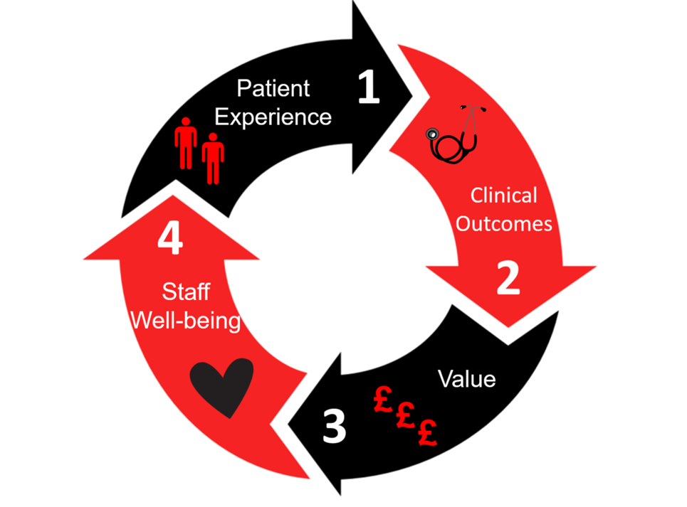
Reporting and review of progress
Rigorous application of oversight against outcomes and key metrics of the Six Goals programme:
Regular updates between Health Boards the national Six Goals programme team through Six Goals Improvement Triumvirate Teams
Updates on areas where progress is not being made as anticipated at Welsh Government IQPD meetings
Half-year review of progress to date will be held reflecting progress against plans
End of year impact report, demonstrating the realisation of benefits at project and programme level

