Slide 1


Evaluation of GDS Reform

Slide 2




Independent academic evaluation led by Bangor University (Welsh Government Contract D286/2020/2021
Formative evaluation – regular ‘checkpoint’ meetings with national policy team to maintain relevance in a dynamic policy landscape and feed back emerging insights
The team:
Dr Lorelei Jones
Dr Sion Williams
Manna Mostaghim
Project manager
Ellie Overs
Research Officer
Professor Chris Burton

Slide 3
April 2022 – September 2023
Evaluation activities aim to capture learning in three areas:
Development and implementation in practice
New measures of quality and activity
Principles of care
Innovation and improvement
Promising practice in improving access
Using data for improvement
Recovery and adaptation

Slide 4
Theme | Research questions | Methods
Development and implementation in practice New metrics Principles of care | How satisfied are stakeholders with different aspects of the process? What reasons are there for engagement/lack of engagement? What are the barriers and facilitators to implementation? What are the benefits/disbenefits in practice? What recommendations can be made for further refinements? | Stakeholder interviews at different levels of the system National policy team Health boards Practice teams

Slide 5
Theme Innovation and Improvement Improving access Using data for improvement | Research questions What challenges do dental practices face? What approaches and strategies have health boards used to support access? With what effects? What innovations and ‘promising practice’ can be identified? how is ACORN data interpreted and used by different stakeholders? | Methods Stakeholder interviews at different levels of the system (national policy, commissioners, providers) Collation and sharing of short descriptions of ‘promising practice’ Interviews with NHSBSA team Observation of training events Document analysis

Slide 6
Recovery and adaptation
Adaptation is a key element of system resilience - being able to come out of a crisis stronger, but also being better prepared to face the future based on learning and change (Duchek 2019)
Key dimensions of adaptive governance
learning from experience
using evidence and data
transparency and involvement
a whole-system perspective

Slide 7
Analysis
Map the challenges facing dental services at different levels
national teams
health board teams
practice teams
understand how teams are making complex decisions about the governance, organization, and delivery of services
identify what further information, guidance and infrastructure is needed to support them

Slide 8

Including patient views and experiences in policy and programme evaluation
Top down research
Bottom up research

Slide 9
Previous research (top-down)
Evaluation in England 2014
Used a single measure of ‘patient satisfaction’
 | Pilot practices | National mean
Patient satisfaction | 95.8% | 92.2%
Evaluation in Northern Ireland 2020
Survey co-designed with patients
Focus groups
‘patients did not appear to notice very much change’ (Brocklehurst et al 2020, p vi)
A strong degree of trust in the dentist and willingness to accept their advice.

Slide 10
Value-based healthcare
Policy objectives
Improve the oral health of the population
Address persistent inequalities in health and access to dental services
Sustain, develop, and value clinical teams
Make efficient use of available resources by increasing the use of skill mix
Key Principles
Extended recalls according to need
Prevention and self-care
Skill mix
Conditional access

Slide 11
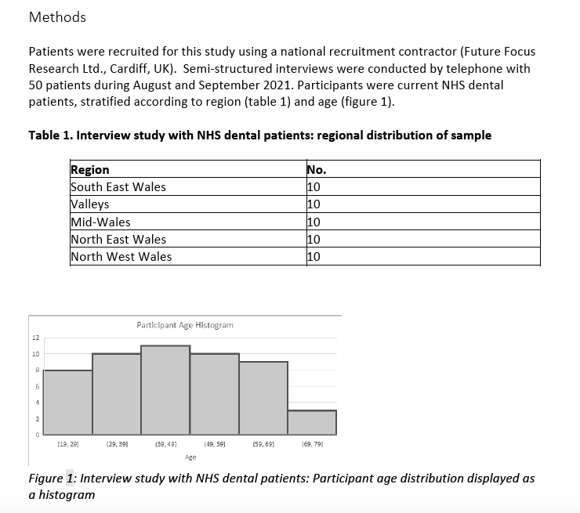

Slide 12
Qualitative research design
Aim is to understand range and nature of perspectives (not to measure relative prevalence) and to distill insights and learning for policy
The sample size based on aims and scope of the research
Recruitment stopped when no new themes or insights were being identified

Slide 13
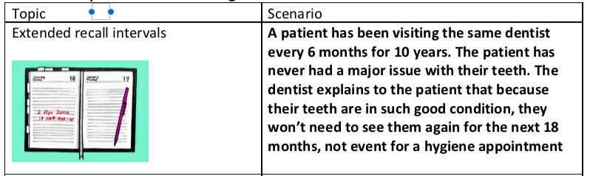
Vignettes
Useful for opening up conversations, a point of departure for an in-depth conversation of an issue
Easier for people to talk about something concrete rather than abstract principles
Reduces social-desirability bias
Example:

Slide 14
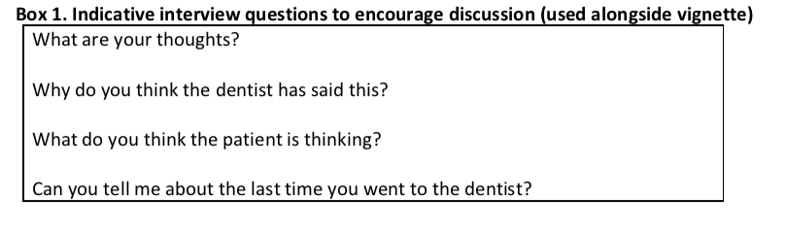

Slide 15
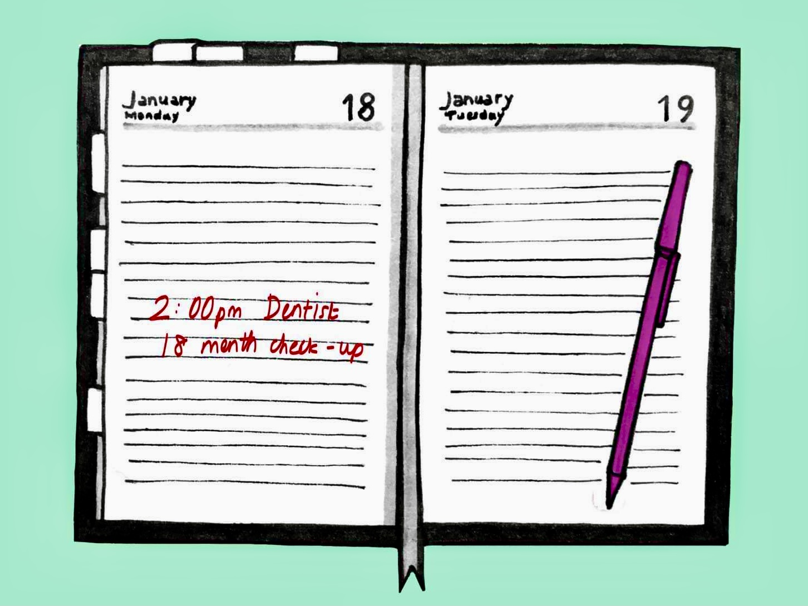
Extended recall intervals
Patients value regular visits with the dentist.
seen as part of a collaborative practice of oral health maintenance.
concerns that disease could develop between visits
Some patients believe they will lose access to an NHS dentist if they do not attend every six months.
‘punished’ for being ‘good’
There is greater openness to a change in recall interval if the reasons are explained (but ‘sceptical trust’)
Patients are more likely to accept a change to routine where there is a good relationship with the dentist.

Slide 16
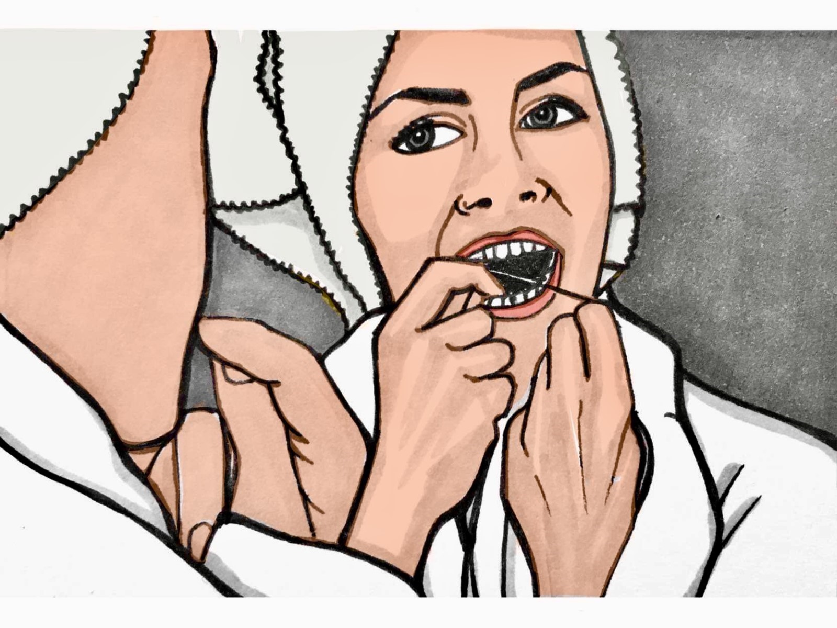
Prevention
Patients value advice on maintaining good oral health

Slide 17

Skill-mix
familiar with skill-mix and onward referral from other services such as general practice.
little knowledge of dental roles other than the dentist.
patients did not want to see skill-mix developed at the expense of access to local services.

Slide 18
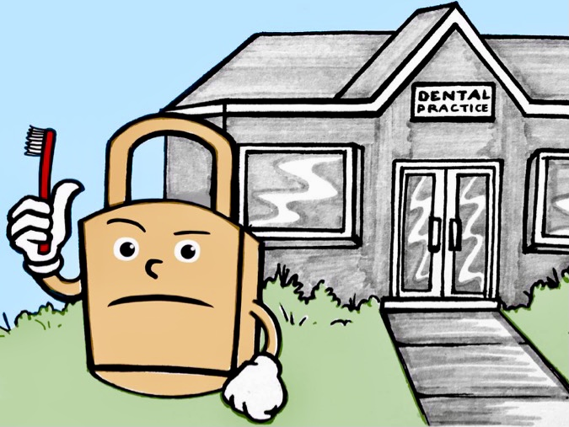
Conditional access
Patients believe it is important not to waste NHS resources but think that delaying treatment may lead to more costly interventions.
Patients believe that there are things they can and should do to maintain their oral health.
They also want NHS services to show understanding and support for individuals who face challenges looking after their health.

Slide 19
 | Citizen-taxpayer | Individual-consumer | Patient
Extended recalls | The NHS is under pressure and people need to help conserve resources People with greatest need should be prioritised | I value regular appointments to help me maintain healthy habits I value regular appointments for screening | I trust the advice of my dentist I value continuity
Prevention | People can and should do things to maintain their oral health | I value advice to stay healthy
Skill-mix | Resources should be used efficiently People should have local access to a dentist | I want the best for myself and my family I want local access to a dentist | I trust that the practitioner is qualified to do the work
Conditional access | People can and should do things to maintain their oral health Some people may face particular challenges and should be exempt or receive additional support Resources should not be wasted Delaying treatment may cost more further down the line The service should be available to all
Notes:
This combination of perspectives may stem in part from the complex mix of governance mechanisms in contemporary social policy (Jones 2016), the mixed economy in dentistry, and the fact that NHS dentistry itself involves both delivery free at the point of use and patient charges.
For practitioners and policy makers, the relative frequency of each perspective is less important than the range of different perspectives that may be encountered, and that people may hold a combination of perspectives. In this context good relationships between patients and dentists are key. Good relationships foster trust and acceptance of new ways of working. Opportunities for dialogue enable changes to be discussed in a way that considers individual patient preferences, circumstances, and concerns.

Slide 20
Key messages
the relative frequency of each perspective is less important than the range of different perspectives that may be encountered, and that people may hold a combination of ‘public’ standpoints - citizen-taxpayer, individual-consumer’, ‘patient’.
In this context good relationships between patients and dentists are key:
Good relationships foster trust and acceptance of new ways of working.
Opportunities for dialogue enable changes to be discussed in a way that considers individual patient preferences, circumstances, and concerns.
It is important that public communication not only explains the reasoning behind extended recall intervals but is sensitive to patient concerns and values.

Slide 21



F
Diolch
For more information contact Lorelei Jones: lorelei.jones@bangor.ac.uk

