Slide 1
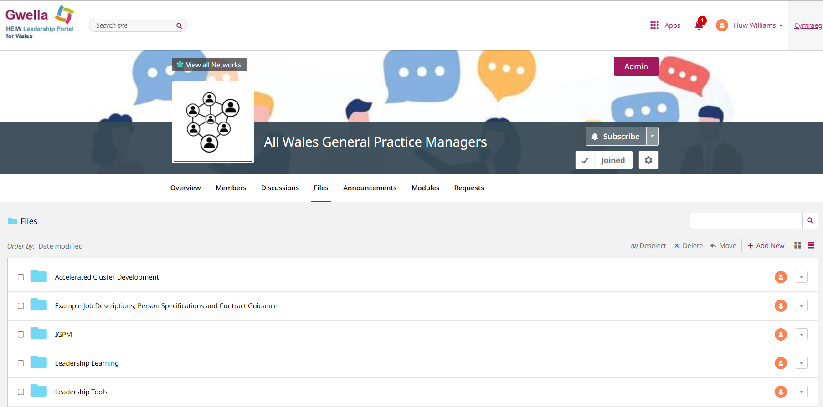

All Wales General Practice Managers Network on Gwella
Benefits:
Role-specific content
Hear the latest news and events
Share best practice across Wales
Free to join
Welsh-focused
Watch a demonstration of the network here.
Contact huw.williams22@wales.nhs.uk to register
Once registered you can access the network here.

